Slide 1
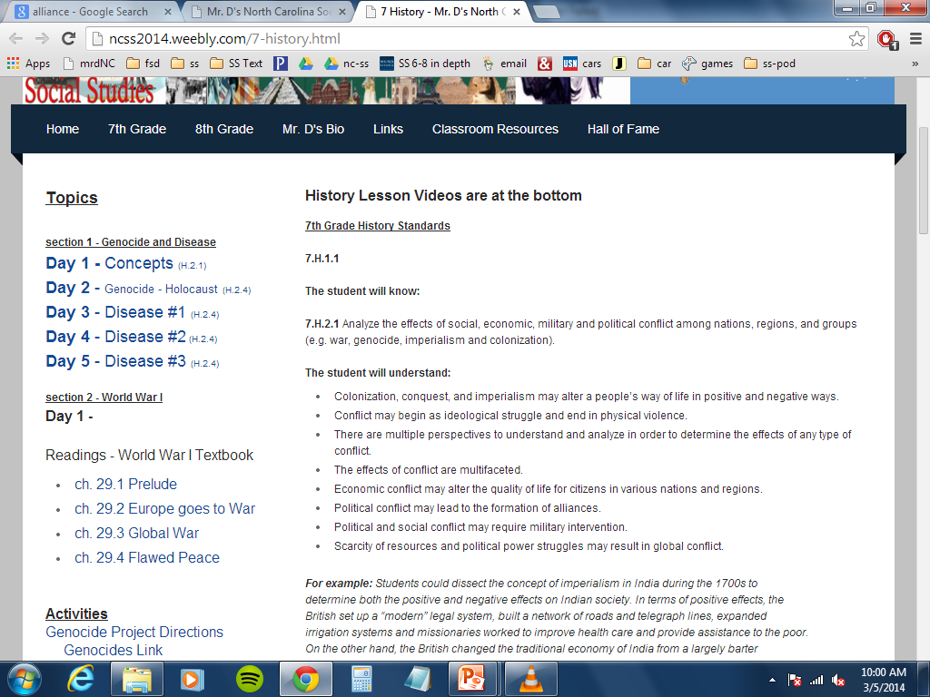

Slide 2
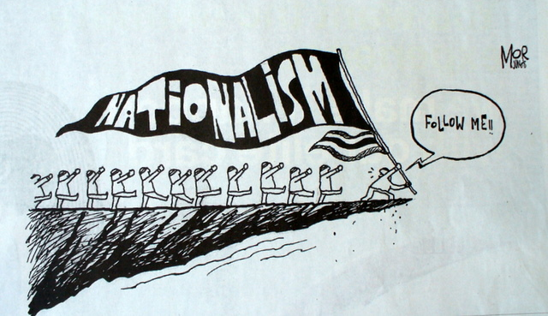
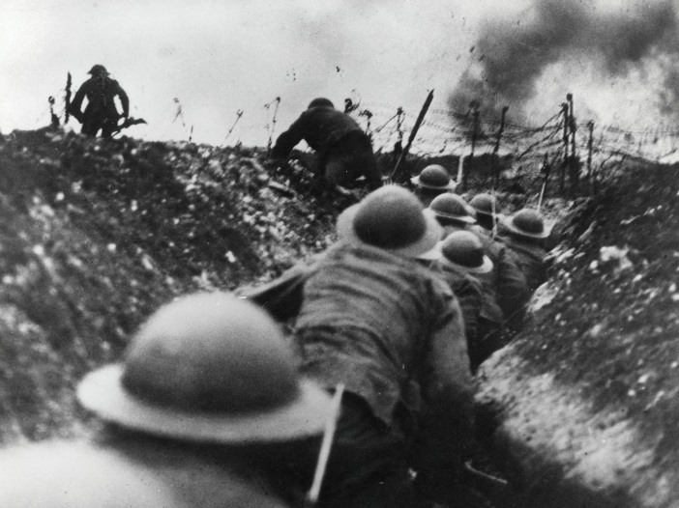
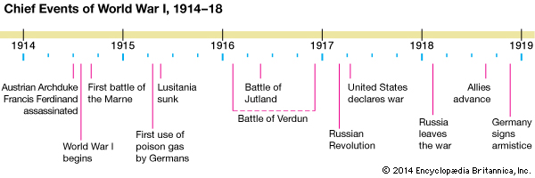
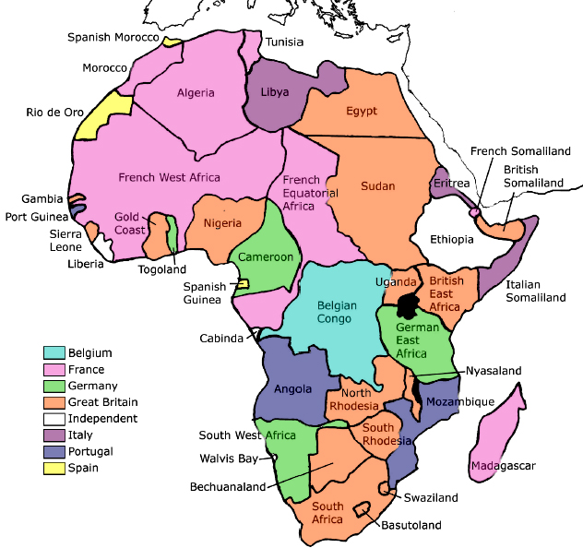
Day 1 – WWI
bad war that didn't have to happen
1914-18
Global War – Total War
Causes of WWI
Nationalism
Imperialism
Alliances
Militarism
Nationalism
Pride in your Nation
Other nations = rivalry, hatred
Imperialism
Intensified the rivalry and hatred
Militarism
Long time since a major war

Slide 3
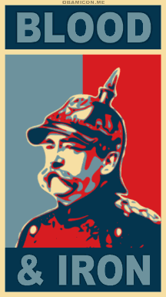
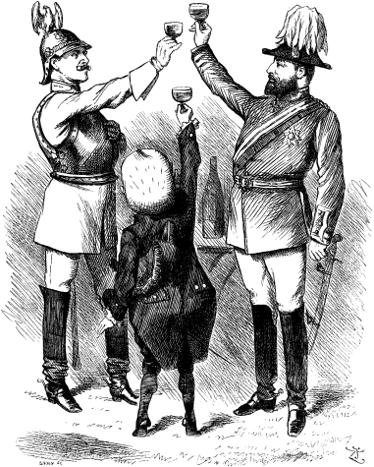
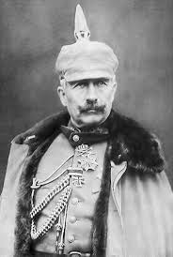
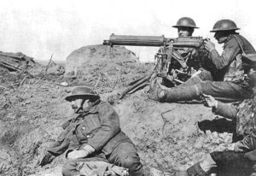
Militarism
Long time since a major war
New Weapons
Glorified War
Alliances
Otto Von Bismarck unifies Germany
Franco-Prussian War Win
Germany satisfied, want peace in Europe
Germany worried about French Revenge
Form alliances to deter France
Triple Alliance
Austria-Hungary
Italy
Adds - alliance with Russia
Kaiser Wilhelm II takes over Germany (1890)
Wants to use army to show power
Ditches alliance with Russia

Slide 4
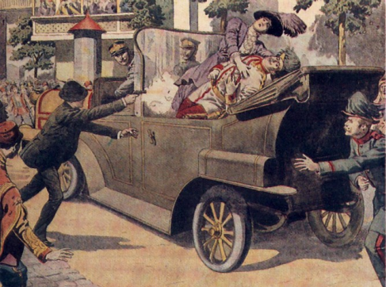
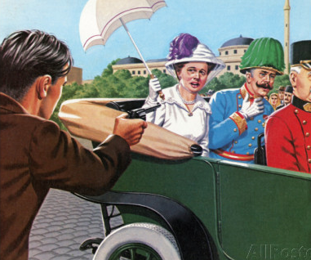
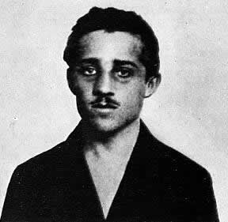
Kaiser Wilhelm II takes over Germany (1890)
Wants to use army to show power
Ditches alliance with Russia
Russia form alliance with France
Germany has enemies on East and West
Britain joins the Russia and France
Triple Entente
Balkans
Nationalism dividing Ottoman Empire
Serbia growing
Austrio-Hungary does not want to lose land
Austria takes over Bosnia and Herzegovina
Serbs mad
Archduke Franz Ferdinand visits Sarajevo
Gavrilo Princip (terrorists) assassinates him
Austria declares war, no diplomacy

Slide 5
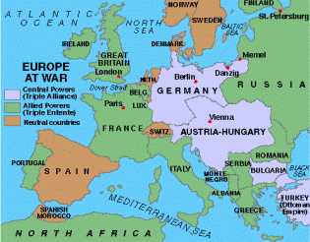
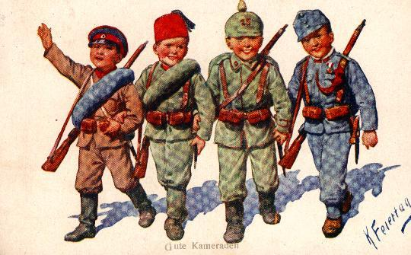
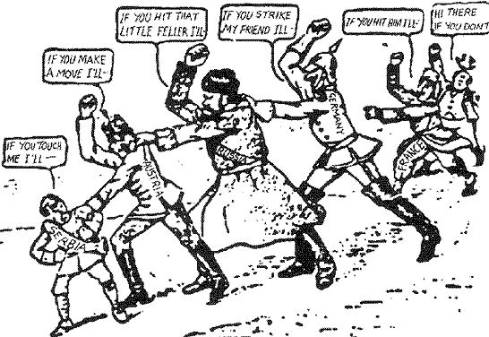
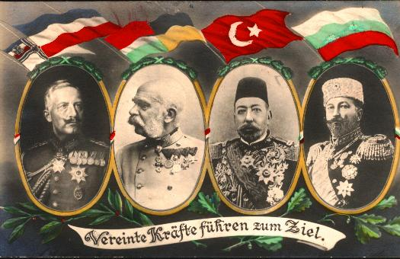
Archduke Franz Ferdinand visits Sarajevo
Gavrilo Princip (terrorists) assassinates him
Austria declares war, no diplomacy
CHAIN REACTION
Serbia’s Ally: Russia mobilizes near East Germany
Germany takes this as a declaration of war
Before France can join, Germany declares war on France too!
Great Britain jumps in
1914
Central Powers (triple alliance)
Germany
Austria-Hungary
Bulgaria
Ottoman Empire

Slide 6
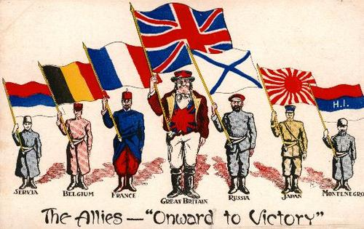
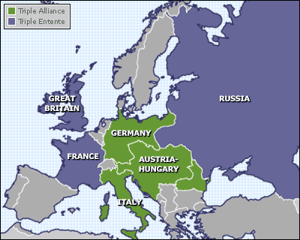
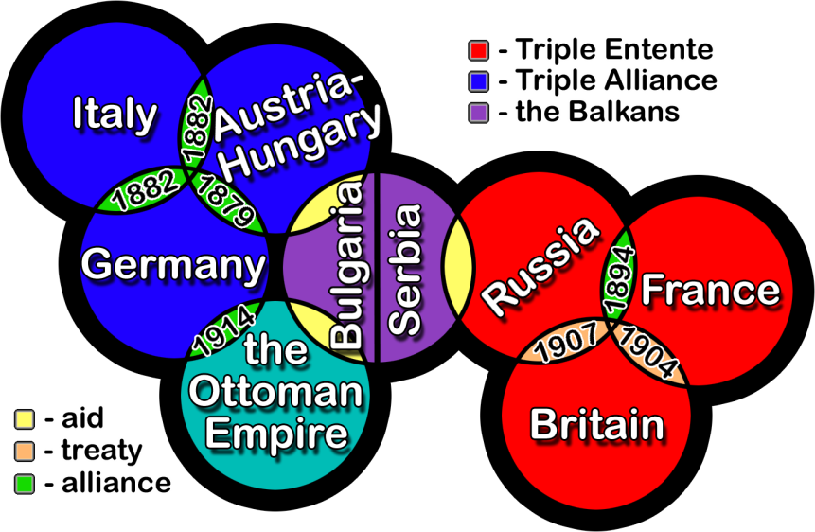
CHAIN REACTION
Serbia’s Ally: Russia mobilizes near East Germany
Germany takes this as a declaration of war
Before France can join, Germany declares war on France too!
Great Britain jumps in
1914
Central Powers (triple alliance)
Germany
Austria-Hungary
Bulgaria
Ottoman Empire
Allied Powers (triple entente)
Great Britain
France
Russia
Italy (switches sides – War unjust)

Slide 7
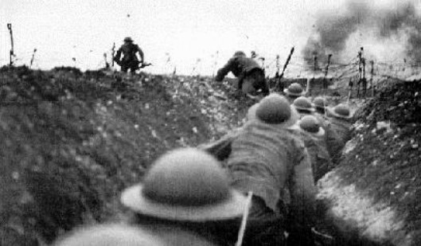
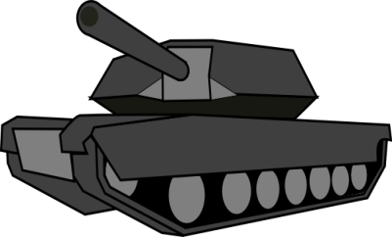
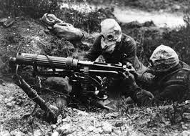
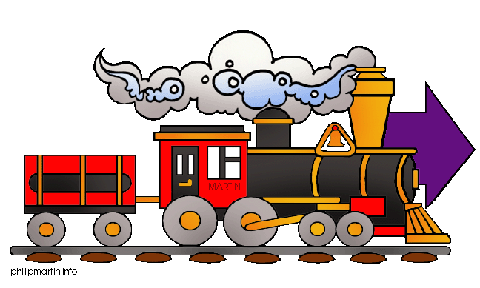
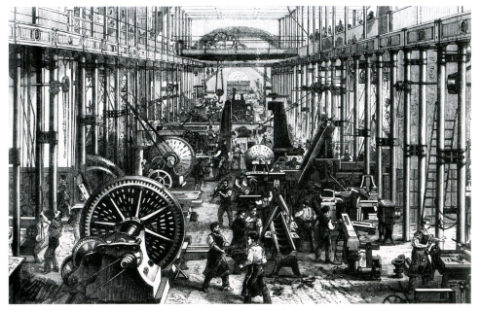
Technology – Short War…DEAD WRONG
Stalemate
Eastern Front (Russia)
Western Front (France)
Trench Warfare
Poison Gas
Machine Guns
Tank
Submarine
Problem – Russia Not industrialized
Can’t transport supplies
Can’t make supplies
Russia’s strength = a lot of soldiers
Russia suffers major losses

Slide 8
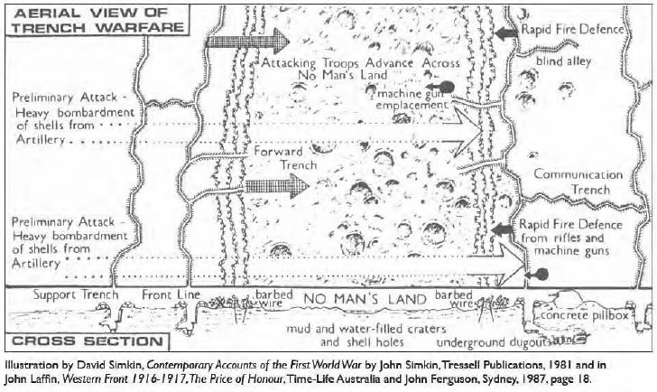
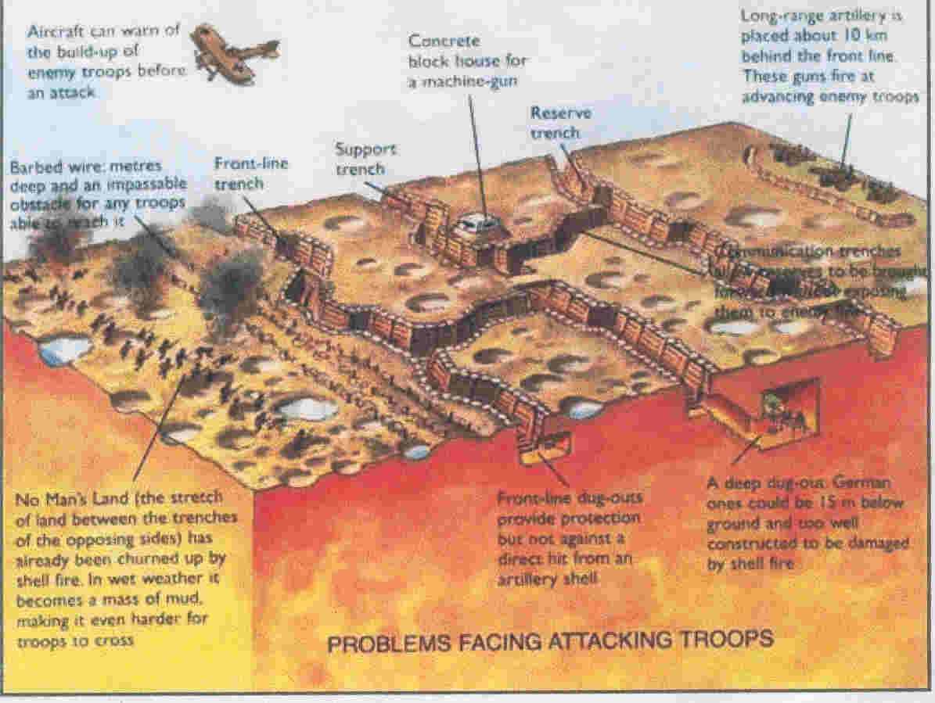

Slide 9
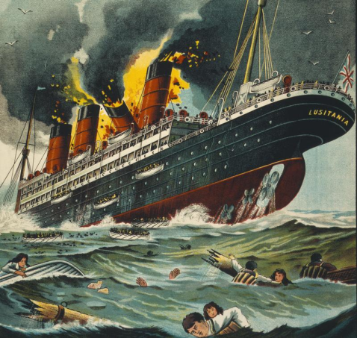
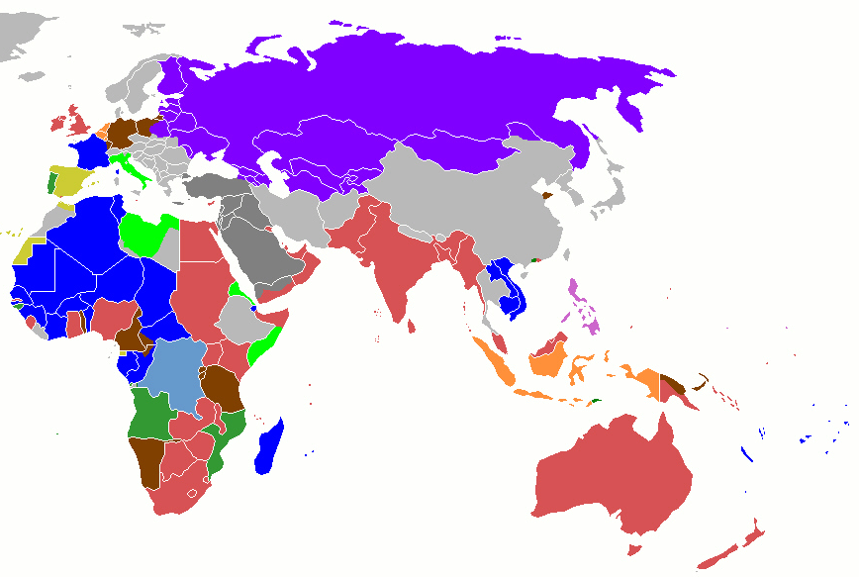
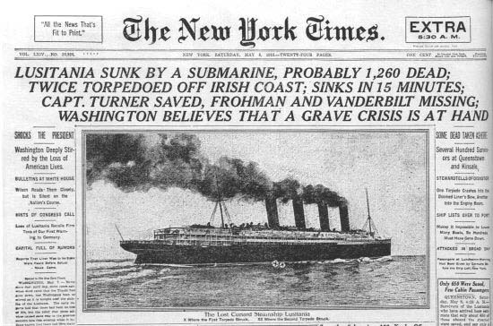
Global War
Australia and Japan join allies
Indians help British Colonists
Help Britain = get independence
The Gallipoli Campaign
Establish a supply line to Russia
Fails – turns into Trench warfare stalemate
War around the world
Japan takes over German colonies
Allied Powers and their colonial subjects joined forces
What about America?
German submarines
US sending supplies to the Allied powers
Germany says stay out or else
Lusitania – passenger ship bombed 1,198 killed
128 US citizens

