Slide 1
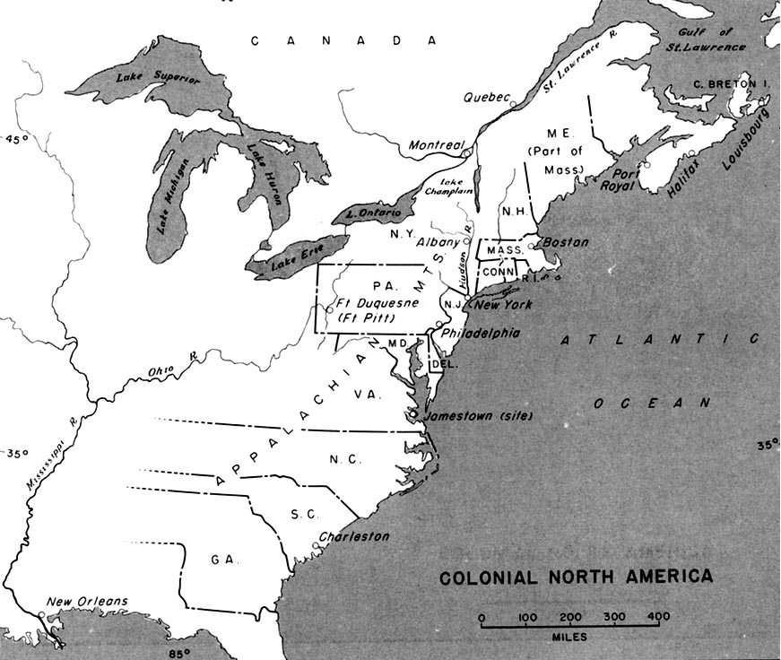


America (17-18th century)

Slide 2


Slide 3

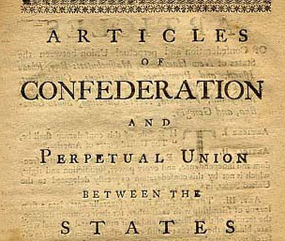

Slide 4

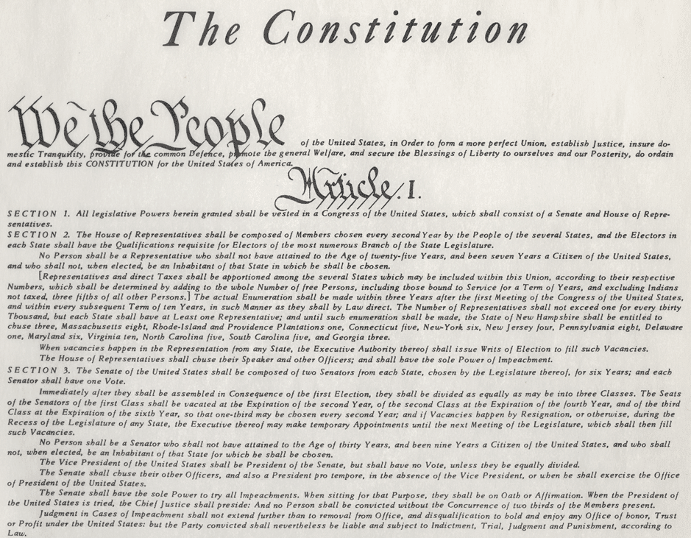


Slide 5
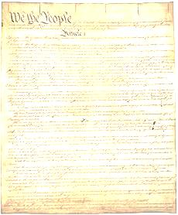
US Constitution
Preamble
Purpose and Goals of our Gov’t
Articles
Structure of Gov’t (3 branches)
Powers of Gov’t
How to amend the constitution
Amendments
27 Changes
1-10: Bill of Rights

Slide 6
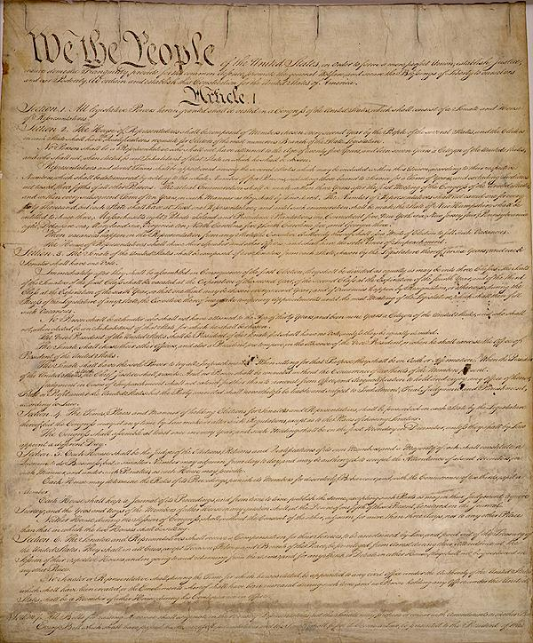

Slide 7
Preamble
We the people of the United States, in order to form a more perfect union, establish justice, insure domestic tranquility, provide for the common defense, promote the general welfare, and secure the blessings of liberty to ourselves and our posterity, do ordain and establish this Constitution for the United States of America.

Slide 8



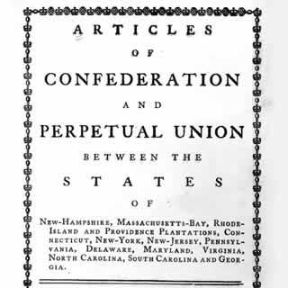


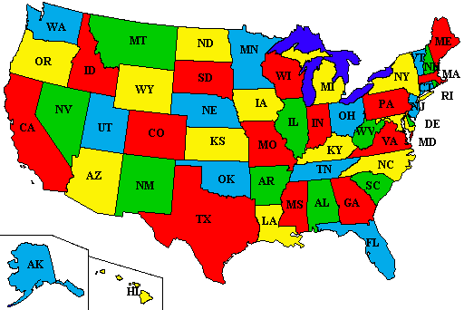

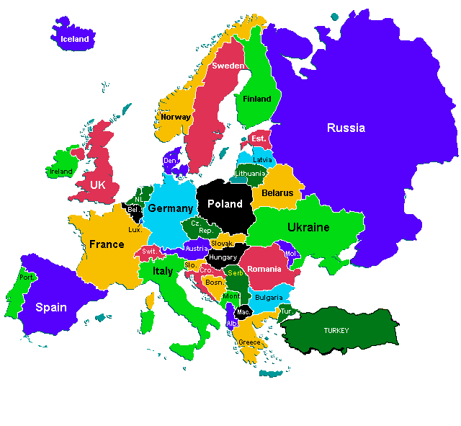

Preamble: intro that states the purpose of the US gov’t
We the people
To form a more perfect union
establish justice
domestic tranquility
common defense
promote the general welfare
blessings of liberty
People are the source of power
Kill Articles of Confederation
Fair courts & laws
Peace in USA
Protect from other countries
Make our lives better
Protect our rights

Slide 9


US Constitution
2nd form of National Gov’t
Equality
1
2
US
Constitution

Slide 10


Slide 11
Article 1
Article 2
Article 3

Slide 12
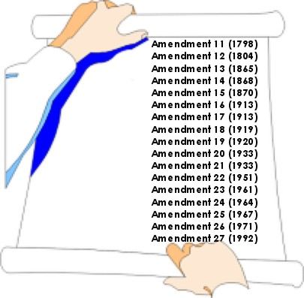
Amendment 1
Amendment 2
Amendment 3
Amendment 4
Amendment 5
Amendment 6
Amendment 7
Amendment 8
Amendment 9
Amendment 10

Slide 13

1 – 2 – 3 – 4 – 5 – 6 – 7 – 8 – 9 - 10
Congress shall make no law respecting an establishment of religion, or prohibiting the free exercise thereof; or abridging the freedom of speech, or of the press; or the right of the people peaceably to assemble, and to petition the Government for a redress of grievances.
Translation
Freedom of:
-Religion
-Assembly
-Press
-Petition
-Speech

Slide 14
religion
assembly
press
petition
speech
“To gather together in a peaceful crowd”
Formal request to the gov’t
-TV news
-Newspaper
-Internet news

Slide 15


Slide 16
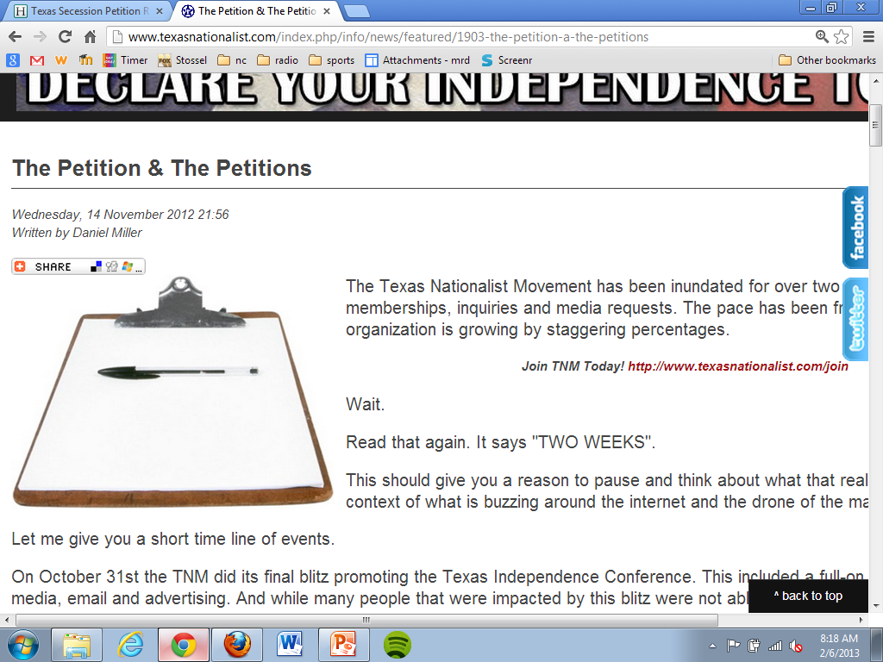

Slide 17

1 – 2 – 3 – 4 – 5 – 6 – 7 – 8 – 9 - 10
A well regulated Militia, being necessary to the security of a free State, the right of the people to keep and bear Arms, shall not be infringed.
Translation
Right to own weapons.

Slide 18

1 – 2 – 3 – 4 – 5 – 6 – 7 – 8 – 9 - 10
No Soldier shall, in time of peace be quartered in any house, without the consent of the Owner, nor in time of war, but in a manner to be prescribed by law.
Translation
You don't have to let soldiers live in your house, except if there is a war, and even then only if Congress has passed a law about it.

Slide 19
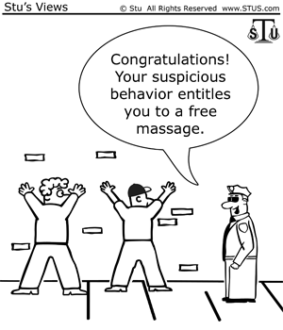
1 – 2 – 3 – 4 – 5 – 6 – 7 – 8 – 9 - 10
The right of the people to be secure in their persons, houses, papers, and effects, against unreasonable searches and seizures, shall not be violated, and no Warrants shall issue, but upon probable cause, supported by Oath or affirmation, and particularly describing the place to be searched, and the persons or things to be seized.
Translation
Nobody can search you without reason

Slide 20
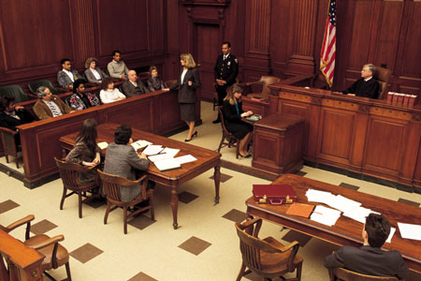

1 – 2 – 3 – 4 – 5 – 6 – 7 – 8 – 9 - 10
No person shall be held to answer for a capital, or otherwise infamous crime, unless on a presentment or indictment of a Grand Jury, except in cases arising in the land or naval forces, or in the Militia, when in actual service in time of War or public danger; nor shall any person be subject for the same offence to be twice put in jeopardy of life or limb; nor shall be compelled in any criminal case to be a witness against himself, nor be deprived of life, liberty, or property, without due process of law; nor shall private property be taken for public use, without just compensation.
Translation
- Grand Jury
- Double Jeopardy
- Right to remain silent
- Eminent Domain
- Due Process (nat’l gov’t)

Slide 21


1 – 2 – 3 – 4 – 5 – 6 – 7 – 8 – 9 - 10
In all criminal prosecutions, the accused shall enjoy the right to a speedy and public trial, by an impartial jury of the State and district wherein the crime shall have been committed, which district shall have been previously ascertained by law, and to be informed of the nature and cause of the accusation; to be confronted with the witnesses against him; to have compulsory process for obtaining witnesses in his favor, and to have the Assistance of Counsel for his defence.
Translation
- Speedy Trial
- Public Trial
- Jury Trial
- What did you do
- Who said you did it
- Lawyer

Slide 22
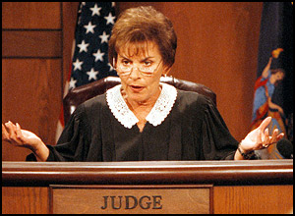
1 – 2 – 3 – 4 – 5 – 6 – 7 – 8 – 9 - 10
In Suits at common law, where the value in controversy shall exceed twenty dollars, the right of trial by jury shall be preserved, and no fact tried by a jury, shall be otherwise re-examined in any Court of the United States, than according to the rules of the common law.
Translation
- Civil Case Jury

Slide 23
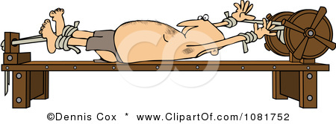
1 – 2 – 3 – 4 – 5 – 6 – 7 – 8 – 9 - 10
Excessive bail shall not be required, nor excessive fines imposed, nor cruel and unusual punishments inflicted.
Translation
No Excessive bail
No Cruel & Unusual punishment

Slide 24

1 – 2 – 3 – 4 – 5 – 6 – 7 – 8 – 9 - 10
The enumeration in the Constitution, of certain rights, shall not be construed to deny or disparage others retained by the people.
Translation
If it’s not written, that right still exists.

Slide 25
1 – 2 – 3 – 4 – 5 – 6 – 7 – 8 – 9 - 10
The powers not delegated to the United States by the Constitution, nor prohibited by it to the States, are reserved to the States respectively, or to the people.
Translation
Gov’t powers not listed, are reserved for the state gov’t

