Slide 1
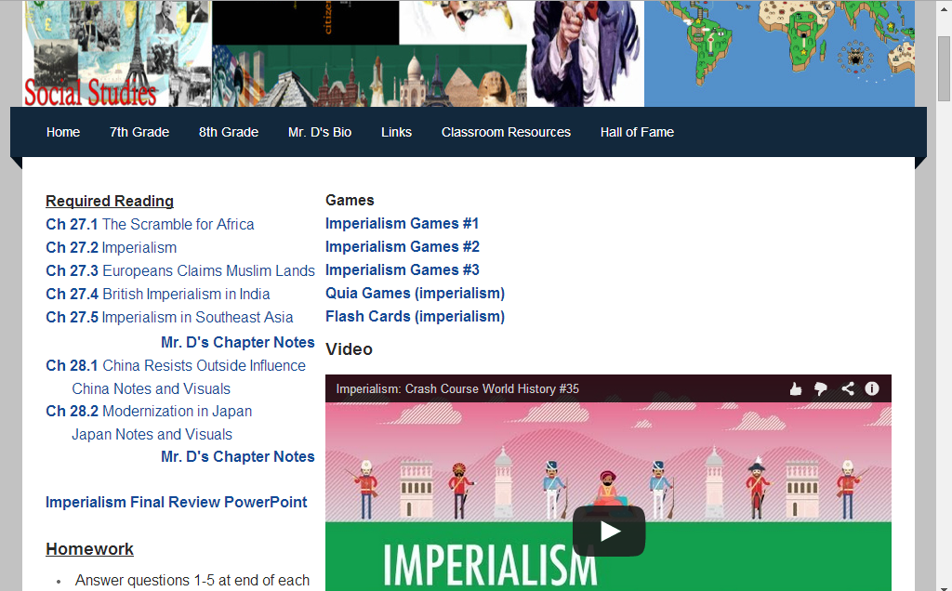
Common Exam in 7 days! Study at Home
Visit all units
Play Games
Look at Flash Cards
Watch Videos

Slide 2
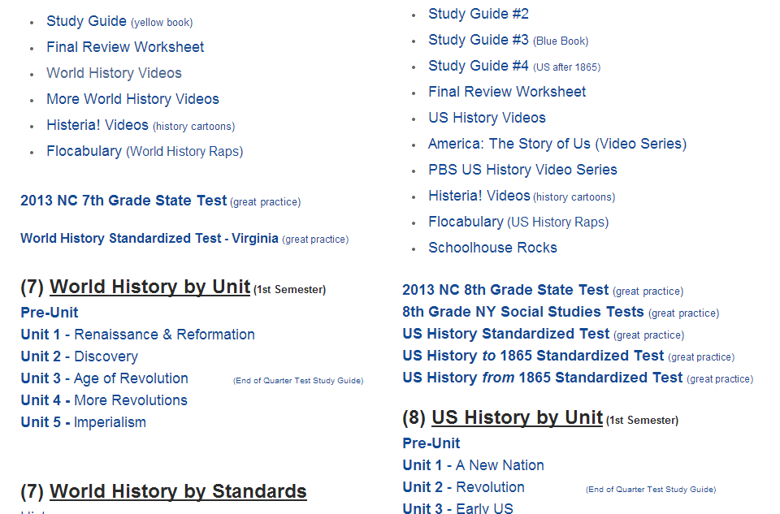
Extra Credit – go to my site. Take practice tests. Grade it.

Slide 3
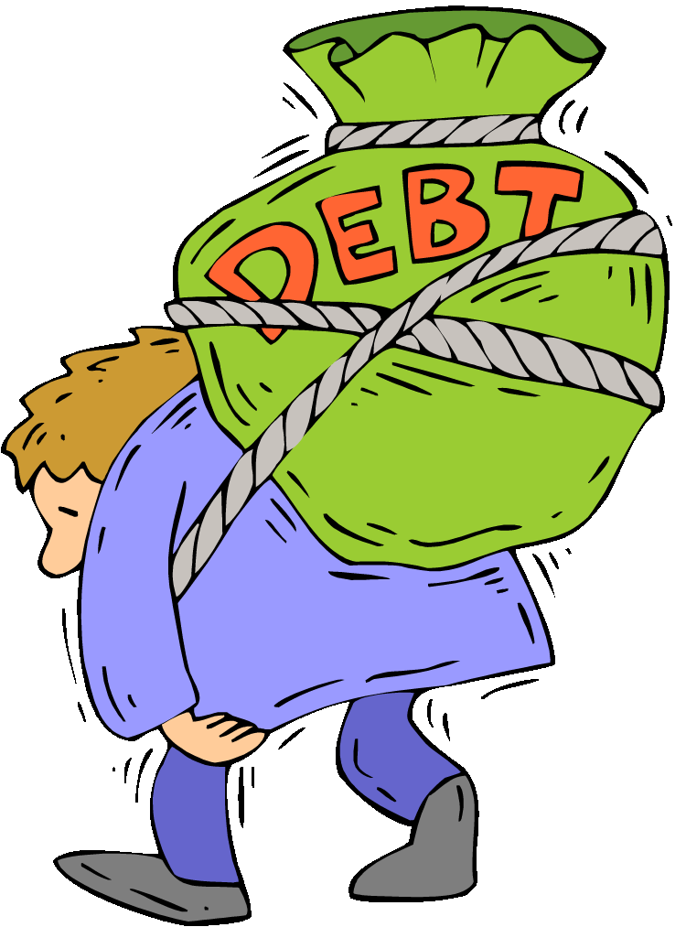
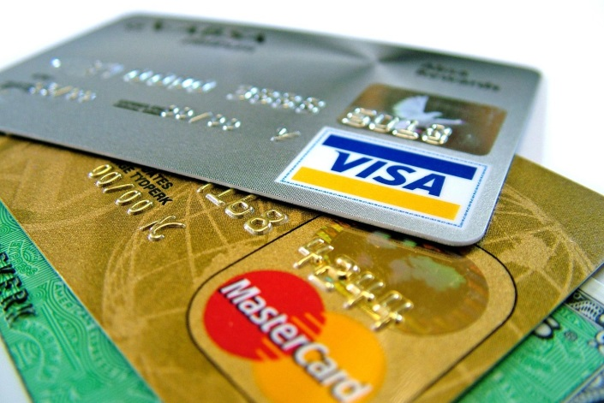
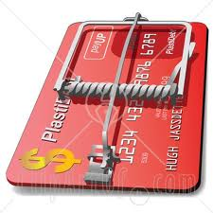
8.E.1.3 Explain how quality of life is impacted by personal financial choices (e.g. credit, savings, investing, borrowing and giving).
The student will understand that:
Responsible use of credit and borrowing as well as consistency in saving and investing increases the likelihood of a higher standard of living and better quality of life in the future.
Bad economic decisions may negatively affect an individual’s ability to achieve their personal goals.

Slide 4
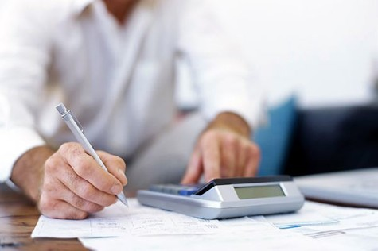
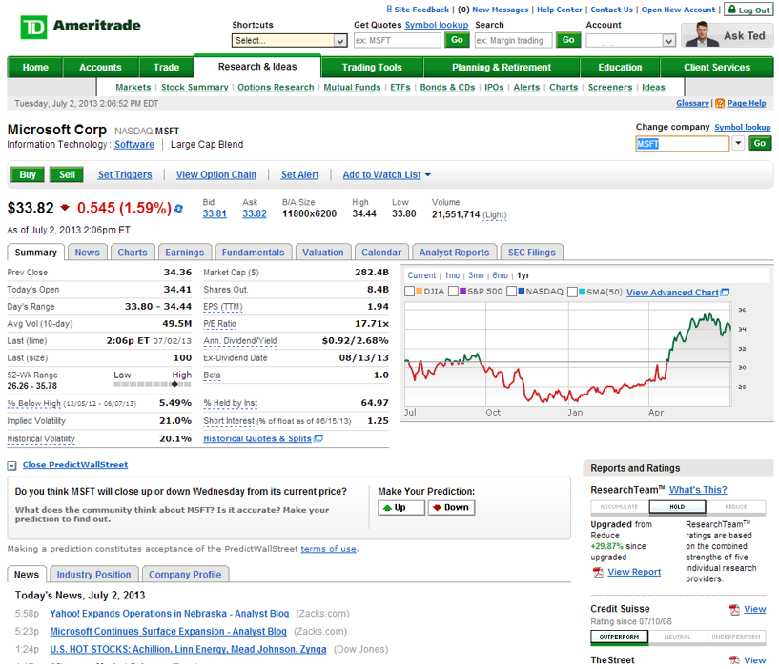
8.E.1.3 Explain how quality of life is impacted by personal financial choices (e.g. credit, savings, investing, borrowing and giving).
The student will understand that:
Responsible use of credit and borrowing as well as consistency in saving and investing increases the likelihood of a higher standard of living and better quality of life in the future.
Bad economic decisions may negatively affect an individual’s ability to achieve their personal goals.
The student will know:
How to save and invest wisely to achieve future goals.
The wise and unwise use of credit and borrowing.
The benefit of charitable giving.
How to devise and plan to improve quality of life for now and in the future.

Slide 5
$2000 (monthly paycheck)
- Monthly Rent (May)
$ after rent
- Monthly Car Payment (May)
$ after car & rent
- $300 monthly bills (May)
Car Payment Math:
$4000-5000 = $120
$5001-8000 = $240
$8001-12000 = $350
$12001-16000 = $470
$16001-22000 = $640
$22001 – 28000 = $815
$28001 or higher = NO!

Slide 6
May Choice
Save your Left over money in a Bank Account
Invest your left over money in Tech Company
Cash out your investment
Spend your left over money
Donate your left over money to charity
…write down on your sheet of paper what you choose to do

Slide 7
May Chance
A
B
C
D
…write down on your sheet of paper what you choose to do

Slide 8
May Chance
A – If your car has over 100,000 miles. It breaks down. You must spend $1000 to fix the car.
B – If your apt. cost more than $900, you’re rent goes up $100. They added a pool.
C – You got sick and went to the ER. You owe $500.
D – You got a raise. Add $500 to your mo. salary.

Slide 9
Add $2000 (monthly paycheck - June)
- Monthly Rent June
$ after rent
- Monthly Car Payment June
$ after car & rent
- $300 monthly bills June

Slide 10
June Special Choice
Your friends are going to the beach. The total trip will costs $200.
Go! Deduct $200
Stay home.

Slide 11
June Choice
Save your Left over money in a Bank Account
Invest your left over money in Tech Company
Cash out your investment
Spend your left over money
Donate your left over money to charity
…write down on your sheet of paper what you choose to do

Slide 12
June Chance
A
B
C
D
…write down on your sheet of paper what you choose to do

Slide 13
June Chance
A – You have a baby congrats! It costs $300 a month.
B – You paid your bills late. You Credit Score went down it’s rated as - BAD
C – You paid your bills on time. You Credit Score went down it’s rated as - Good
D – You got a raise. Add $100 to your mo. salary.

Slide 14
Add $2000 (monthly paycheck July)
- Monthly Rent - July
$ after rent
- Monthly Car Payment - July
$ after car & rent
- $300 monthly bills - July
$ after car, rent, and bills
- $300 baby cost July (if you have a baby)

Slide 15
July Special Choice
Move to a cheaper or better apartment
…you can move to any apt you want. Change the price on next month’s rent.

Slide 16
July Special Choice
Trade in your car for another car
Increase your monthly bill
Decrease your monthly bill
…you can buy any car you want. Change the price on next month’s payment.

Slide 17
July Special Choice
Should you throw a 4th of July party?
Yes – deduct $200 for fireworks
No – deduct nothing

Slide 18
July Choice
Save your Left over money in a Bank Account
Invest your left over money in Tech Company
Cash out your investment
Spend your left over money
Donate your left over money to charity
…write down on your sheet of paper what you choose to do

Slide 19
July Chance
A
B
C
D
…write down on your sheet of paper what you choose to do

Slide 20
July Chance
A – If you have a Good credit score, you were offered a new job. Add $500 to your monthly salary
B – If you had a 4th of July party, you met new friends (networking). Your new connection found you better job. You make $3000 a month.
C – If you live in an apt. with rent lower than $700. You were robbed. Subtract $500.
D – If you have a baby, your baby got sick. Subtract $500 for an ER visit.

Slide 21
Add $2000 (monthly paycheck - August)
- Monthly Rent August
$ after rent
- Monthly Car Payment August
$ after car & rent
- $300 monthly bills August
$ after car, rent, and bills
- $300 baby cost August (if you have a baby)

Slide 22
August Special Choice
You have been offered a credit card. You can spend up to $5,000 on it. The interest rate is 20%.
Take it – you need help paying your monthly budget
Do not take it – the interest rate is too high.

Slide 23
August Choice
Save your Left over money in a Bank Account
Invest your left over money in Tech Company
Cash out your investment
Spend your left over money
Donate your left over money to charity
…write down on your sheet of paper what you choose to do

Slide 24
August Chance
A
B
C
D
…write down on your sheet of paper what you choose to do

Slide 25
August Chance
A – If you invested, The stock market price of the Tech company is booming. Multiply your invest by 5.
B – If you did not go to the beach, you are too stressed out. It shows at work. Your monthly salary is now $300 less.
C – Your mother has fallen behind on her bills. Deduct $1000. If you do not have the money, your mother lives with you and deduct $300 each month.
D – If you have a baby, your baby won a prettiest baby contest. Add $250.

Slide 26
Add $2000 (monthly paycheck - September)
- Monthly Rent Sept
$ after rent
- Monthly Car Payment Sept
$ after car & rent
- $300 monthly bills Sept
$ after car, rent, and bills
- $300 baby cost Sept (if you have a baby)

Slide 27
September Special Choice
The Jay-Z and Beyoncé “on the run” tour comes to town.
By Front Row Seats for you and a friend - $250
By Upper Level Seats - $100
Save your money

Slide 28
September Choice
Save your left over money in a Bank Account
Invest your left over money in Tech Company
Cash out your investment
Spend your left over money
Donate your left over money to charity
…write down on your sheet of paper what you choose to do

Slide 29
September Chance
A
B
C
D
E
…write down on your sheet of paper what you choose to do

Slide 30
September Chance
A – If you invested, The stock market price of the Tech company BUSTS. The company is bankrupt. Your investment is worth nothing.
B – If you invested, The stock market price of the Tech company BUSTS. The company is bankrupt. Your investment is worth nothing.
C – If you have a baby, You’re upset with your babies daycare, you find a new daycare. Pay $400 a month for your baby.
D – If your apartment is under $900, your apartment floods. You must pay for the damages. You owe $2500.
E – If you have a credit card, the company noticed that you have a good record of paying your bills. They have lowered you interest rate to 8%.

Slide 31
Add $2000 (monthly paycheck - October)
- Monthly Rent Oct
$ after rent
- Monthly Car Payment Oct
$ after car & rent
- $300 monthly bills Oct
$ after car, rent, and bills
- $300 baby cost Oct (if you have a baby)

Slide 32
October Special Choice
Tickets to an NFL game.
$400
I’ll Pass

Slide 33
October Choice
Save your left over money in a Bank Account
Invest your left over money in Medical Company
Invest your money in a Tech Company
Cash out your investment
Spend your left over money
Donate your left over money to charity
…write down on your sheet of paper what you choose to do

Slide 34
October Chance
A
B
C
D
…write down on your sheet of paper what you choose to do

Slide 35
October Chance
A – If you invested in a Tech company, The stock market price of the Tech company Booms. The company is worth 5 times your investment.
B – If you invested in a Medical company, The stock market price increases. The company is worth 2 times your investment.
C – If your car is used, it breaks down. Pay $2000 to get it fixed.
D – If you went to the Jay-Z concert, your boss noticed some inappropriate pictures of you at the concert. You were fired. Your new job only pays $1500 a month.

Slide 36
Add $2000 (monthly paycheck - November)
- Monthly Rent Nov
$ after rent
- Monthly Car Payment Nov
$ after car & rent
- $300 monthly bills Nov
$ after car, rent, and bills
- $300 baby cost Nov (if you have a baby)

Slide 37
November Special Choice
Tickets to an NFL game.
$400
I’ll Pass

Slide 38
November Choice
Save your left over money in a Bank Account
Invest your left over money in Medical Company
Invest your left over money in a Tech Company
Cash out your investment
Spend your left over money
Donate your left over money to charity
…write down on your sheet of paper what you choose to do

Slide 39
November Chance
A
B
C
D
…write down on your sheet of paper what you choose to do

Slide 40
November Chance
A – A family member is financial trouble, you give them $2000.
B – If you invested in a Medical company, The stock market price increases. The company is worth 4 times your investment.
C – If you have more than $2000 saved in the bank, the bank offers you a better interest rate on your car loan. Cut you monthly car payment in half.
D – If you have a baby, a local charity gives you $1500 to help with costs.

Slide 41
Add $2000 (monthly paycheck - December)
- Monthly Rent Dec
$ after rent
- Monthly Car Payment Dec
$ after car & rent
- $300 monthly bills Dec
$ after car, rent, and bills
- $300 baby cost Dec (if you have a baby)

Slide 42
December Special Choice
Buy Holiday gifts for children in need.
$1,000
No, I’m the Grinch.

Slide 43
December Choice
Save your left over money in a Bank Account
Invest your left over money in Medical Company
Cash out your investment
Spend your left over money
Donate your left over money to charity
…write down on your sheet of paper what you choose to do

Slide 44
December Chance
A
B
C
D
…write down on your sheet of paper what you choose to do

Slide 45
November Chance
A – If you live in an apt under $900 and have $1000 in pocket money; you are robbed. You lose all of your pocket money (savings and investments are safe)
B – If you donated for holiday gifts, the local church honors you at a banquet. You get interviewed on TV.
C – The bank needs cash, you can pay your car off completely, now! If you pay half the price of the car now, you will no longer have car payments.
D – If your house is 3 bedrooms and is under $900, it’s because it’s haunted. You are killed by ghosts.

