Slide 1
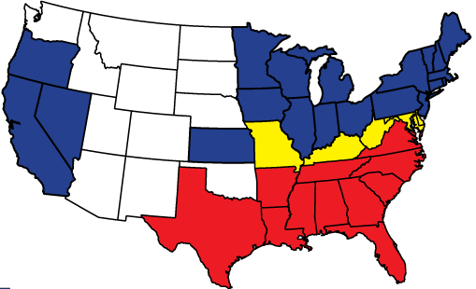
North and South
Theory:
Northern People help each other
Southern People do NOT help each other

Slide 2
North and South
High Taxes
Gov’t helps the poor
Gov’t helps the elderly
Gov’t helps schools
Low Taxes
Gov’t does not help the poor
Gov’t does not help the elderly
Gov’t does not help schools

Slide 3
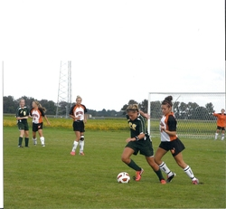
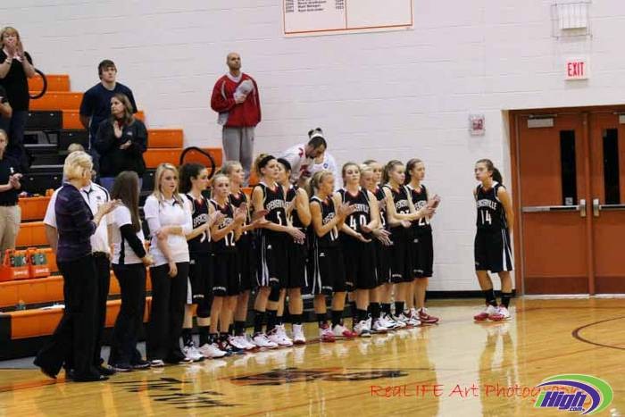
Evidence to prove the theory
Ft. Jennings School
Class size – 12 students
Less students than Carter
5 times bigger than Carter

Slide 4
Why does the North have better schools?
Democracy!!!
People have the power
In the North, people understand that:
Education leads to better jobs and a better life
They are willing to pay more in taxes
They VOTE to make laws that create taxes
The tax money goes to schools
The South…The people never even attempt to vote on issue of money for schools

Slide 5
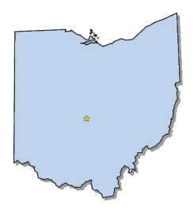
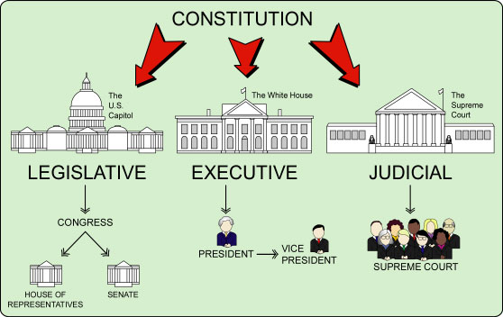
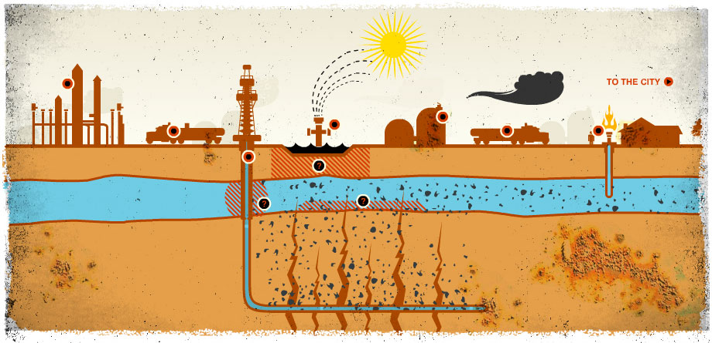
Democracy
People make decisions through voting
Republicanism
Elect representatives to make laws for us
Issue: fracking
Yes or No?
Representatives decide
YES
YES
Governor
Governor
Fracking Law
The Hulk
https://www.youtube.com/watch?v=wbtNJPCsekA

Slide 6
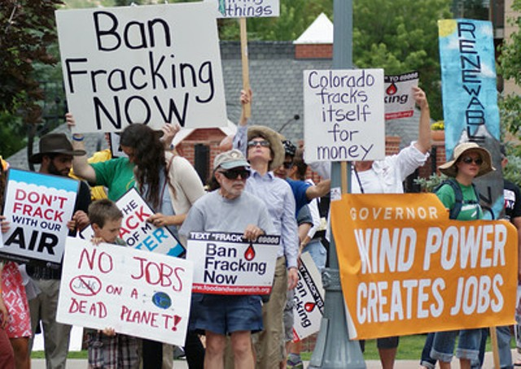
The Governor of Ohio signed the law and Fracking is allowed in Ohio.
Is it over?
Fracking Law
Governor

