Slide 1
Civics and Government Concept Game
What Civics and Government Concept does the picture represent?
Write down your answer on a scratch sheet of paper
Write down
True – If the picture represents the what the concept correctly
Opposite – if the picture represents the OPPOSITE of the concept
Extra Credit to anyone that scores 80% or better

Slide 2
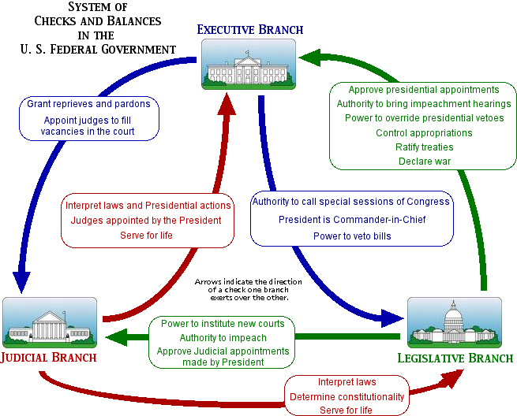
Separation of Power
Limited Gov’t
True
Federalism
Popular Sovereignty
Republicanism
Opposite
Individual Rights

Slide 3
Separation of Power
Limited Gov’t
True
Federalism
Popular Sovereignty
Republicanism
Opposite
Individual Rights

Slide 4
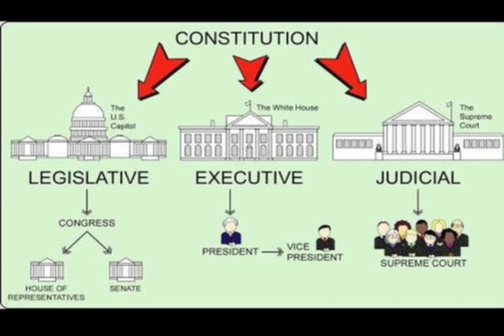
Separation of Power
Limited Gov’t
True
Federalism
Popular Sovereignty
Republicanism
Opposite
Individual Rights

Slide 5
Separation of Power
Limited Gov’t
True
Federalism
Popular Sovereignty
Republicanism
Opposite
Individual Rights

Slide 6
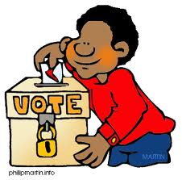
Separation of Power
Limited Gov’t
True
Federalism
Popular Sovereignty
Republicanism
Opposite
Individual Rights

Slide 7
Separation of Power
Limited Gov’t
True
Federalism
Popular Sovereignty
Republicanism
Opposite
Individual Rights

Slide 8
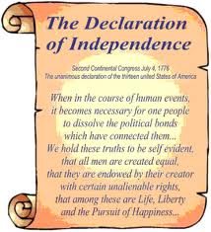
Separation of Power
Limited Gov’t
True
Federalism
Popular Sovereignty
Republicanism
Opposite
Individual Rights

Slide 9
Separation of Power
Limited Gov’t
True
Federalism
Popular Sovereignty
Republicanism
Opposite
Individual Rights

Slide 10
Separation of Power
Limited Gov’t
True
Federalism
Popular Sovereignty
Republicanism
Opposite
Individual Rights

Slide 11
Separation of Power
Limited Gov’t
True
Federalism
Popular Sovereignty
Republicanism
Opposite
Individual Rights

Slide 12
Separation of Power
Limited Gov’t
True
Federalism
Popular Sovereignty
Republicanism
Opposite
Individual Rights

Slide 13
Separation of Power
Limited Gov’t
True
Federalism
Popular Sovereignty
Republicanism
Opposite
Individual Rights

Slide 14
Separation of Power
Limited Gov’t
True
Federalism
Popular Sovereignty
Republicanism
Opposite
Individual Rights

Slide 15
Separation of Power
Limited Gov’t
True
Federalism
Popular Sovereignty
Republicanism
Opposite
Individual Rights

Slide 16
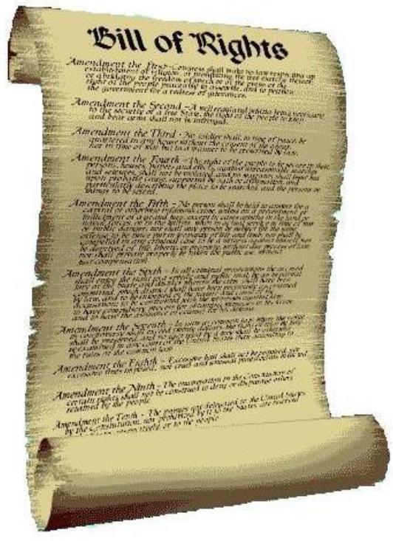
Separation of Power
Limited Gov’t
True
Federalism
Popular Sovereignty
Republicanism
Opposite
Individual Rights

Slide 17
Separation of Power
Limited Gov’t
True
Federalism
Popular Sovereignty
Republicanism
Opposite
Individual Rights

Slide 18
Separation of Power
Limited Gov’t
True
Federalism
Popular Sovereignty
Republicanism
Opposite
Individual Rights

Slide 19
Separation of Power
Limited Gov’t
True
Federalism
Popular Sovereignty
Republicanism
Opposite
Individual Rights

Slide 20
Separation of Power
Limited Gov’t
True
Federalism
Popular Sovereignty
Republicanism
Opposite
Individual Rights

Slide 21
Separation of Power
Limited Gov’t
True
Federalism
Popular Sovereignty
Republicanism
Opposite
Individual Rights

Slide 22
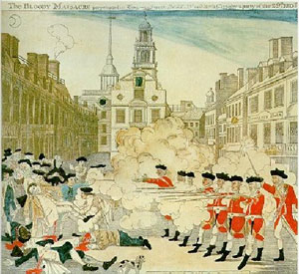
Separation of Power
Limited Gov’t
True
Federalism
Popular Sovereignty
Republicanism
Opposite
Individual Rights

Slide 23
Separation of Power
Limited Gov’t
True
Federalism
Popular Sovereignty
Republicanism
Opposite
Individual Rights

Slide 24
Separation of Power
Limited Gov’t
True
Federalism
Popular Sovereignty
Republicanism
Opposite
Individual Rights

Slide 25
Separation of Power
Limited Gov’t
True
Federalism
Popular Sovereignty
Republicanism
Opposite
Individual Rights

Slide 26
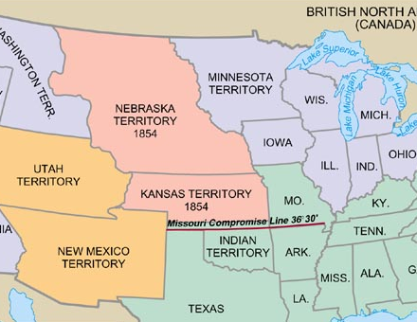
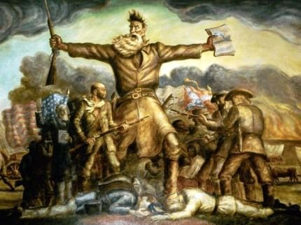
Separation of Power
Limited Gov’t
True
Federalism
Popular Sovereignty
Republicanism
Opposite
Individual Rights

Slide 27
Separation of Power
Limited Gov’t
True
Federalism
Popular Sovereignty
Republicanism
Opposite
Individual Rights

Slide 28
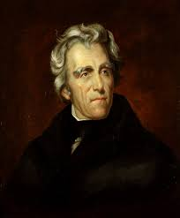
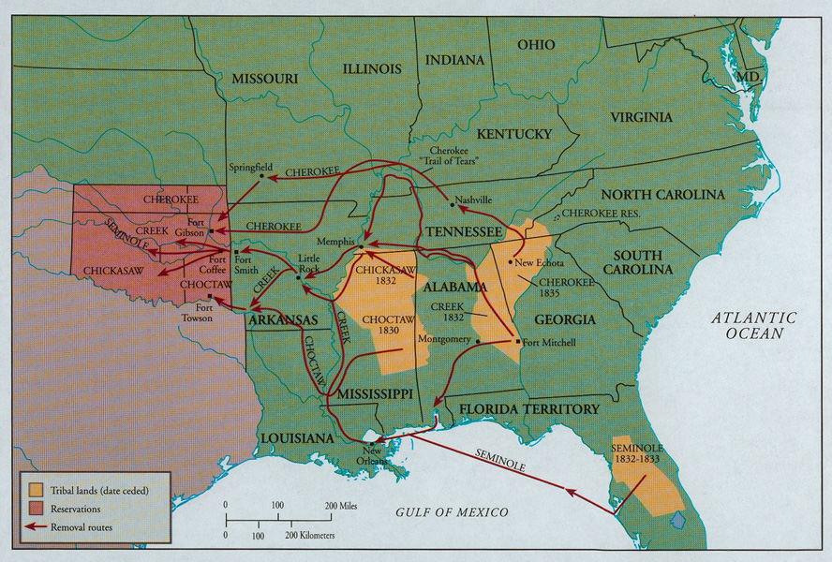
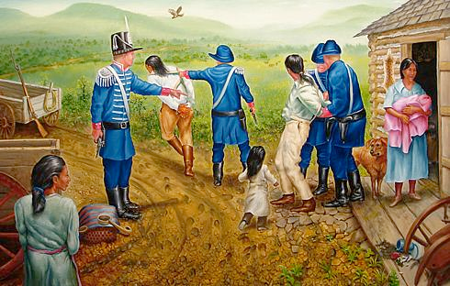
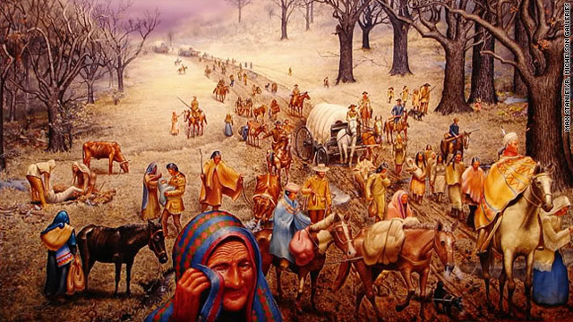
Separation of Power
Limited Gov’t
True
Federalism
Indian Removal Act
Popular Sovereignty
Republicanism
Opposite
Individual Rights

Slide 29
Separation of Power
Limited Gov’t
True
Federalism
Indian Removal Act
Popular Sovereignty
Republicanism
Opposite
Individual Rights

Slide 30
Separation of Power
Limited Gov’t
True
Federalism
Popular Sovereignty
Republicanism
Opposite
Individual Rights

Slide 31
Separation of Power
Limited Gov’t
True
Federalism
Popular Sovereignty
Republicanism
Opposite
Individual Rights

Slide 32
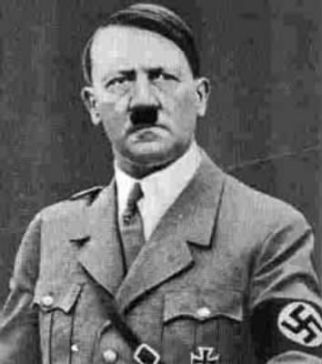
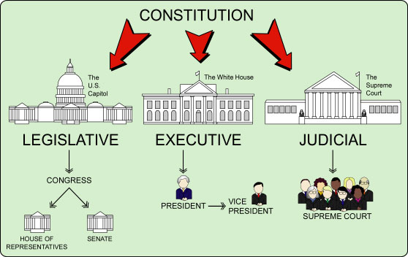
Separation of Power
Limited Gov’t
True
Federalism
Popular Sovereignty
Republicanism
Opposite
Individual Rights

Slide 33
Separation of Power
Limited Gov’t
True
Federalism
Popular Sovereignty
Republicanism
Opposite
Individual Rights

Slide 34
Separation of Power
Limited Gov’t
True
Federalism
Popular Sovereignty
Republicanism
Opposite
Individual Rights

Slide 35
Separation of Power
Limited Gov’t
True
Federalism
Popular Sovereignty
Republicanism
Opposite
Individual Rights

Slide 36
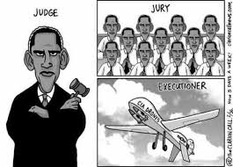
Separation of Power
Limited Gov’t
True
Federalism
Popular Sovereignty
Republicanism
Opposite
Individual Rights

Slide 37
Separation of Power
Limited Gov’t
True
Federalism
Popular Sovereignty
Republicanism
Opposite
Individual Rights

Slide 38
Separation of Power
Limited Gov’t
True
Federalism
Popular Sovereignty
Republicanism
Opposite
Individual Rights

Slide 39
Separation of Power
Limited Gov’t
True
Federalism
Popular Sovereignty
Republicanism
Opposite
Individual Rights

Slide 40
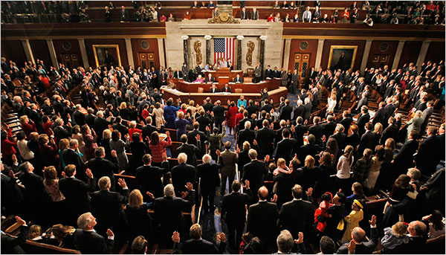
Separation of Power
Limited Gov’t
True
Federalism
Popular Sovereignty
Republicanism
Opposite
Individual Rights

Slide 41
Separation of Power
Limited Gov’t
True
Federalism
Popular Sovereignty
Republicanism
Opposite
Individual Rights

Slide 42
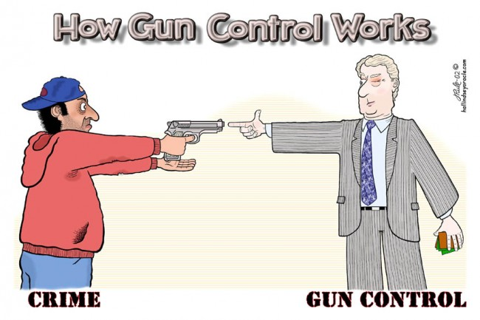
Separation of Power
Limited Gov’t
True
Federalism
Popular Sovereignty
Republicanism
Opposite
Individual Rights

Slide 43
Separation of Power
Limited Gov’t
True
Federalism
Popular Sovereignty
Republicanism
Opposite
Individual Rights

Slide 44
Separation of Power
Limited Gov’t
True
Federalism
Popular Sovereignty
Republicanism
Opposite
Individual Rights

Slide 45
Separation of Power
Limited Gov’t
True
Federalism
Popular Sovereignty
Republicanism
Opposite
Individual Rights

Slide 46
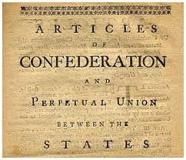
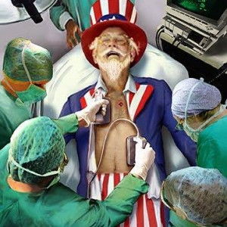
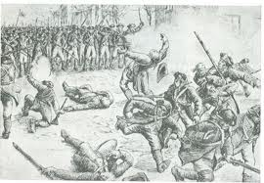
Separation of Power
Limited Gov’t
True
Federalism
Popular Sovereignty
Republicanism
Opposite
Individual Rights

Slide 47
Separation of Power
Limited Gov’t
True
Federalism
Popular Sovereignty
Republicanism
Opposite
Individual Rights

