Slide 1
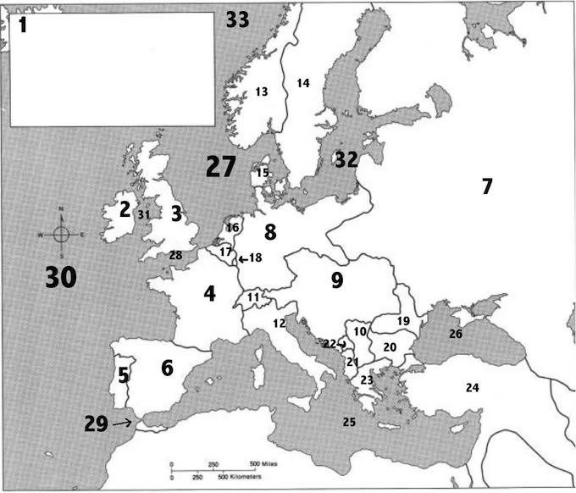
Pre World War I Map (1914)
CWa/2

Slide 2
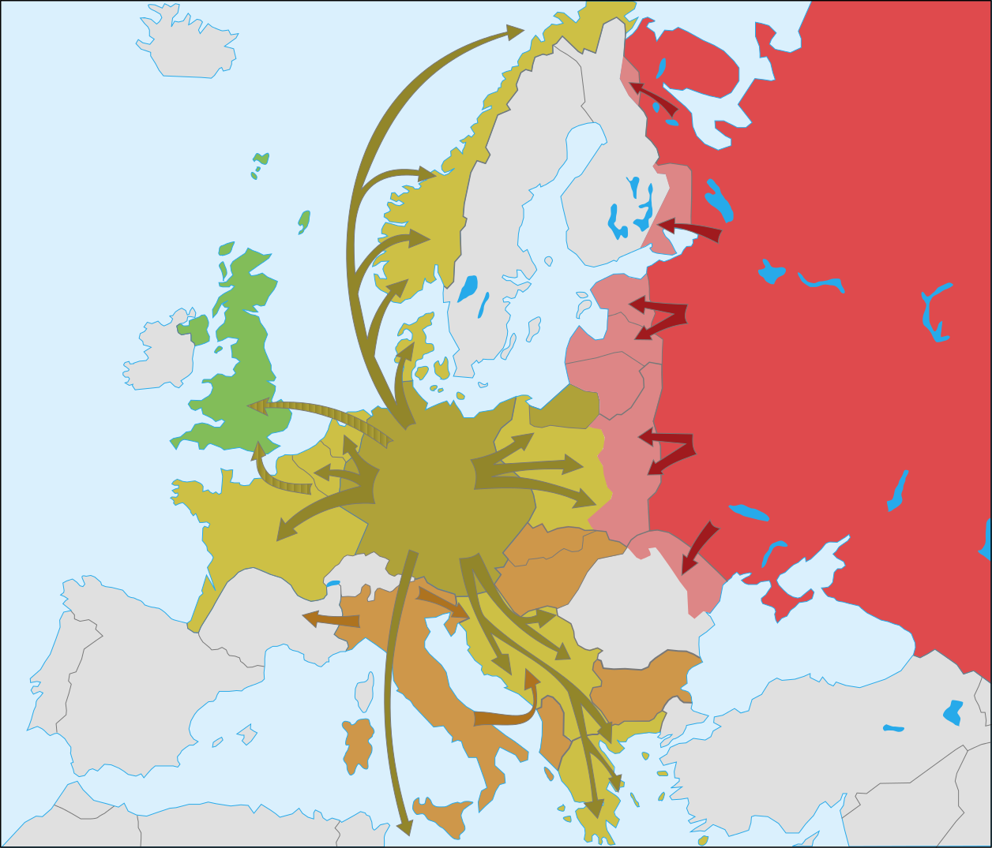
World War II Map (1939-41)

