Slide 1
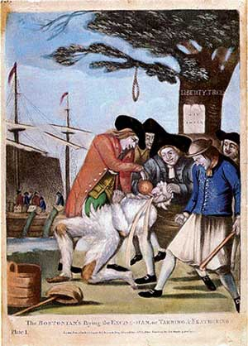
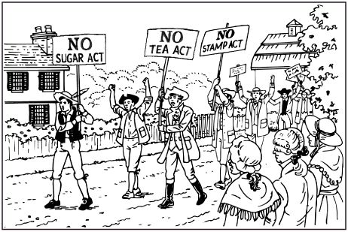
Cause
Effect
Sugar Act
&
Crack Down
on Smuggling
Colonist
Boycott
British Goods
Colonist attack Tax Collectors
Stamp Act

Slide 2
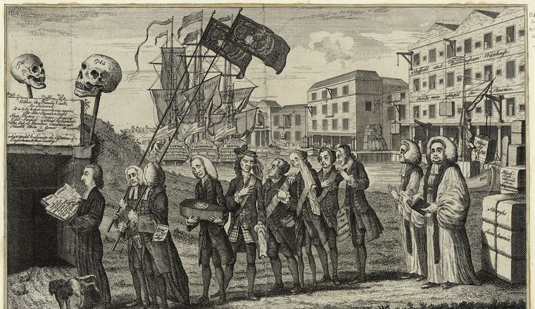
Colonist attack Tax Collectors
British
Repeal
Stamp Act
Stamp Act
Colonist
Boycott
British Goods
Townshend
Acts

Slide 3
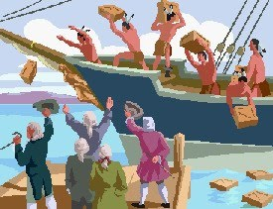
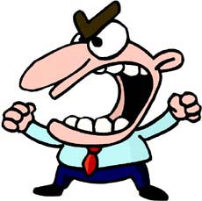
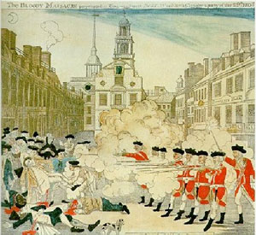
British Repeal
Townshend
Acts
Boston Massacre
Boston
Tea
Party
Intolerable
Acts
Tea Act

Slide 4
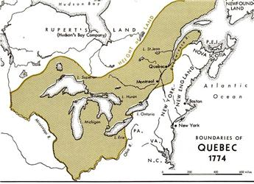
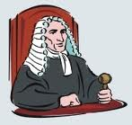
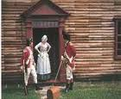
Intolerable Acts
Boston harbor is closed
No Local Government
British Officials get trials in England
Quartering Act – Colonists must house British soldiers
Large amount of land goes to Quebec
New Governor of Massachusetts

Slide 5
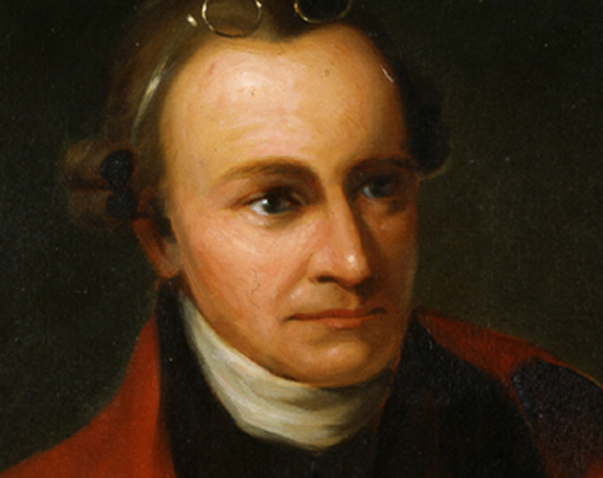
Cause
Effect
First Continental Congress
Intolerable
Acts
Violence!
Virginia Declaration
of Rights
Peace!
Patrick Henry

Slide 6
Virginia Declaration
of Rights
Gov’t Must Protect:
Life, Liberty, & Property
Declaration of Independence
Gov’t Must Protect:
Life, Liberty, & Pursuit of Happiness

