Slide 1
Quiz Topics (unit 6) look over your orange study guide
Why Indian Conflict? (3)
Rich v. Poor (2)
Labor Unions (2)
Dawes Act
Sherman Anti-Trust Act
Laissez-Faire (2)
Social Darwinism
Railroads (3)
Agriculture Technology
Vertical Integration
Horizontal Integration
Assimilation
American Dream
Monopolies
Rebus Review Before Quiz

Slide 2
D
+S
+t
+S
the

Slide 3
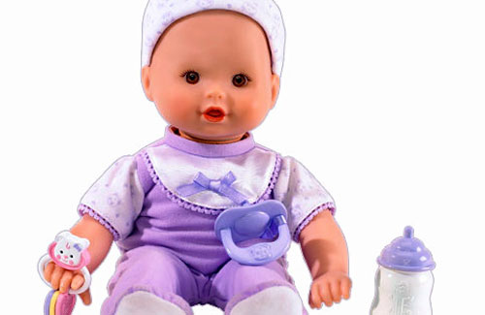
+s

Slide 4
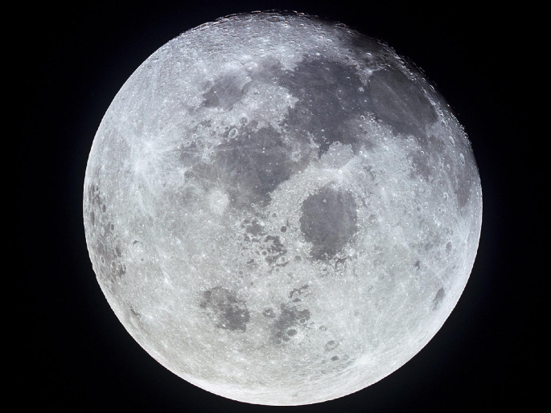
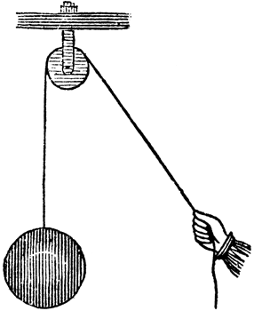
-O

Slide 5
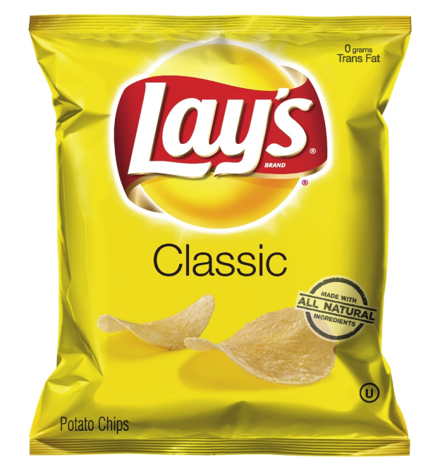
-S

Slide 6
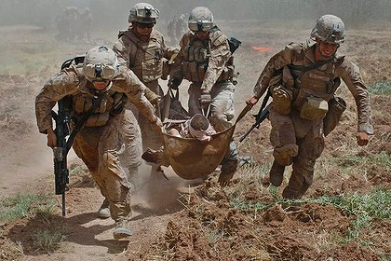
-fl
+k
-

