Slide 1
Benchmark wed 10/8
Topic | # of questions
Constitutional Compromises | 5
Constitution | 7
1800s Geography | 4
1800 Foregin Policy | 2
Innovation | 1
1800s Economics | 4
President Jackson | 3
Marbury V. Madison | 1
States' Rights | 1
Topic | # of questions
exploration | 1
French-Indian War | 1
Colonial Geography | 4
Colonial Economics | 2
colonial government | 2
British Oppression | 5
Declaration of Independence | 5
Articles of Confederation | 1

Slide 2
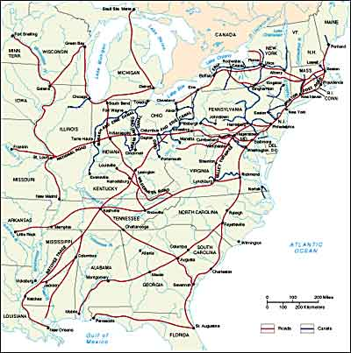

Slide 3
inflation
Demand
Price
Demand
Price
Supply
Price
Supply
Price

Slide 4
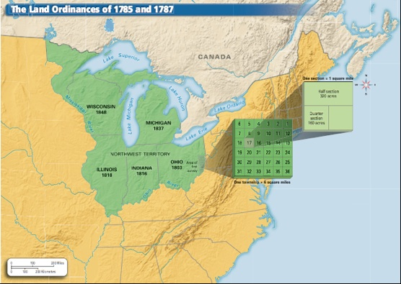



Gov’t involvement in the economy
Panic of 1819
of USA

Slide 5
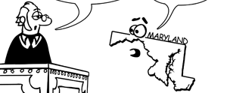
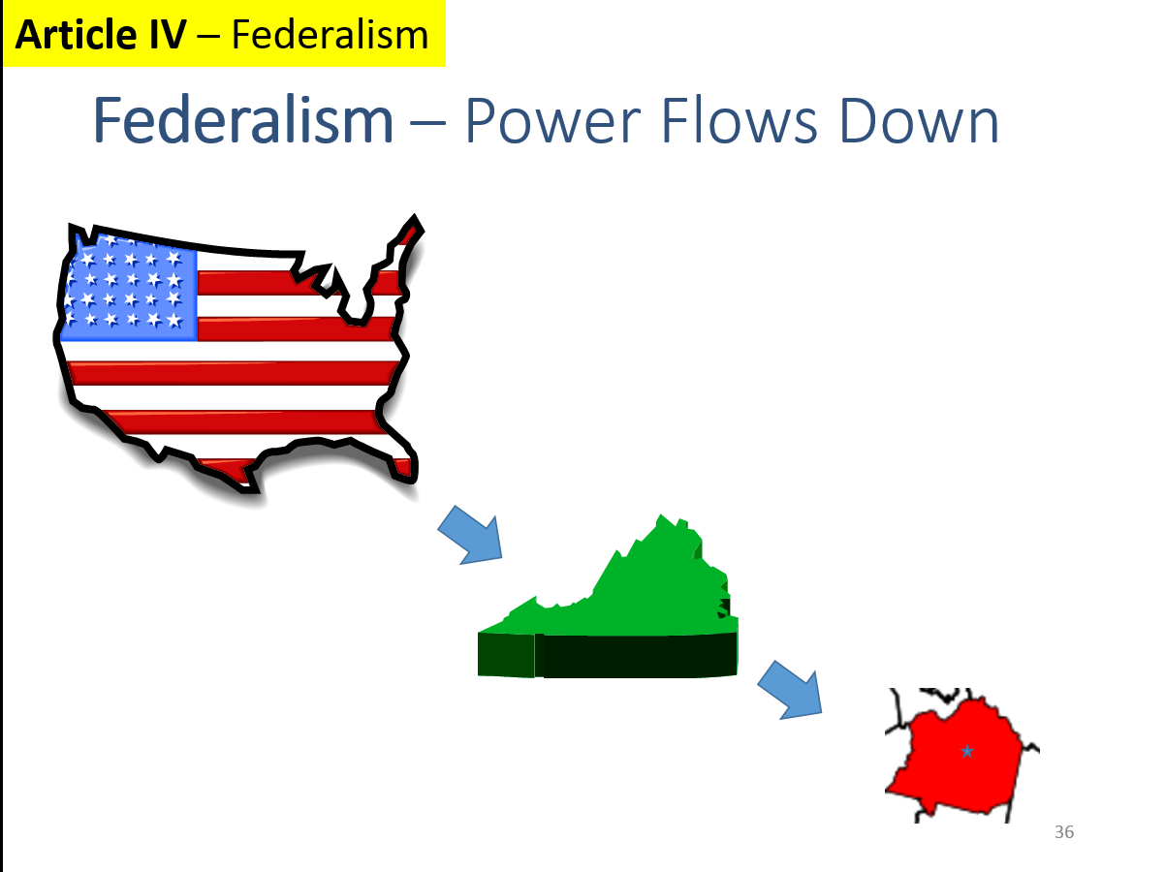
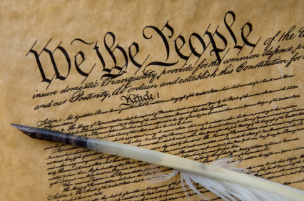
Federalism
Maryland vs. McCulloch

Slide 6
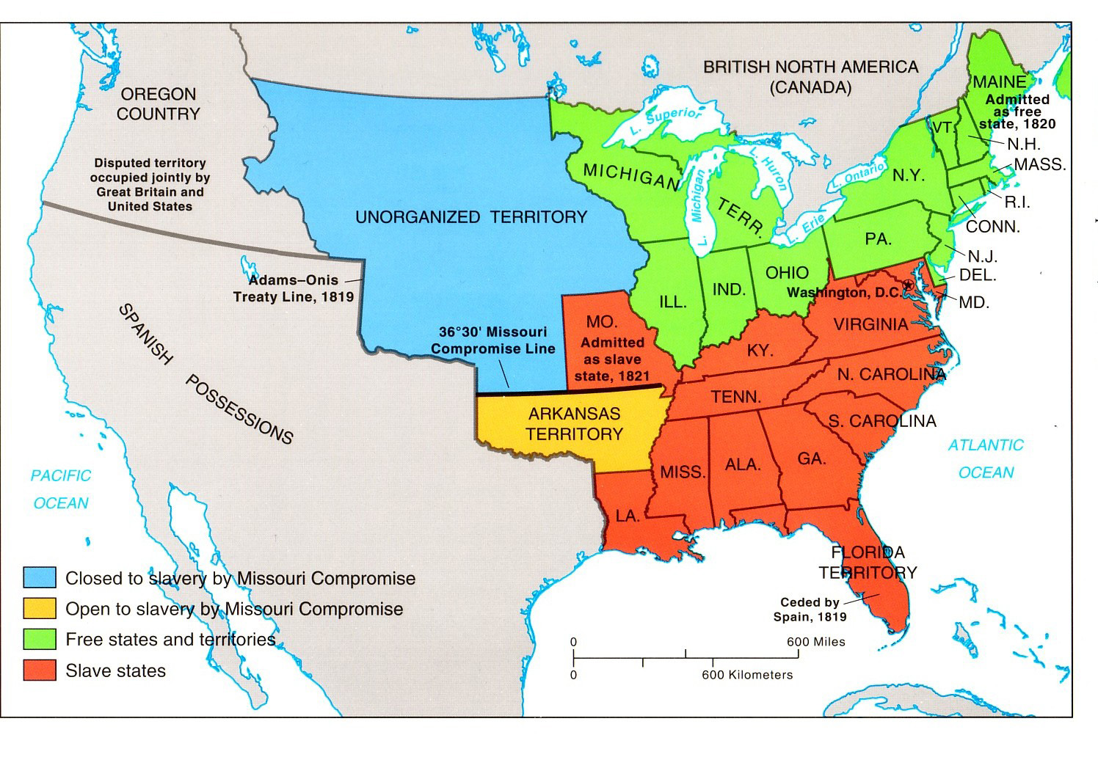

Slide 7
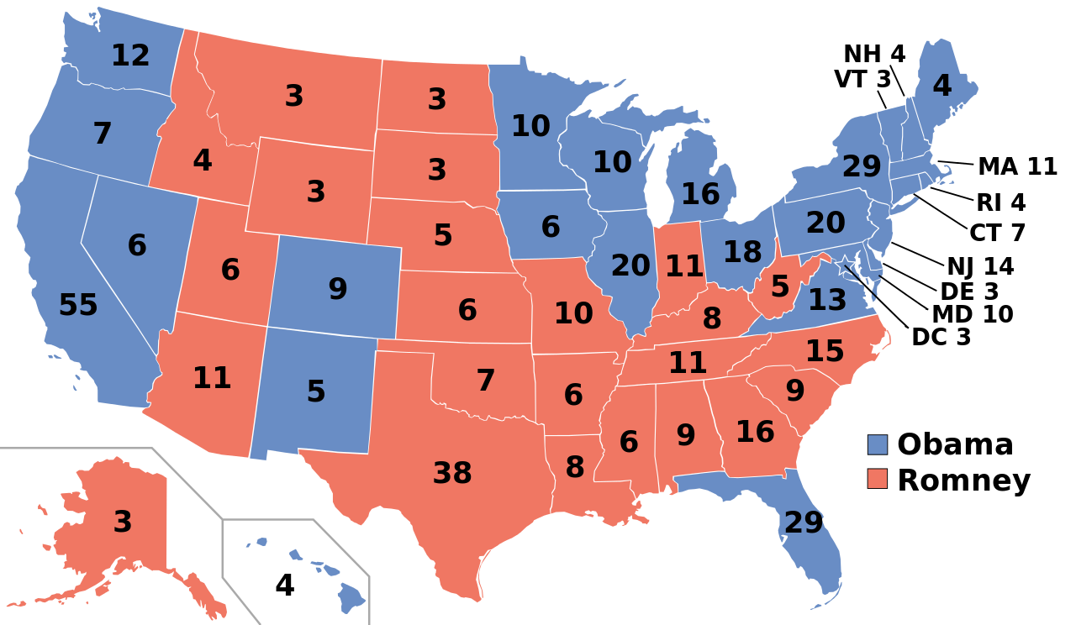
Electoral College (2012 election)
538 pts total – 270 to win (51%)
332
206

Slide 8
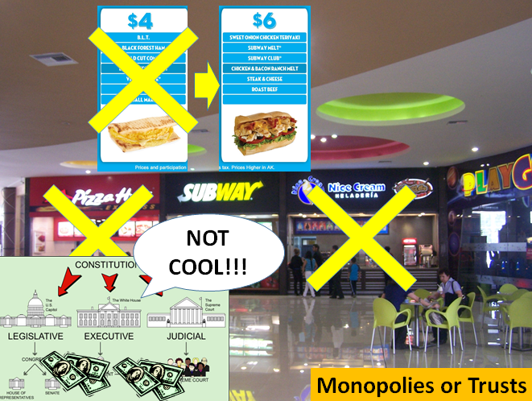
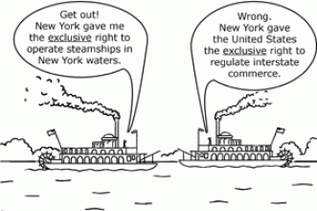

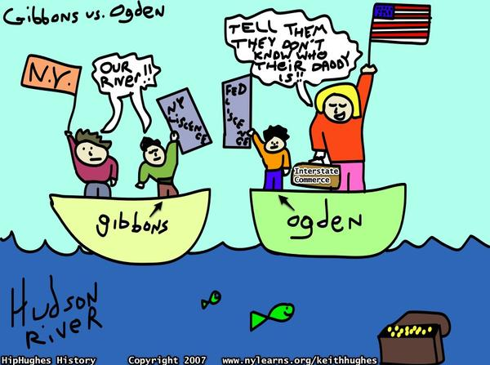
Federalism
Gov’t regulates the economy

Slide 9
inflation
Demand
Price
Demand
Price
Supply
Price
Supply
Price

Slide 10


Gov’t involvement in the economy
Panic of 1837

Slide 11
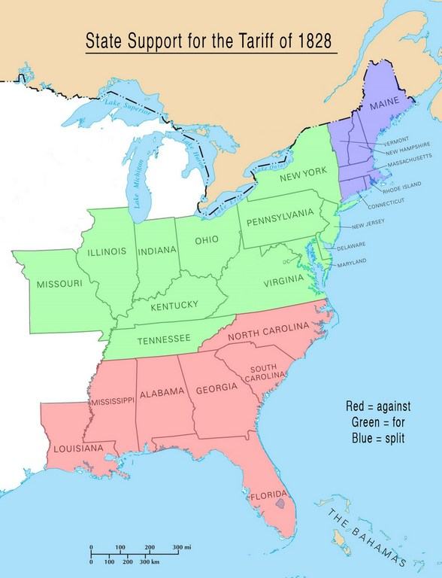


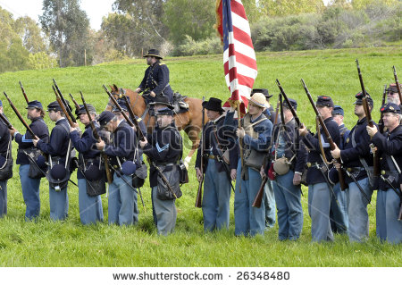
Economic arguments lead to bigger problems
We’re going to leave and start our own country!
Tariff
Of 1828
VOID

Slide 12
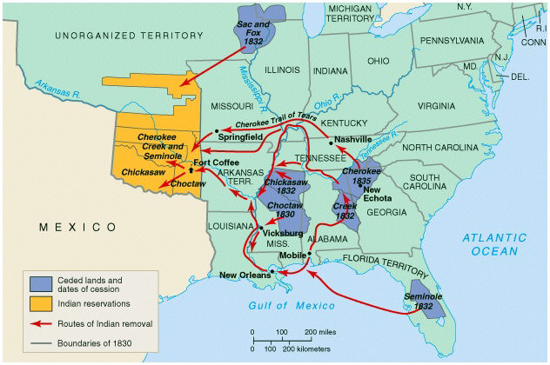
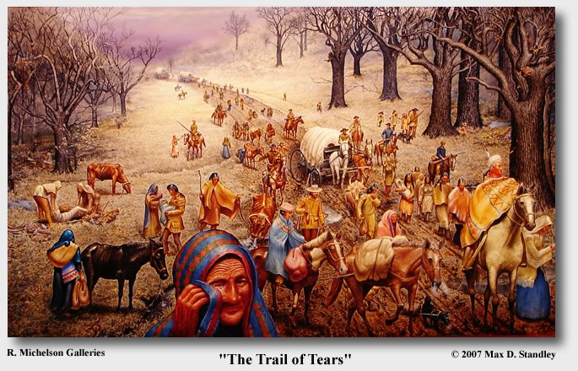
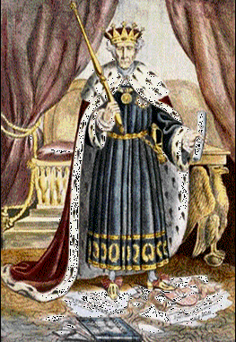

Civil Rights violation
Cultural Beliefs
Indian Removal Act
Indians do not have to move.
Try and stop me!

