Slide 1
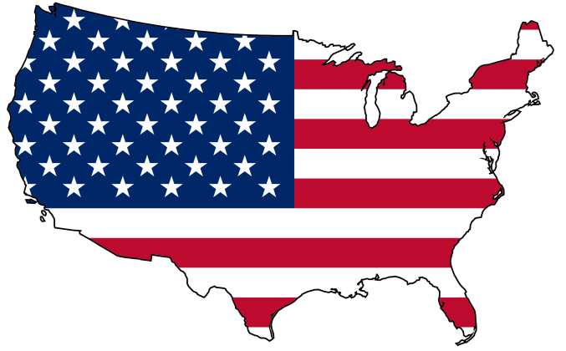
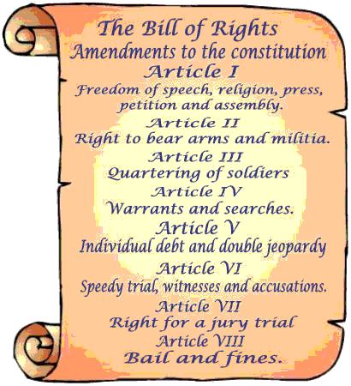

Day 5
Ratifying the Constitution
  Federalists = supported the Constitution
    FEDERAL gov’t has power
  Antifederalists = opposed the constitution
    STATE gov’t has power
    Constitution does not protect individual rights
  It’s Ratified (1787)
President = George Washington
  Cabinet – Assistants

Slide 2

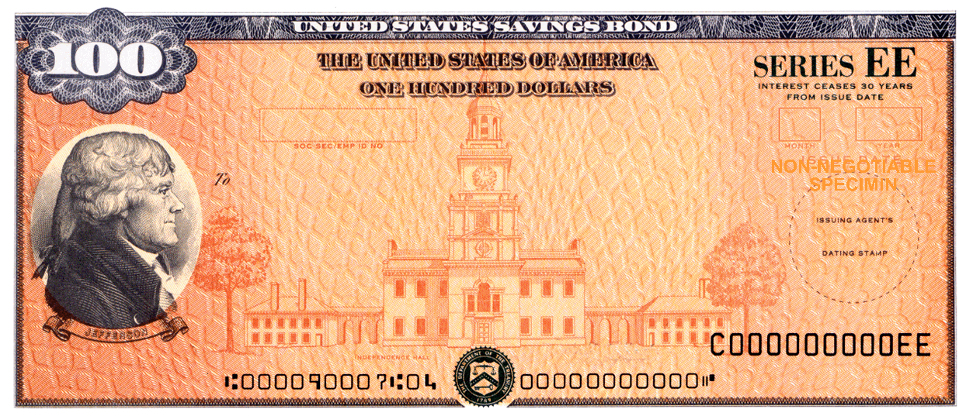
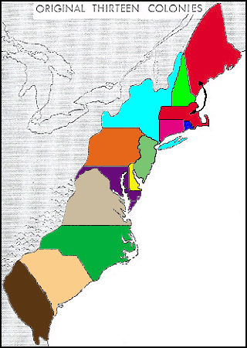
Day 5
Ratifying the Constitution
  Federalists = supported the Constitution
    FEDERAL gov’t has power
  Antifederalists = opposed the constitution
    STATE gov’t has power
    Constitution does not protect individual rights
  It’s Ratified (1787)
President = George Washington
  Cabinet – Assistants
US in Debt – War!
  11.7 mil to foreign countries
  40 mil to American
    Bonds – an IOU with interest
States Debt
  Federal Gov’t will pay it
    South MAD! They do not want to pay for the North
      Compromise: Move the Capital to the South (DC)
iou

Slide 3




Hamilton
  Strong National Gov’t
  Manufacturing Economy
Jefferson
  Strong State Gov’t
  Agricultural Economy
National Bank
  Loan money to the US Gov’t
    Bank is NOT in the constitution (Jefferson)
Hamilton uses the “elastic clause”
  Two ways to read the US Constitution
    Loose Construction
    Strict Construction
Congress agrees to start:
  Bank of the United States
constitution

Slide 4
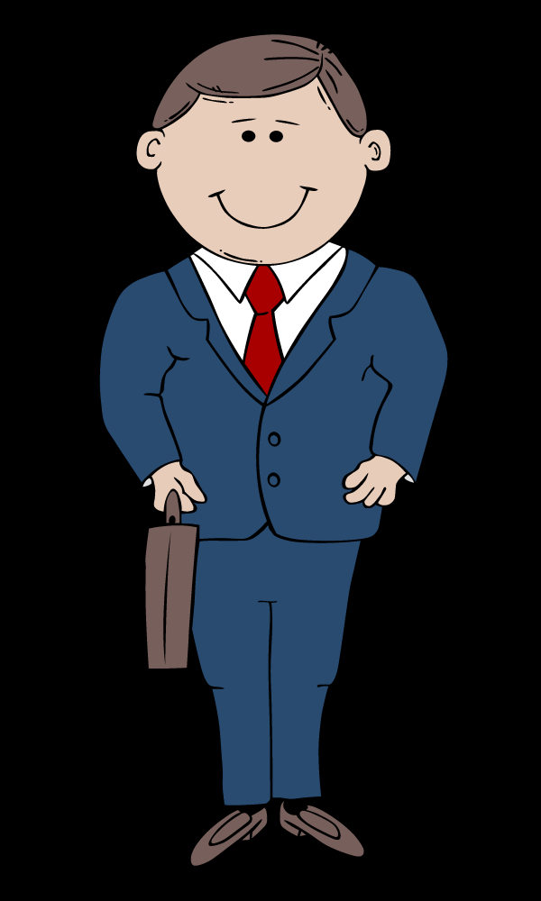
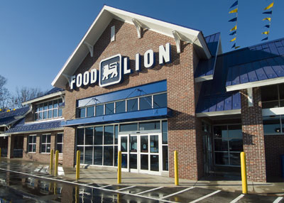
$$$
Hire More Workers
$$$

Slide 5
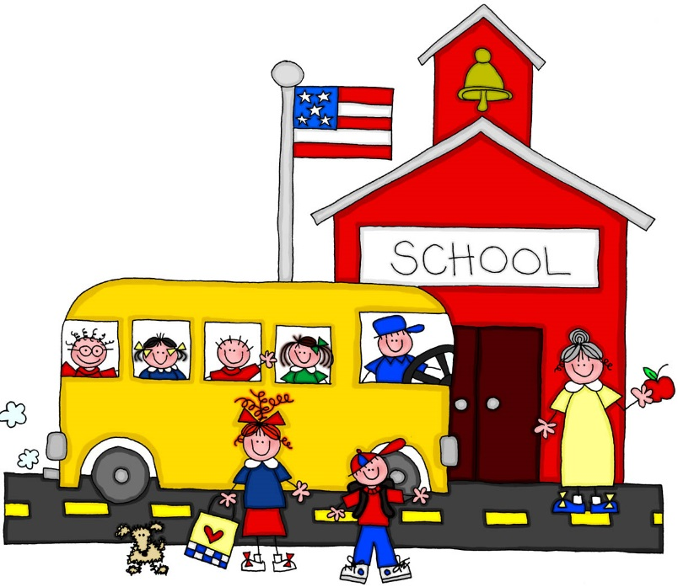

Hire More Teachers

