Slide 1
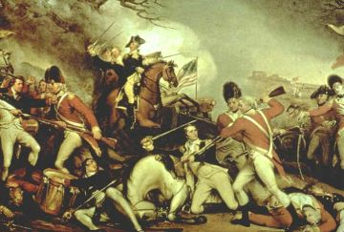
War is over. American wins. What now? Why did the US fight in the first place?

Slide 2
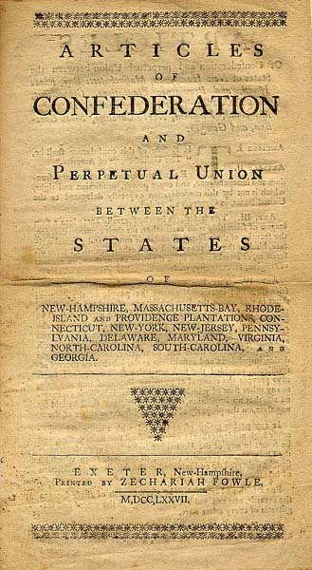
The 1st US Gov’t Failed!

Slide 3
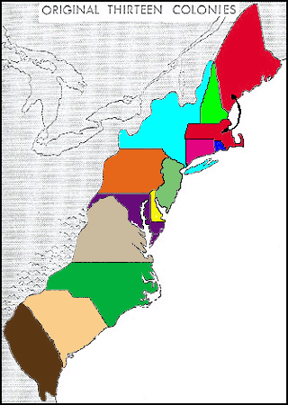
Articles of Confederation
Weak Central Gov’t
Strong State Gov’t
No Power to Tax
No President
Can’t enforce laws
1
1
1
1
1
1

Slide 4
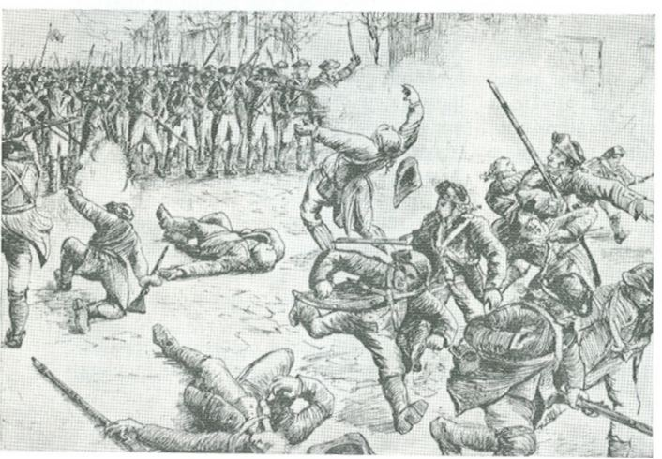
Shay’s Rebellion

Slide 5
ARTicles of Confederation
Problems
Weak Central Gov’t
Strong State Gov’t
No Power to Tax
No President
Can’t enforce laws
Big population states = Small population states

