Slide 1

Why does the Gov’t exist
England
USA
To assure order
To make the upper class and the King rich
To make the King more powerful
Protect citizens:
  Life
  Liberty
  Property
Va Declaration of Rights

Slide 2
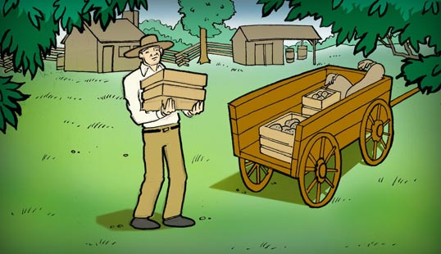

Let’s declare independence from England and fight a war against the strongest nation in the world!
Yeah, I don’t know about that. I think I will just stay here on my farm.

Slide 3
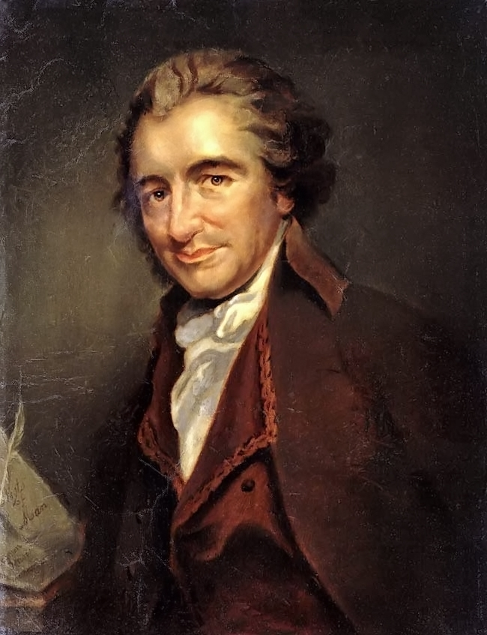


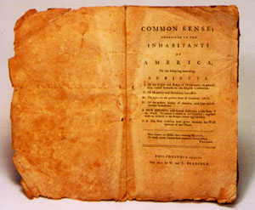

Slide 4

Common Sense
No Need For:
Gov’t
Rules
No Need For:
Gov’t
NEED Rules
NEED Gov’t
NEED Rules

Slide 5
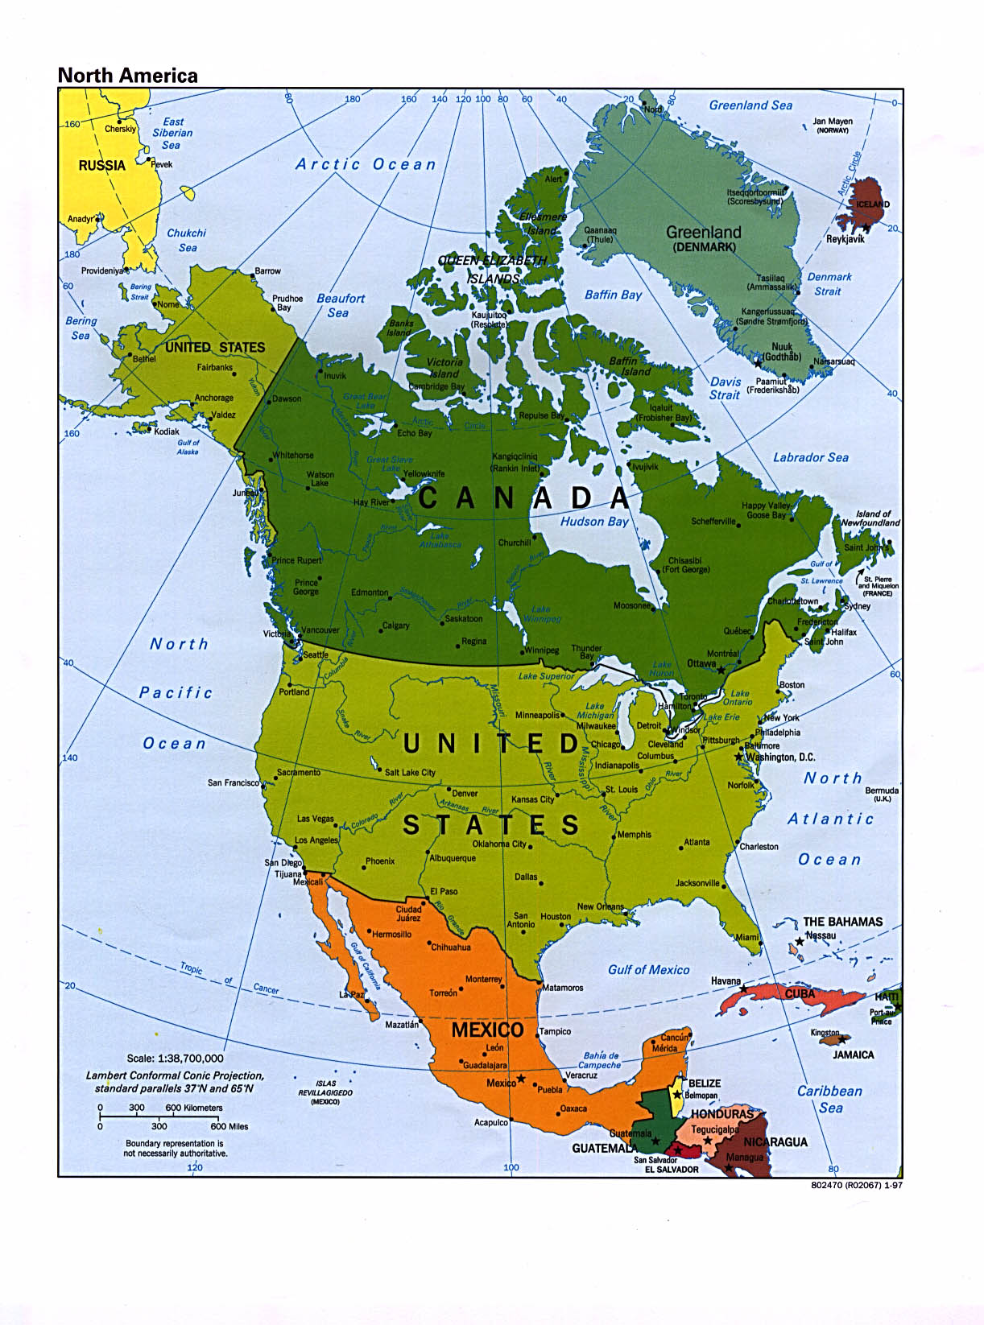
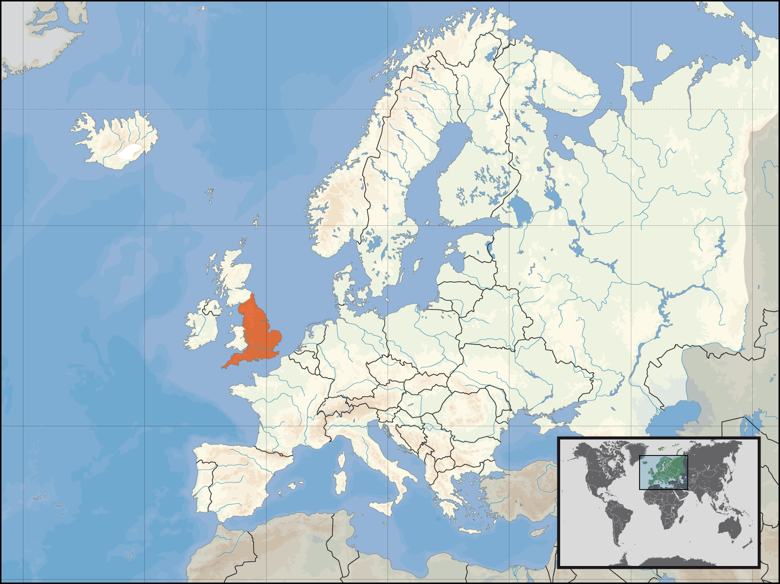
Common Sense

Slide 6
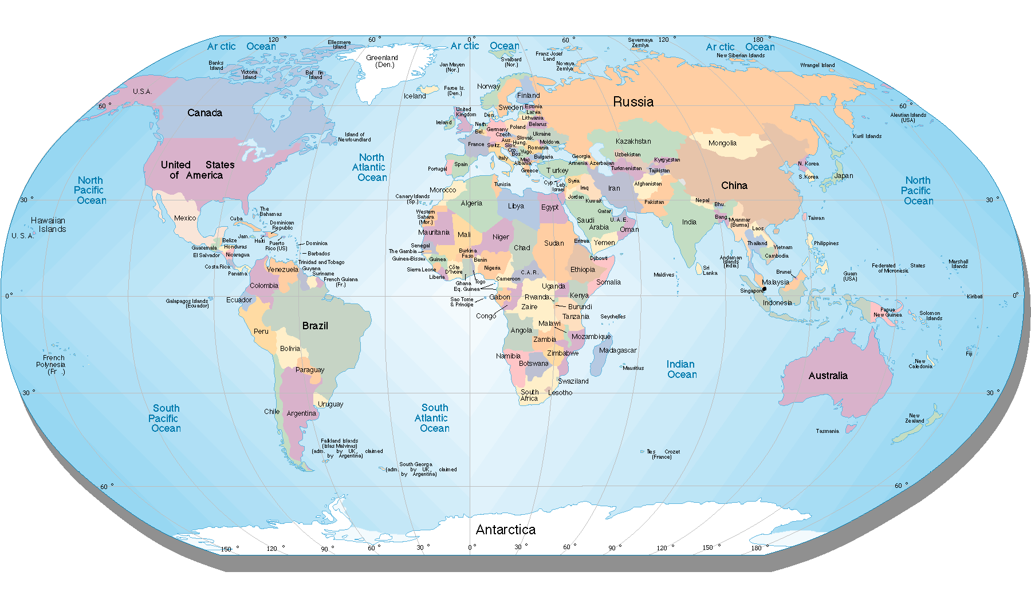
Common Sense
3000 miles

Slide 7


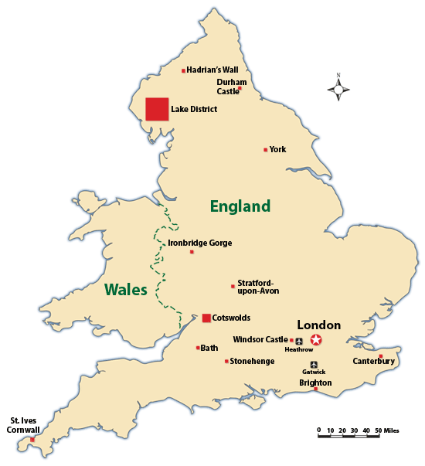

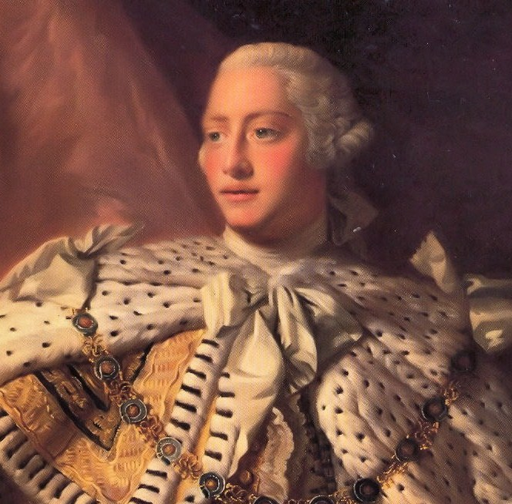

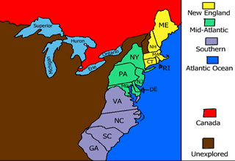

Common Sense
Colonial
Laws

Slide 8



4 Big Points
Declaration of Independence
Independence

Slide 9
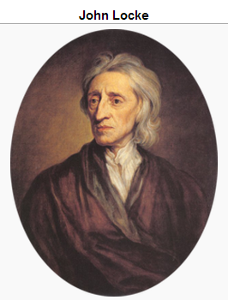
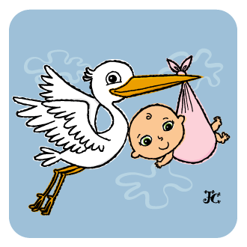
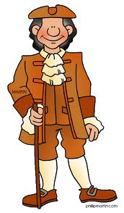
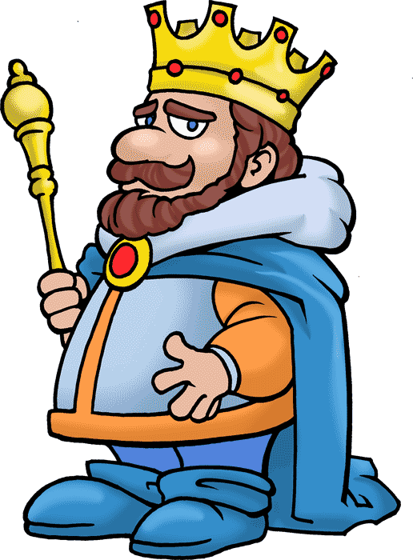
4 Big Points
Declaration of Independence
Independence
Equality
Unalienable Rights
  Life, Liberty, Pursuit of Happiness

Slide 10

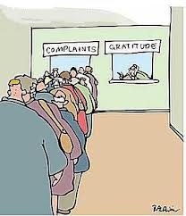

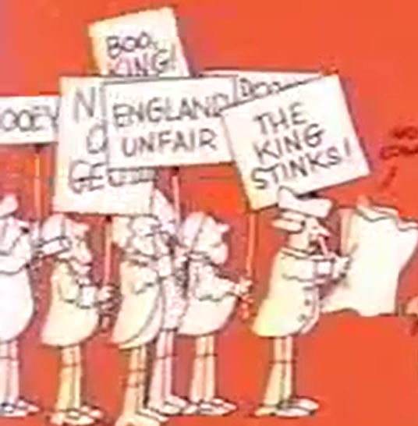
4 Big Points
Declaration of Independence
Independence
Equality
Unalienable Rights
  Life, Liberty, Pursuit of Happiness
Grievances (complaints)

Slide 11
27
Dear King,
You are a tyrant
You have taken our right of trial by jury
You have unfairly taxed us
You have removed our representatives in the government
You have a standing army in the colonies in times of peace
…and more

Slide 12
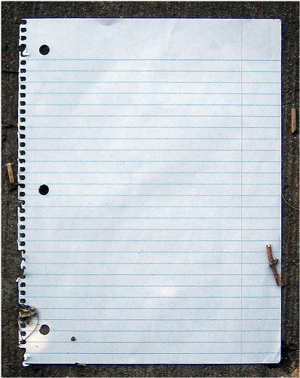
Dear BF or GF,
I’m breaking up with you (independence)
Your breath stinks
You smell
Your jokes aren’t funny
You’re immature
You never stood up for me
You think you’re more important
Your friends are better looking

Slide 13
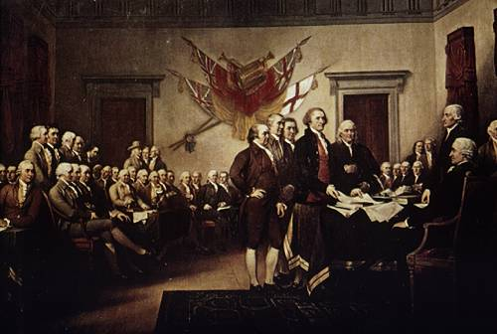
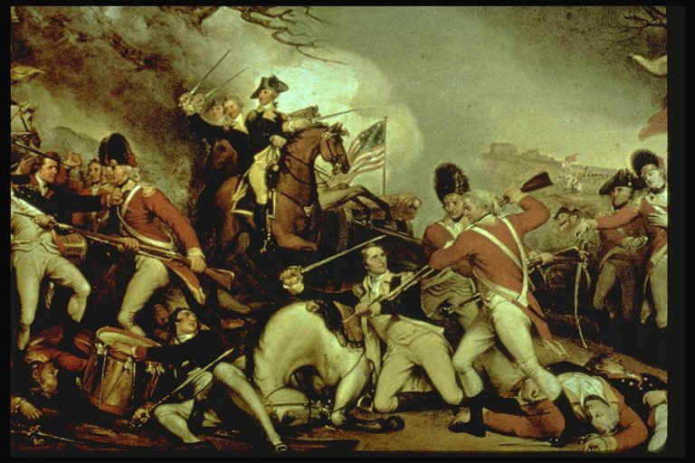
Second Continental Congress
Yes!
Yes!
Yes!
Yes!
Yes!

Slide 14
Where are the 4 parts?
Dear BF or GF,
I’m breaking up with you
Your breath stinks
You smell
Your jokes aren’t funny
You’re immature
You never stood up for me
You think you’re more important
Your friends are better looking

Slide 15
Write your own break up letter to the King or Queen
Declare your independence
explain that you are equal
explain that your unalienable rights were not protected
state 7 grievances
sign it!

