Slide 1
Inflation & Quality Resources

Slide 2
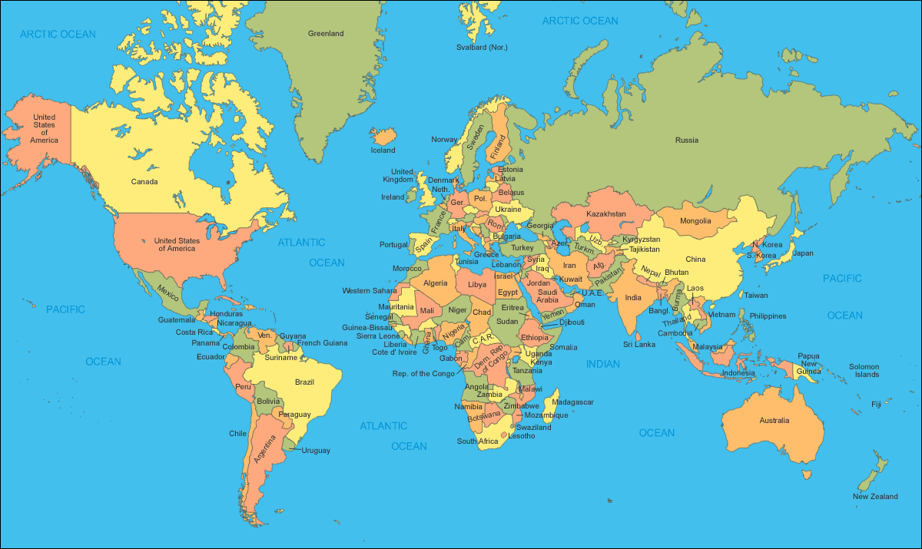
Nation’s with high quality resources grow and are stable

Slide 3
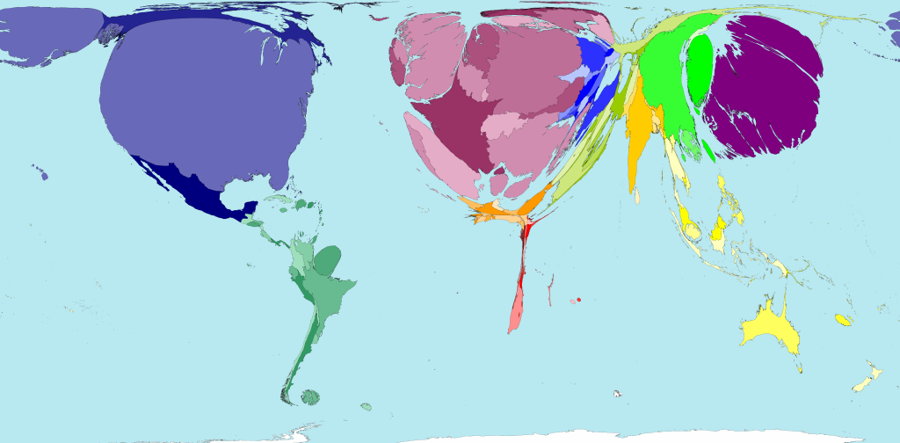
GDP

Slide 4
Economic Concepts
Resources
  Factors of production in producing goods and services
Example: HDtv
  Human: people build the TV
  Natural: Glass, Plastic, Noble gas
  Capital: Factory Building, Machines, $$$
  Entrepreneurship: Brains, Design & Sell the TV

Slide 5



Human Resources

Slide 6

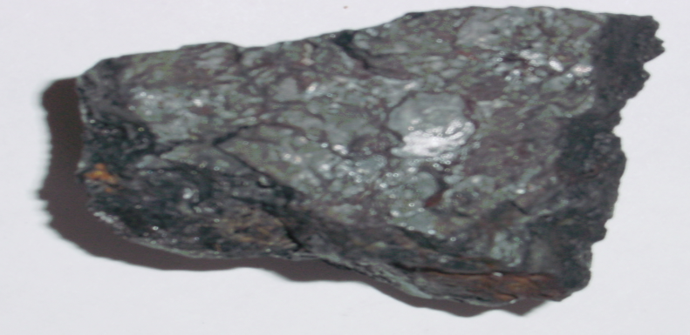
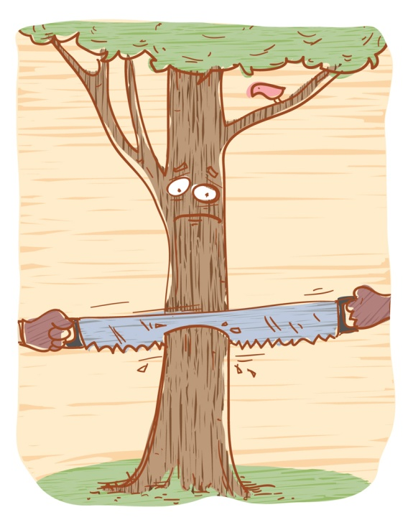

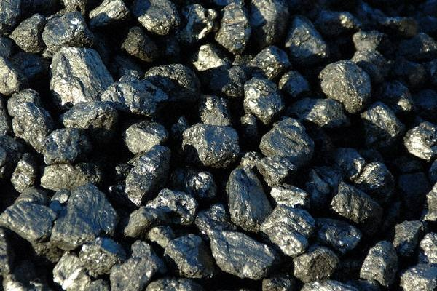
Natural Resources
“From Nature”

Slide 7

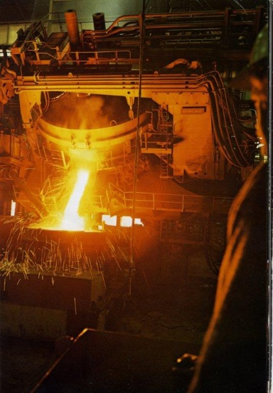

Capital Resources

Slide 8
Entreprenuership

Slide 9
Supply
Price
Supply
Price

Slide 10

Inflation
the devaluation of money
$1
$1
$0.20
Let’s change the supply of candy.
Let’s increase it and see what happens.

Slide 11
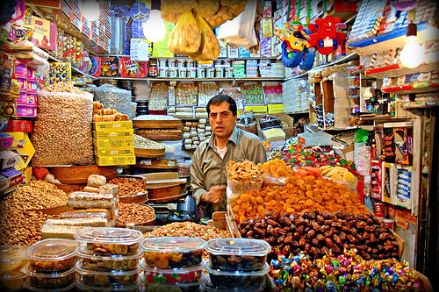
Steve’s Candy Shop
c
Selina
Bruce
Miranda
$1
$3
$2

Slide 12
Inflation the devaluation of money
$3
Let’s change the supply of money.
Let’s increase it and see what happens.
Everyone should be able to buy candy!

Slide 13
Steve’s Candy Shop
Selina
Bruce
Miranda
$1
$3
$2
$4
$6
$5

Slide 14
Inflation the devaluation of money
$6

Slide 15
Inflation the devaluation of money
$3
before
$3
after

Slide 16
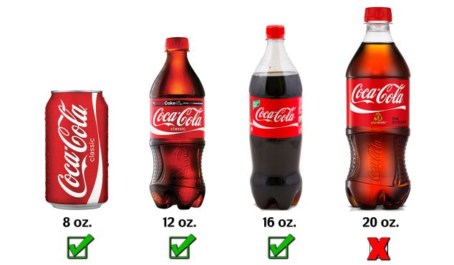
didn’t exist
.99
2000
.50
.75
.99
1.40
2012

Slide 17
Supply
of
Money
Value
Supply
of
Money
Value

Slide 18
Inflation
phenomenon
Money is made up, we created it w/our minds
So a dollar is worth, what we THINK it is worth
  Businesses know:
    Money Supply is always increasing
    Supply of Goods is not
      They will charge more

Slide 19



$3
$1000 Beef
$32,000 a year
Businesses understand Supply and Price
$32,000 a year
$6
$3
$2000 Beef
$64,000 a year

Slide 20
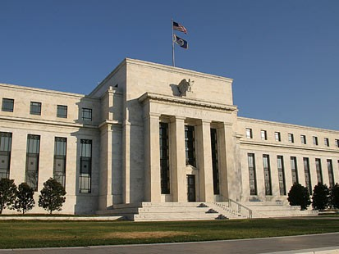
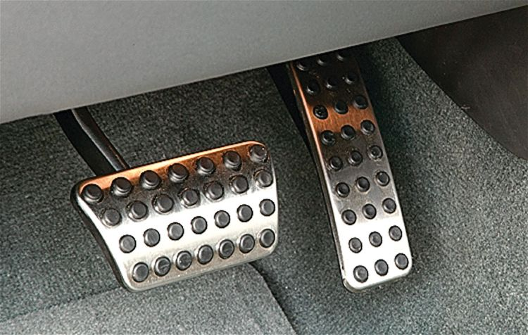
The Fed
Brake:
Take money out of the economy
Stop inflation
Gas:
Put money into the economy
the economy will grow
Economy stops growing
inflation

Slide 21
Calculate Inflation
Inflation Rate = Change in price/original price
I = (B-A)/A
  B = New Price
  A = Old Price
Milk costs $3 a gallon, in 2000 it cost $2.75
  I = (3-2.75)/2.75
  Inflation Rate = .09 or 9%

Slide 22
Answer the flowing in your notes
Inflation Rate = (B-A)/A
  B = New Price
  A = Old Price
    Multiply by 100 to convert it to a percentage
2014 – Coke 1.49, 2000 – Coke $1.00
2014 – Small bag of Chips .50, 2000 – Chips $.33

