Slide 1
Balderdash Rules
Part 1
On a small piece of paper w/ your name:
Correctly explain what each invention does = 1 pt
Or…
Make up a FAKE explanation of what the invention does
Part 2
Mr. D will read several student explanations and the real explanation.
You must pick the correct explanation = 1 pt
If a student picks your fake explanation = you get 1 pt

Slide 2
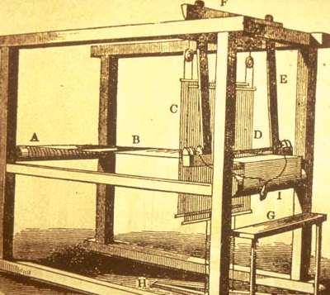
1

Slide 3
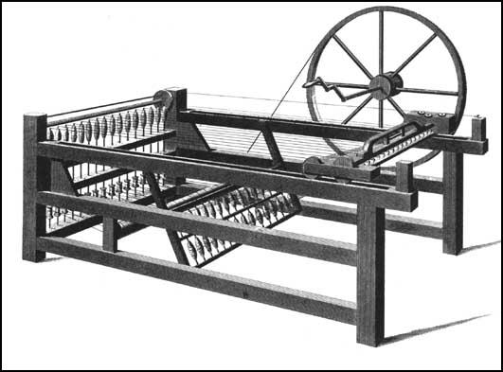
2

Slide 4
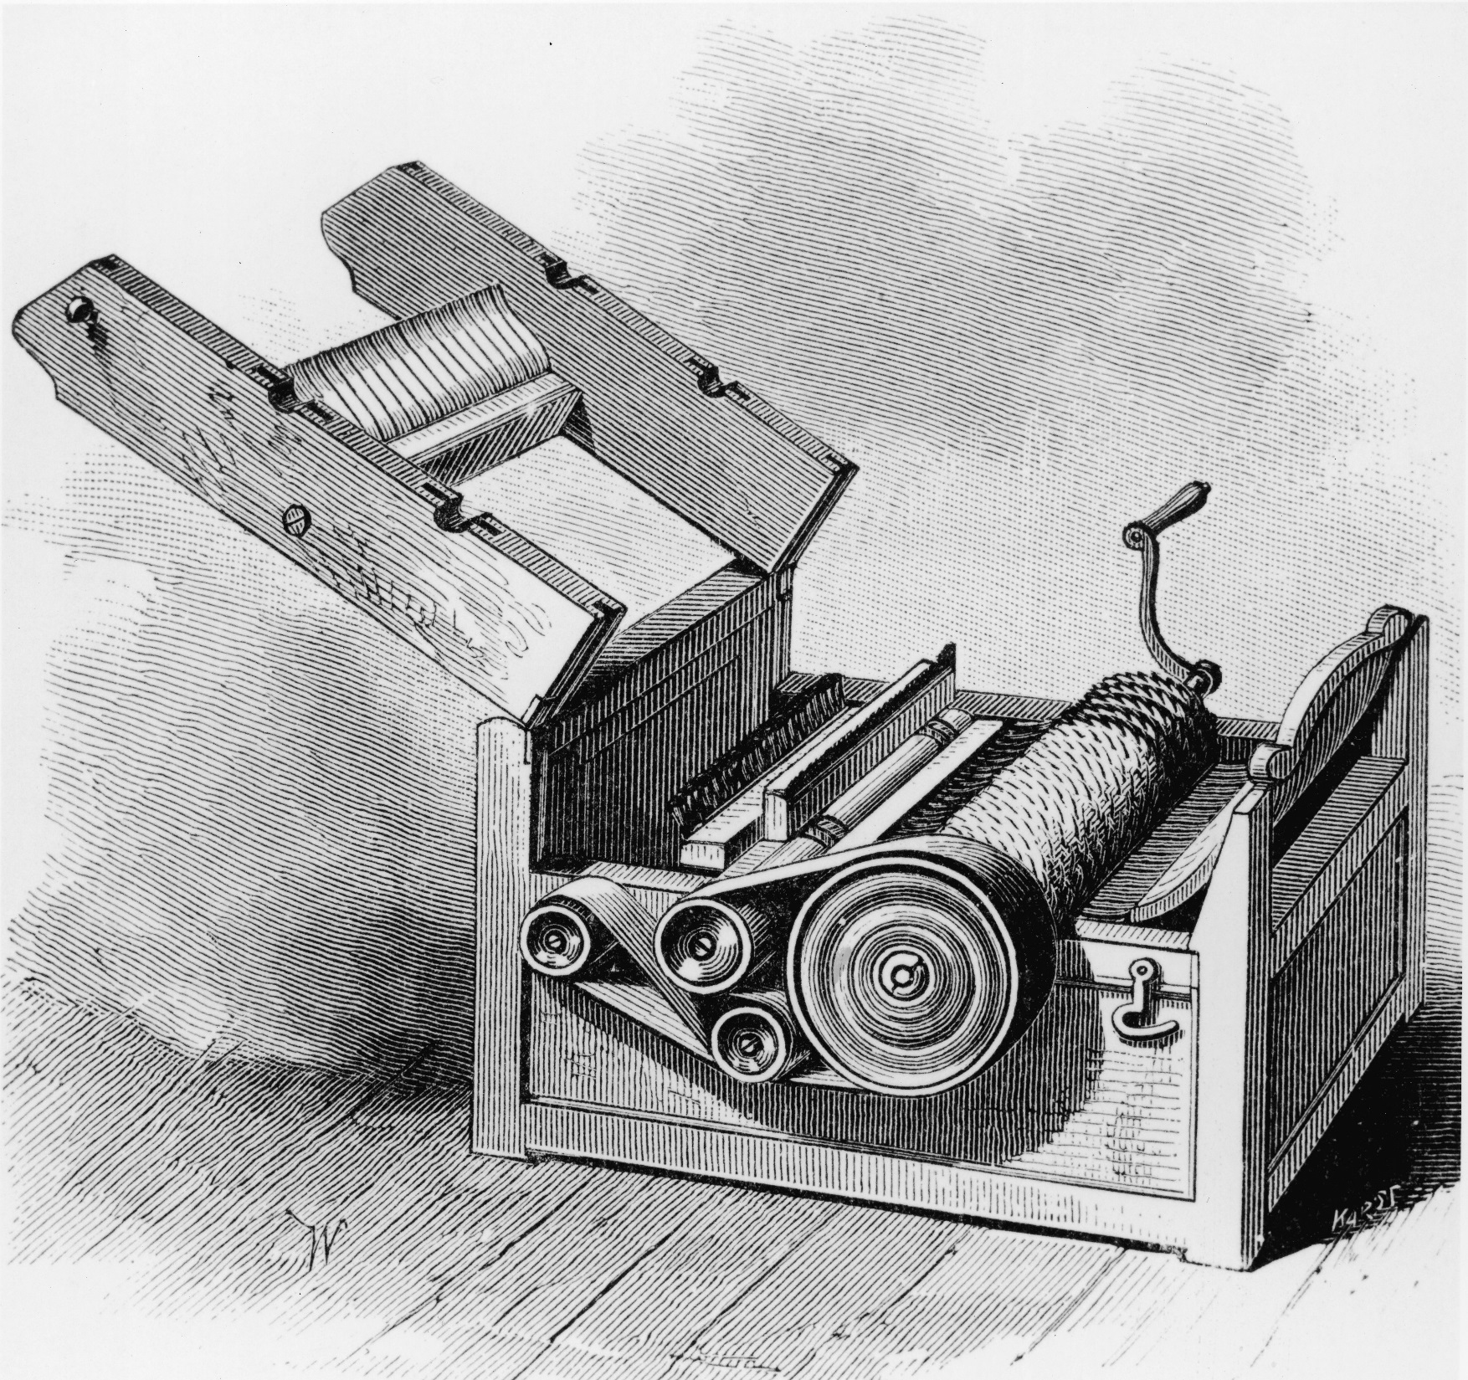
3

Slide 5
Flying Shuttle
1733
Weaves thread into fabric
http://www.youtube.com/watch?v=khiEAEqdkZY
1

Slide 6
Spinning Jenny
1764
makes thread
makes it fast enough to keep up with the flying shuttle
http://www.youtube.com/watch?v=YJonx3fa2cg
2

Slide 7
Cotton
Gin
1793
Cleans cotton faster (removes seed), so it can be turned into thread.
http://www.youtube.com/watch?v=A6wPxAp-1Jc
3

Slide 8
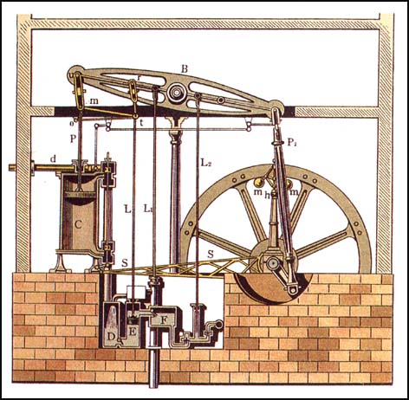
4

Slide 9
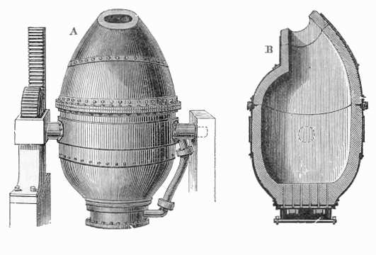
5

Slide 10
Steam Engine
1769
Boils water and the steam pressure moves a piston; that powers a machine.
http://www.youtube.com/watch?v=ESfSG2OlQYQ
4

Slide 11
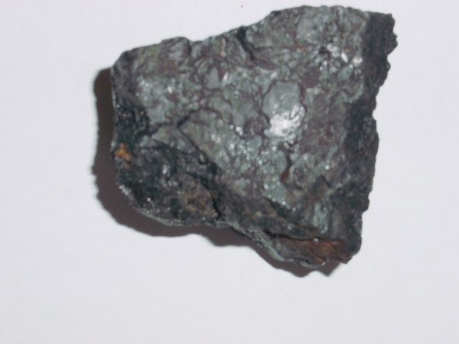
Bessemer
Furnace
1769
With extreme heat, it turns iron into steel.
http://www.youtube.com/watch?v=_kSp5K70cYc
5

