Slide 1
Day 7

Slide 2
Documents!
Rules
Laws
Rights
Contract
Treaty

Slide 3
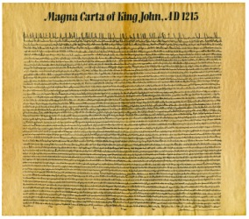
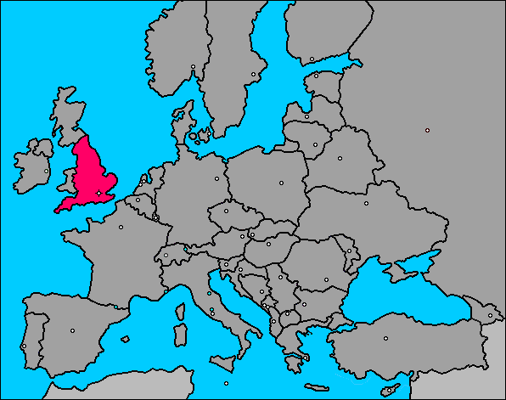
Magna Carta
1215
Limits the King’s Power
Right to Prosper (Succeed)

Slide 4
English Bill of Rights
William & Marry will follow the Magna Carta
Parliament has power:
Write Laws & Tax
People have Rights (speech, jury trial, etc)
Outlawed Cruel & Unusual Punishment

Slide 5
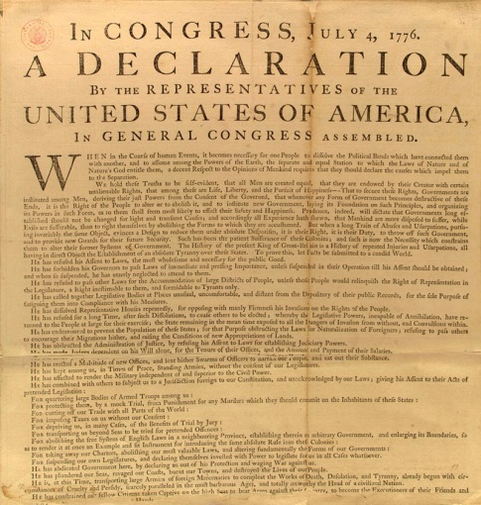
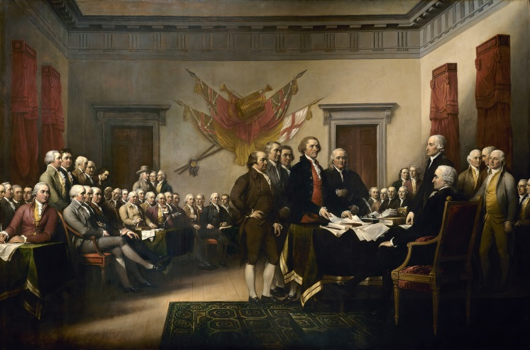
Declaration of Independence
Declares the Colonies independence from England
People are equal
Gov’t must protect our unalienable rights
Life, liberty, & pursuit of happiness
People are allowed to overthrow a tyrannical Gov’t

Slide 6
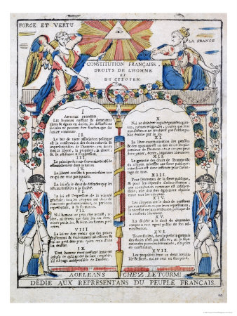
French Declaration of the Rights of Man
Power from the People
People have rights
People are equal

Slide 7
Day 8 – French Revolution
Revolution Review
English people want rights & power in Gov’t
Overthrow Gov’t (several times)
Gov’t agrees to protect their rights
American Colonists want rights & power in Gov’t
Declare independence, go to war, win!
Start NEW gov’t and Nation
Gov’t protects their rights

Slide 8
King does not care about people
People Starving…King throwing parties

