Slide 1
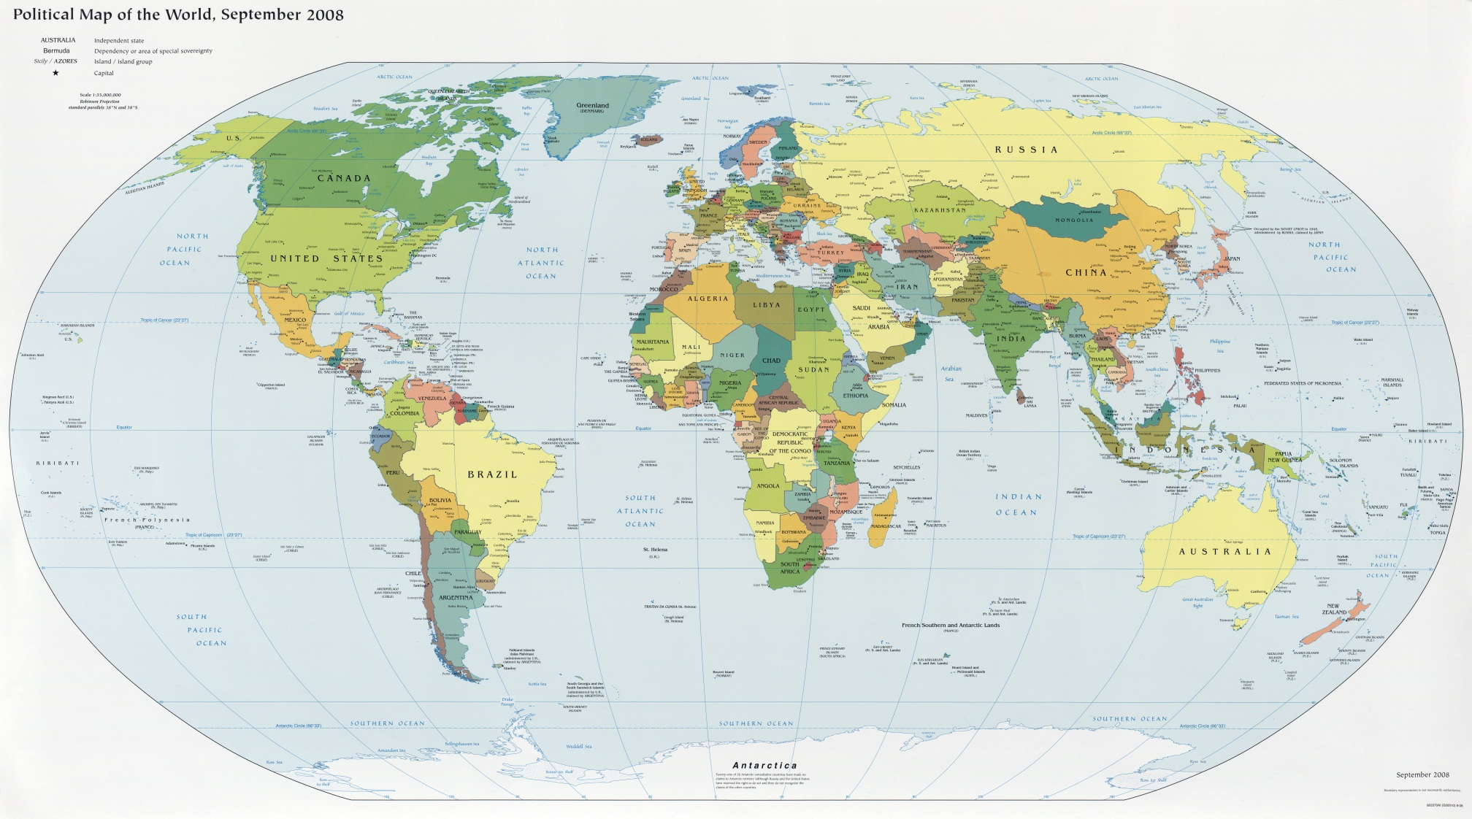
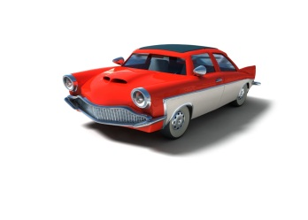

What do they make?
Why do they make it?
Who makes it?
Who buys it?

Slide 2
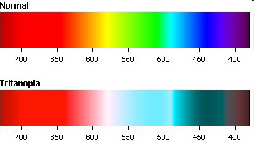

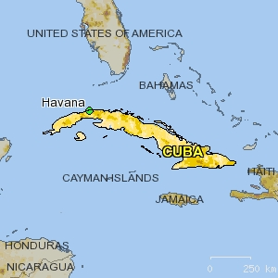
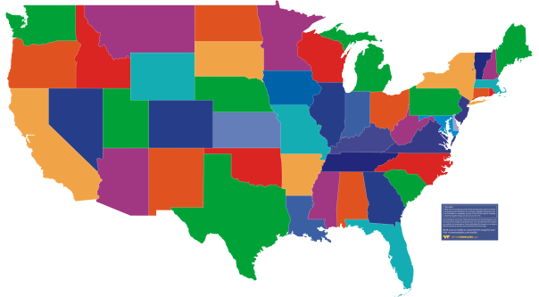
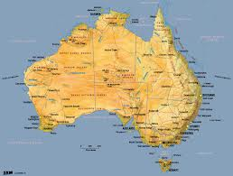
Economies fall along a spectrum:
- Some have a lot of gov’t involvement (command)
- Some have little gov’t involvement (free)
- Some have a mixture of gov’t involvement (mixed)
Command
Communism
Free Market
Capitalism
Mixed
Socialism
Cuba
USA
Australia

Slide 3
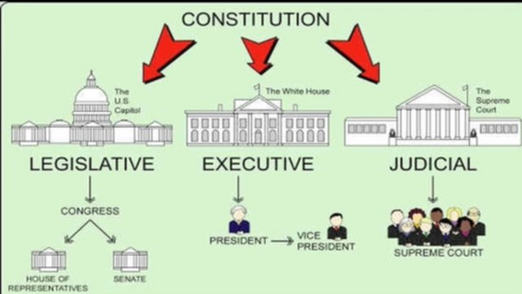
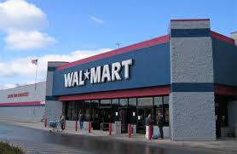



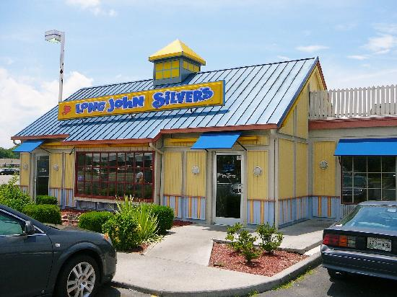



Day 1 – Economic Systems
Command (communism)
Free (capitalism)
- Lots of Gov’t involvement
- Gov’t makes all decisions
- Gov’t owns property
- No Profits (Gov’t helps people)
- No Competition
- Ex. North Korea, Cuba (rare)
- Little Gov’t involvement
- Individuals Choose
- Private property
- Profit Driven (make $)
- Competition
- Ex. Australia
Mixed
- Gov’t involvement (free < mixed < command)
- Individuals & biz make choices
    - private sector (make money)
- Gov’t makes choices
    - public sector (help people)
- Ex. USA (most common economy)
Traditional
-based on survival
-eskimos
-zombie apocalypse

Slide 4

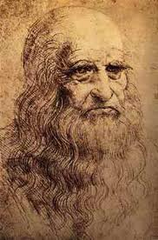
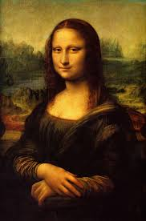
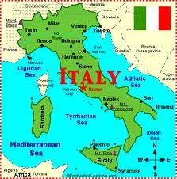
Capitalist Art
I am a Medici, I buy art
I only buy the best art
Bad art = artist doesn’t make money
Good art = artist earns money
  In a Free Market – the gov’t does not get involved
  The best artists (Da Vinci) will be rich
Capitalism = Work Hard – You will do well in life

Slide 5
Capitalist Art
I am a Medici, I buy art
  I will pay you to do a drawing for me
  I will only the buy the drawings that are very good
  If you are drawing is not good enough, then try harder. This is a capitalist classroom NOT communist
Some students are born rich (I will give you some colored pencils)
Some students are born poor (you get nothing)
This is REAL LIFE
  Work hard – overcome disadvantages
  The beauty of Capitalism!

Slide 6
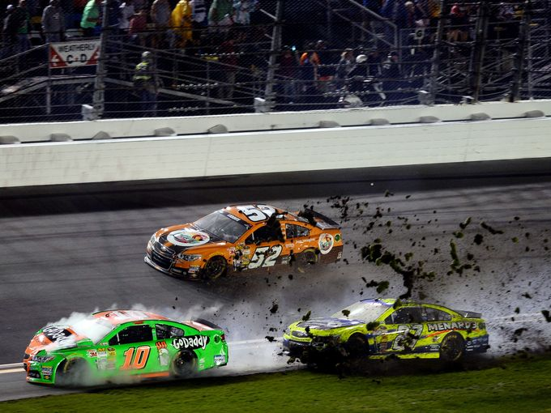
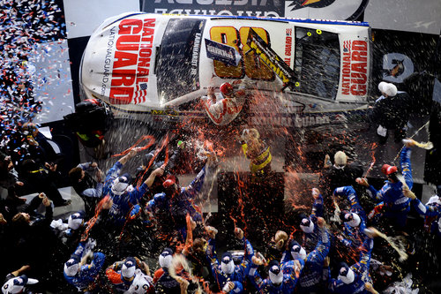

Slide 7
