Slide 1
Genocides in History
Mr. Dietrich

Slide 2
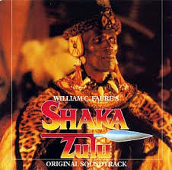
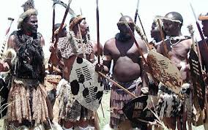
Zulu Kingdom
1810-1828 (pre-Imperialism)
Dictatorial leader Shaka Zulu wanted to expanded his kingdom
He did not seek only military victories, his plan was to kill all of his enemies (men, women, and children)
The Sulu armies killed 1-2 million people

Slide 3
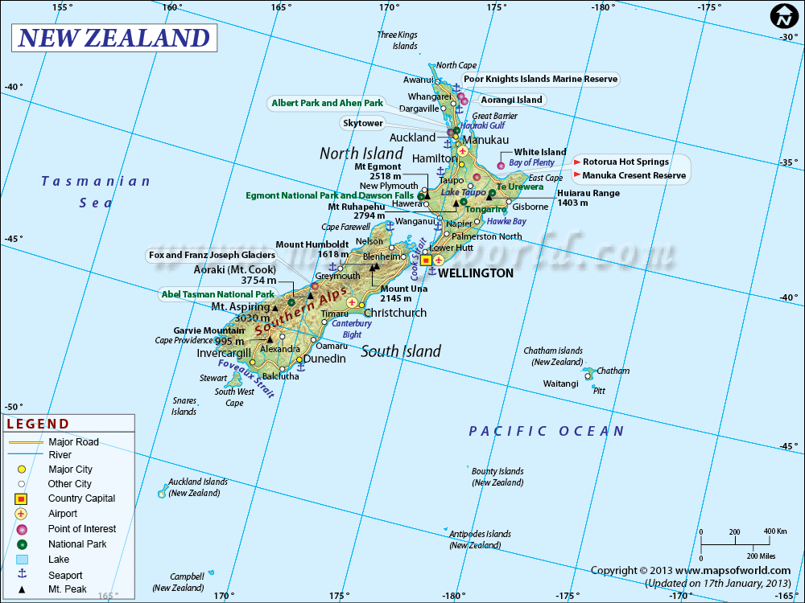
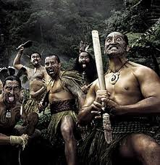
New Zealand
The Moriori people believed in non-violence
The Maori invaded their islands
They enslaved the Moriori, killed the Moriori, and also cannibalized them.
Moriori’s of unmixed ancestry are extinct

