Slide 1
Save your ideas for future generations.
Idea of “people ruling”
Ancient Greece (800 BCE)
Enlightenment (1700s)
USA (1776)

Slide 2
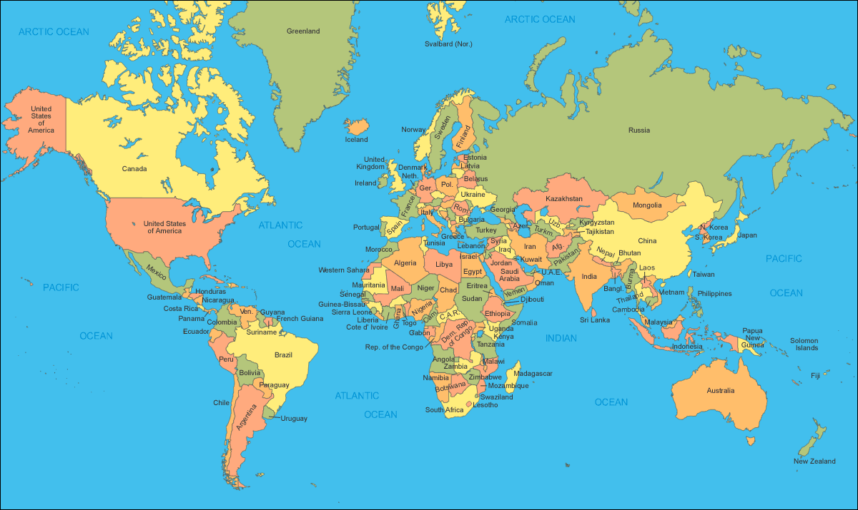
Save your ideas for future generations.
Spread your ideas.

Slide 3
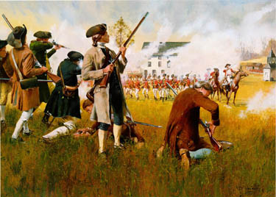
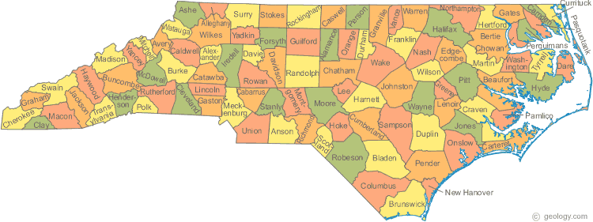
NC = 1st in independence
Mecklenburg Resolves
5/20/1775
After the Battle of Lexington and Concord
“The King’s laws and government are annulled”
Halifax Resolves
4/12/1776
1st document to call for independence in the US Colonies

Slide 4
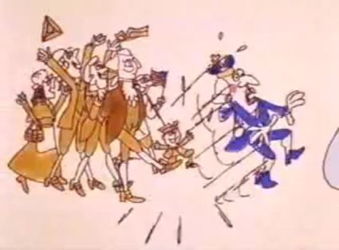
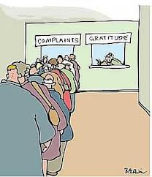
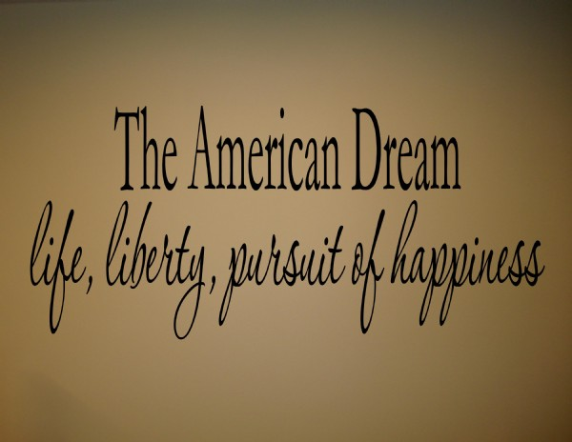
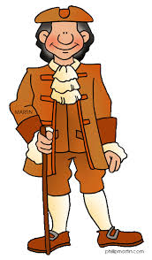
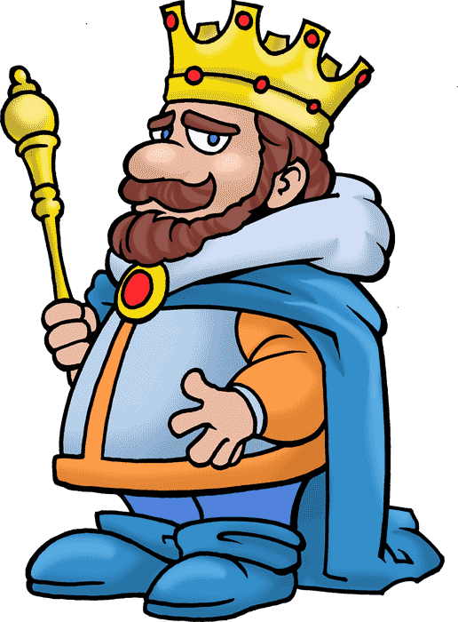
Declaration of Independence
7/4/1776
Declares independence
Grievances
Unalienable Rights
Life, Liberty, and the Pursuit of Happiness
Thomas Jefferson
“All mean are created equal”

Slide 5
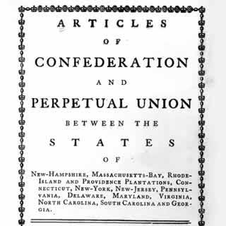
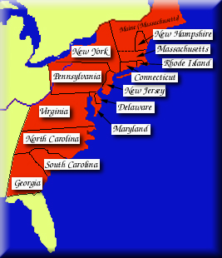
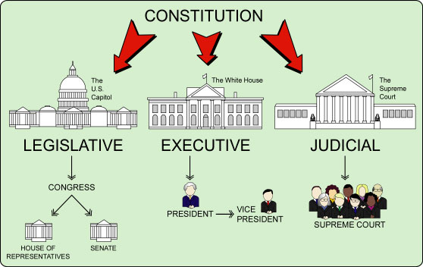
Declaration of Independence
7/4/1776
Declares independence
Grievances
Unalienable Rights
Life, Liberty, and the Pursuit of Happiness
Thomas Jefferson
“All mean are created equal”
Articles of Confederation
First US Government (1781-1789)
Weak National Gov’t
Strong State Gov’t
1
2
US
Constitution
Articles of Confederation

Slide 6
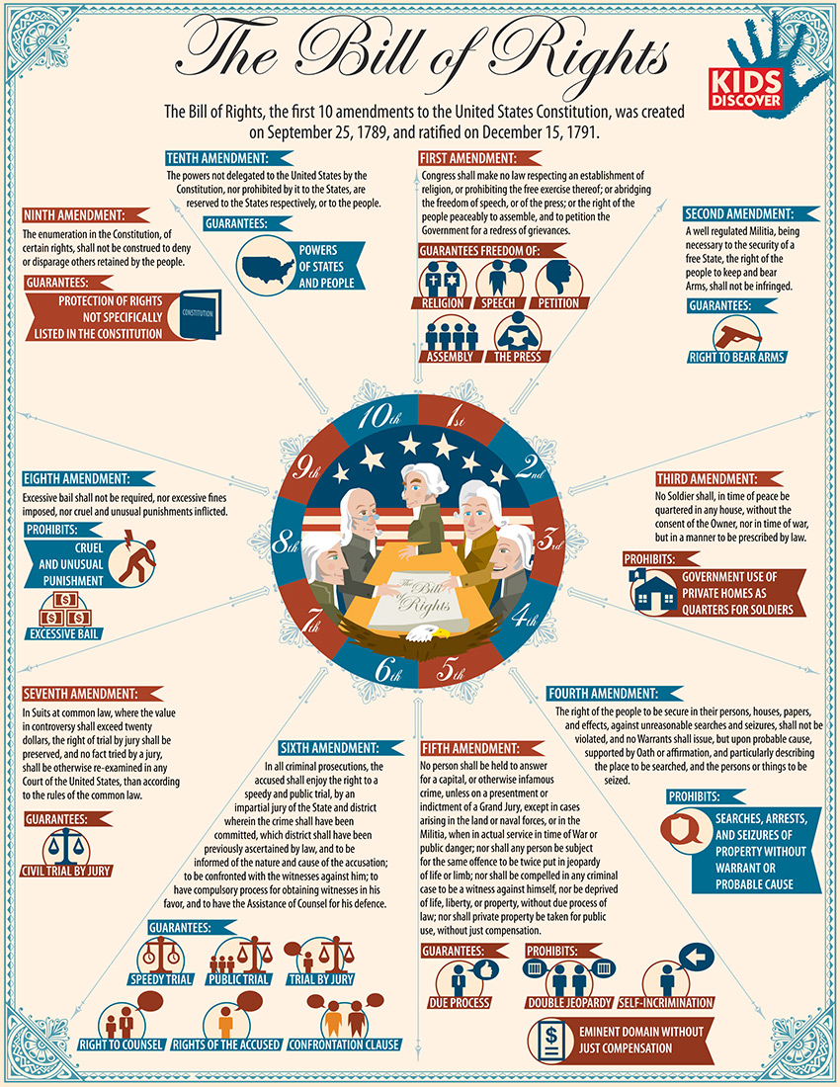
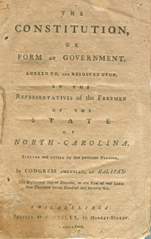
Bill of Rights
1791
1st 10 amendments of the US Constitution
Gov’t must protect your rights
Lists the specific rights
NC Constitution
1776
Basic Government
1868
Post Civil War
Bunch of new amendments
Poorly written
1971
Rewrite NC constitution

Slide 7
Your Assignment
Write Down YOUR IDEAS
So they can spread
So they can be saved
15 minutes
Write your thoughts, beliefs, ideas on anything
Government, family, school, friends, religion, economics, art, LIFE
Do NOT discuss people individually
I will collect – We will analyze the documents at the end of the year
http://www.youtube.com/watch?v=jiyIcz7wUH0

