Slide 1
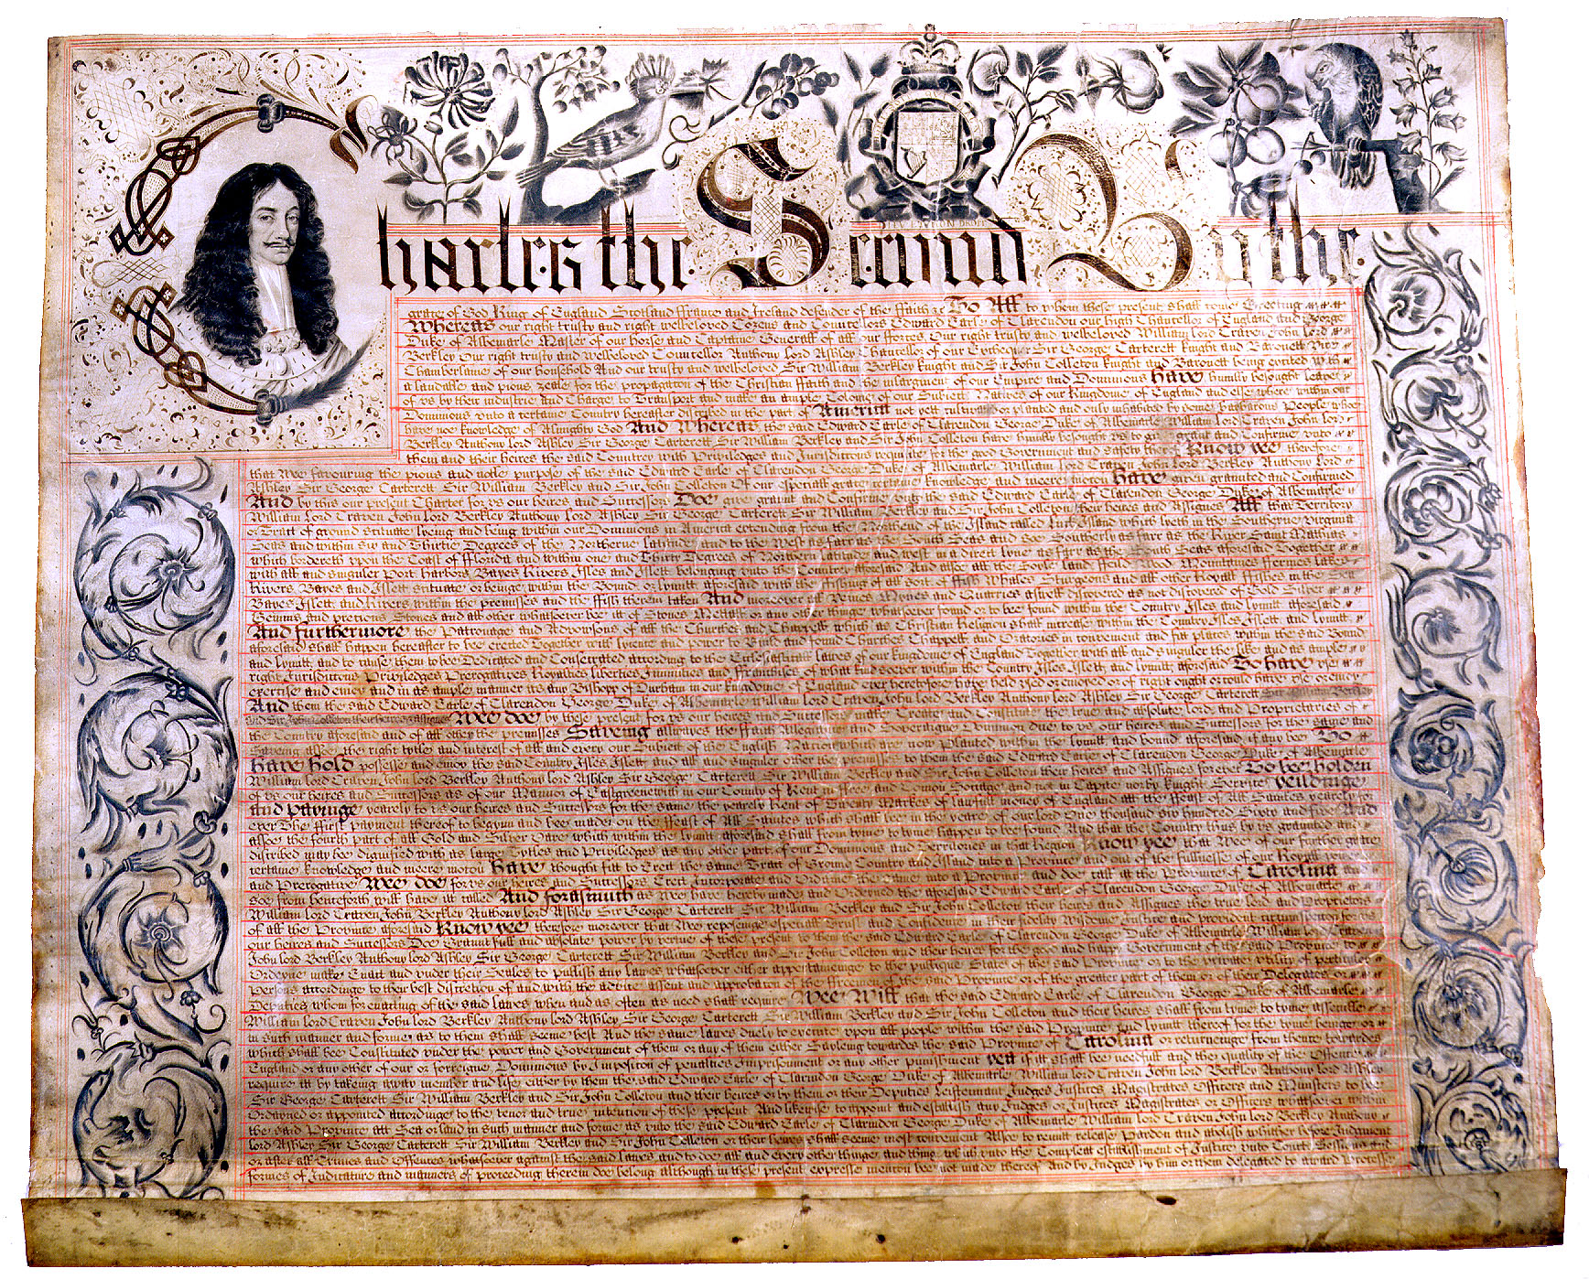
RULES and GOALS

Slide 2
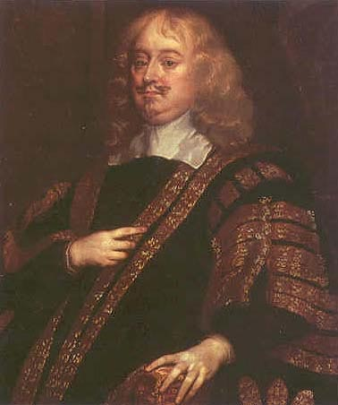
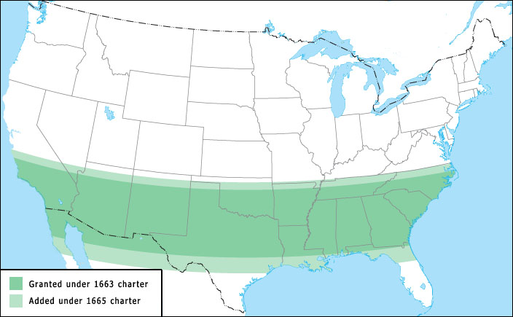
Proprietor = Business Owner

Slide 3
+$99,000
-$1,000
+$1,000

Slide 5
