Slide 1
Mr. D’s Erie Canal Simulation Game
www.socialstudiesgames.us

Slide 2
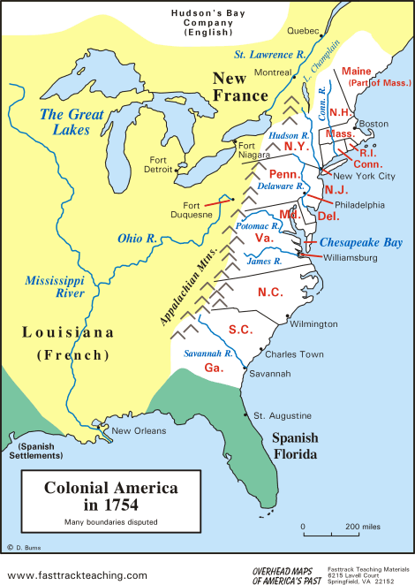


Slide 3
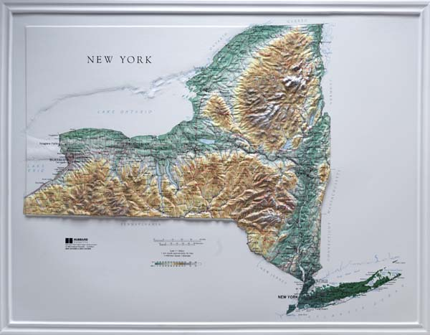

Slide 4
Mountains Chance Card
1
2
3

Slide 5
Mountains Chance Card
#1
Mountains Chance Card
#2
Mountains Chance Card
#3
Mountains Chance Card
#4
Mountains Chance Card
#5
Mountains Chance Card
#6
Mountains Chance Card
#7
Mountains Chance Card
#8
Mountains Chance Card
#9
Mountains Chance Card
#10
Mountains Chance Card
#11
Mountains Chance Card
#12

Slide 6
Mountains Chance Card
#1
Mountains Chance Card
#2
Mountains Chance Card
#3
Mountains Chance Card
#4
Mountains Chance Card
#5
Mountains Chance Card
#6
Mountains Chance Card
#7
Mountains Chance Card
#8
Mountains Chance Card
#9
Mountains Chance Card
#10
Mountains Chance Card
#11
Mountains Chance Card
#12

Slide 7
Mountains Chance Card
#1
Mountains Chance Card
#2
Mountains Chance Card
#3
Mountains Chance Card
#4
Mountains Chance Card
#5
Mountains Chance Card
#6
Mountains Chance Card
#7
Mountains Chance Card
#8
Mountains Chance Card
#9
Mountains Chance Card
#10
Mountains Chance Card
#11
Mountains Chance Card
#12

Slide 9
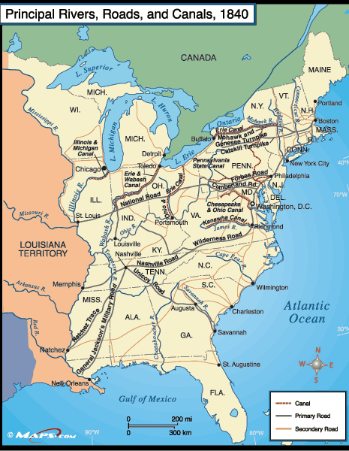
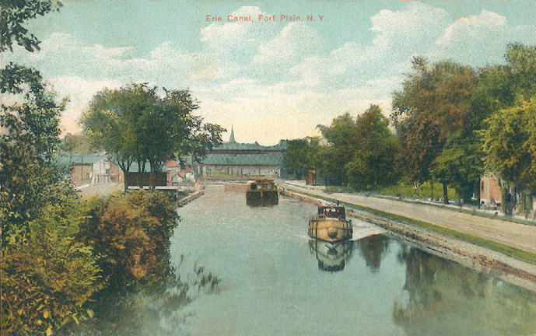
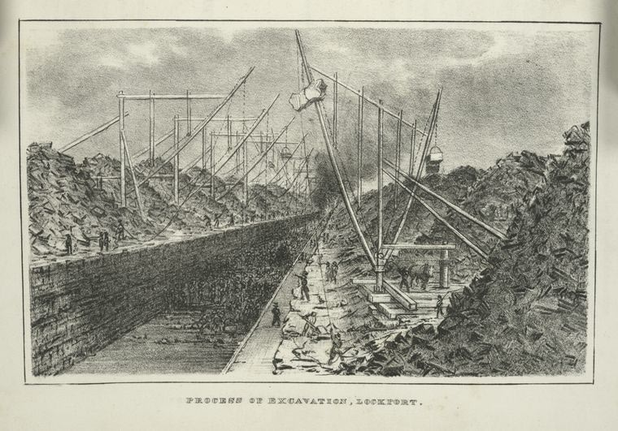

Slide 10

Dynamite Disaster!
Move Back One Space
Back to Map

Slide 11
All is well.
Stay where you are
Back to Map

Slide 12
Everything is going as planned!
Stay where you are
Back to Map

Slide 13
Animals are too tired and work slowly.
Lose a turn.
Back to Map

Slide 14
You are ahead of schedule!
Move ahead one space
Back to Map

Slide 15
Dynamite Disaster!
Move Back One Space
Back to Map

Slide 16
Moving excavated soil takes longer than you expected.
Move Back Two Spaces
Back to Map

Slide 17
Construction halts! Malaria has spread among the workers.
Lose next turn
Back to Map

Slide 18
The animals worked hard today.
Move ahead a space
Back to Map

Slide 19
All is well.
Stay where you are
Back to Map

Slide 20
German Masons invent a early bulldozer
Move ahead two spaces
Back to Map

Slide 21
All is well.
Stay where you are
Back to Map

