Slide 1
What is Culture?
the customs, arts, social institutions, and achievements of a particular group.
Custom
Traditions, common repeated practice, beliefs
Social Institutions
Organization that deals with government, religion, education, economics and family

Slide 2
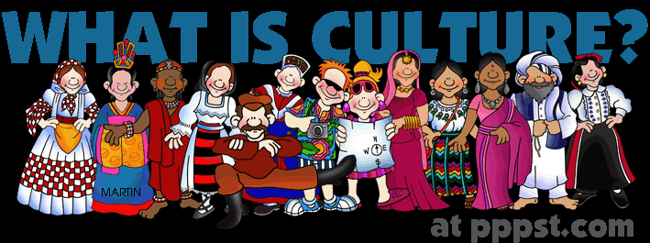
Main Point of our Culture Unit:
What does a specific group believe?
Why do they believe this?

Slide 3
8.C.1.1 Explain how influences from Africa, Europe, and the Americas impacted North Carolina and the United States
Columbian Exchange
the decline of the American Indian populations
The student will know:
The various cultural practices, values and belief systems:
American Indians before contact with Old World
that Africans and Europeans brought to the Americas.
American Indians influence the way of life of Africans and Europeans
http://ncss2014.weebly.com/videos-culture.html

Slide 4
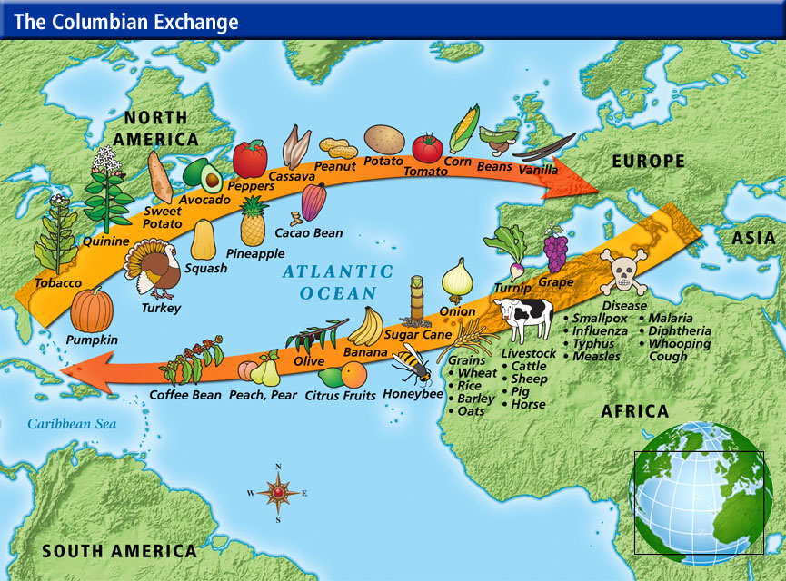

Slide 5
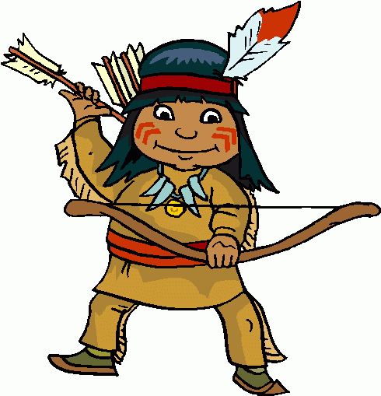
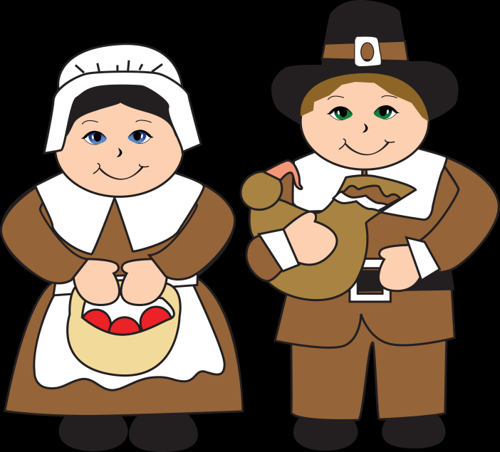
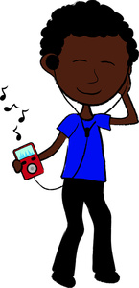
Before Old World
http://ncss2014.weebly.com/videos-culture.html

Slide 6
8.C.1.2 Summarize the origin of beliefs, practices, and traditions that represent various groups within North Carolina and the United States
Moravians
Scots-Irish
Highland Scots
Latino
Hmong
African
American Indian
Use the internet to –
Tell me who they are and some of their beliefs?
Why are they in NC?
Answer on a sheet of paper
Tip - Google Search: “Hmong in NC”

Slide 7
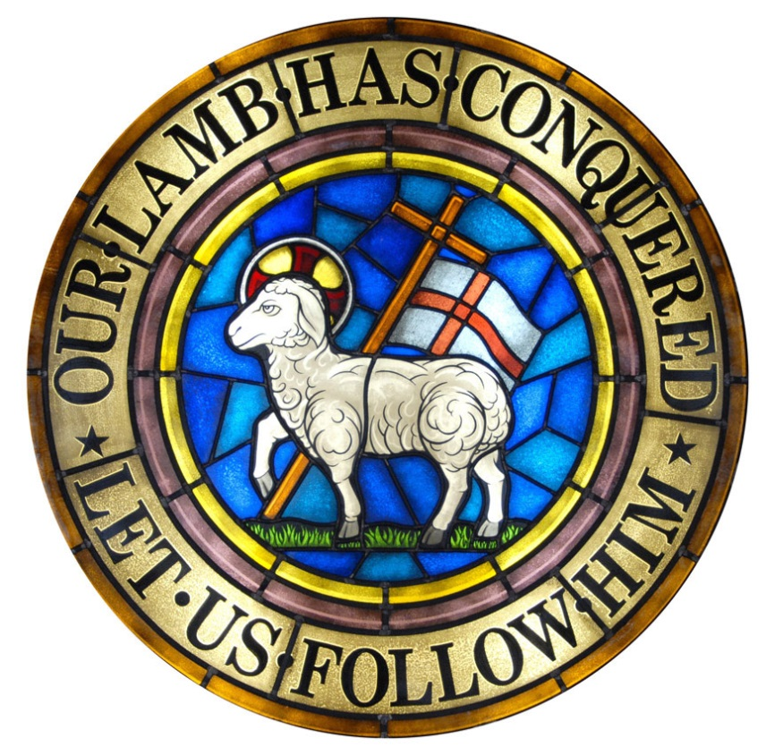
Moravians
What are some of their beliefs?
Protestants
Why NC?
Religious Freedom
Convert American Indians

