Slide 1
Benchmark wed 10/8
Topic | # of questions
Constitutional Compromises | 5
Constitution | 7
1800s Geography | 4
1800 Foreign Policy | 2
Innovation | 1
1800s Economics | 4
President Jackson | 3
Marbury V. Madison | 1
States' Rights | 1
Topic | # of questions
exploration | 1
French-Indian War | 1
Colonial Geography | 4
Colonial Economics | 2
colonial government | 2
British Oppression | 5
Declaration of Independence | 5
Articles of Confederation | 1

Slide 2
Benchmark #1 (Unit 1-2 topics)
Proclamation line
Columbian Exchange
French & Indian War Result
North and South Geography
Mercantilism
House of Burgesses = Representative Gov’t
What does a representative gov’t do?
Navigation Acts
Who migrates?
Boston Tea Party
Britain could not control the colonists
Consent of the Governed
Endowed by their creator
All men are created equal
Declare independence
7/4/1776

Slide 3
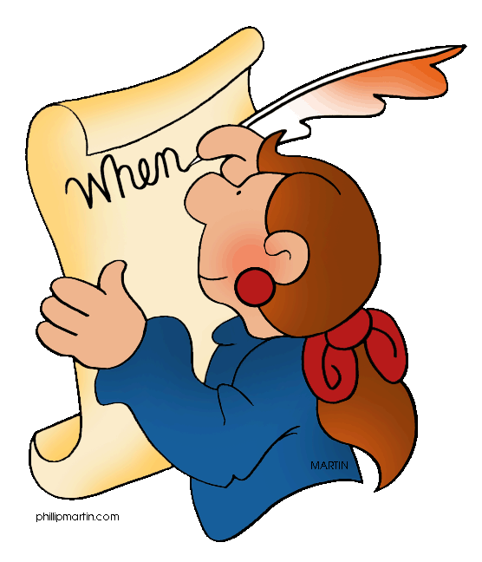
Declaration of Independence
“Consent of the Governed”
“Endowed by their creator”
“All men are created equal”
“Declare independence”
7/4/1776

Slide 4
Declaration of Independence
In America everyone is equal except…
The poor
African-Americans
Women
American Indians
Today we are very close to this statement
Then – not so much
We hold these truths to be self-evident, that all men are created equal, that they are endowed by their Creator with certain unalienable Rights, that among these are Life, Liberty and the pursuit of Happiness.--That to secure these rights, Governments are instituted among Men, deriving their just powers from the consent of the governed, --That whenever any Form of Government becomes destructive of these ends, it is the Right of the People to alter or to abolish it
Who gave you rights?
God gave you rights when you were born – not the gov’t, or the king
Where does gov’t power come from?
The governed – or the PEOPLE. We give our consent – or permission for the government to rule.

Slide 5
1620 – The Mayflower sailed from Plymouth, England, with 120 Pilgrims on board
1628 – Puritans arrived in Salem and establish the Massachusetts Bay Colony
1634 – Catholics traveled to Maryland on the ships Dove and Ark
1682 – William Penn, a Quaker, established the colony of Pennsylvania
1683 – Thirteen German Mennonite families settled in Pennsylvania
1737 – Twenty-one Amish families traveled from the Netherlands to Philadelphia
Which statement is best supported by this information?
A. Most colonists who settled in America came because of religious reasons.
B. Europeans facing religious persecution sought freedom in the American colonies.
C. The American colonies succeeded only with the support of major religious groups.
D. Religious toleration was commonly practiced throughout colonial American societies.

Slide 6
The New England Colonies consisted of Connecticut, Rhode Island, Massachusetts, and New Hampshire. Colonists who settled in these colonies during the 1600s and1700s faced rocky soil and winter that were long and cold- conditions which kept farm sizes small. Much of the land was covered in forest, and the waters off the northern Atlantic coast were full of cod.
What economic activity succeeded the most in New England because of the region’s environmental characteristics?
A. coal mining
B. shipbuilding
C. cattle ranching
D. cash crop agriculture

