Slide 1
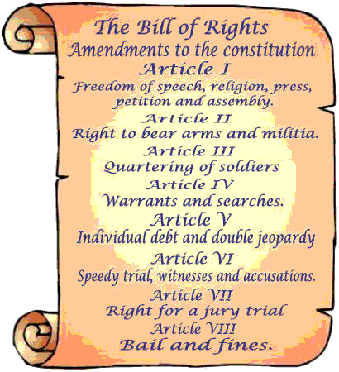
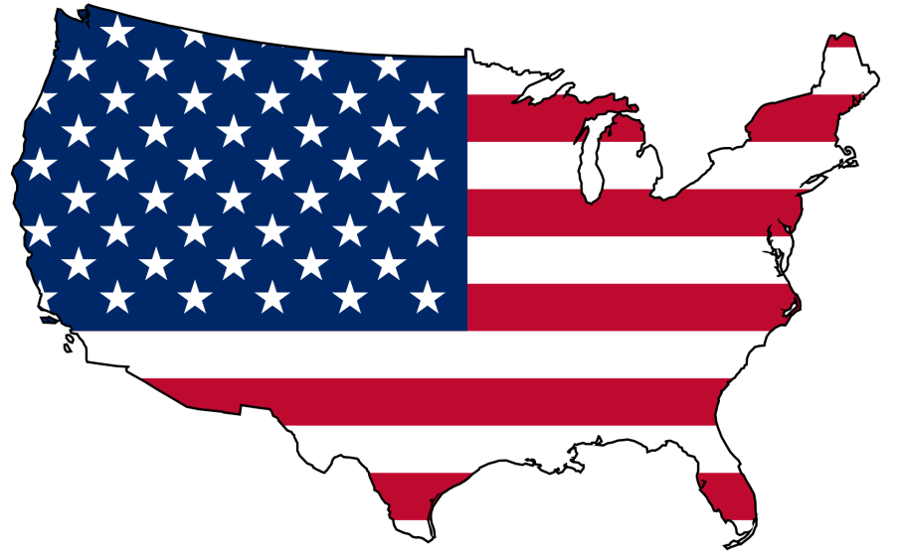
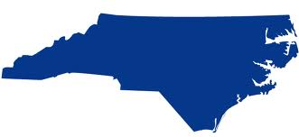
Federalists vs. Anti-Federalists
Hamilton (fed) v. Jefferson (A-F)
Nat’l Gov’t v. State Gov’t
During constitution ratification
Compromise:
Strong Nat’l Gov’t
Bill of Rights is written

Slide 2
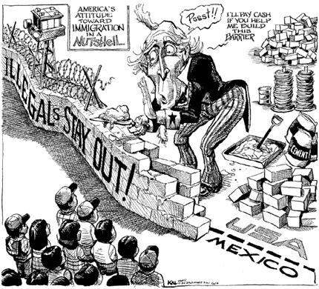
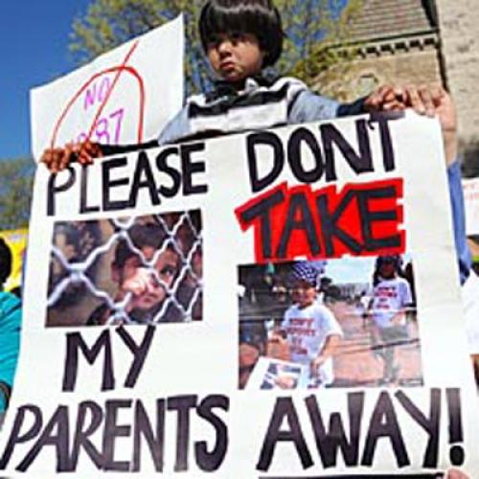
Immigration (view points)
Conservative – LEGAL only, the rest get out
Liberal – Amnesty (forgiveness) for all, everyone is a citizen

Slide 3
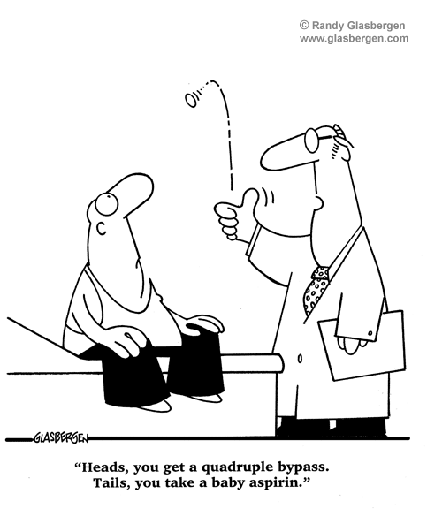
Healthcare
Liberal – Gov’t should provide it for everyone (high taxes)
Conservative – Buy your own (Low taxes)

Slide 4
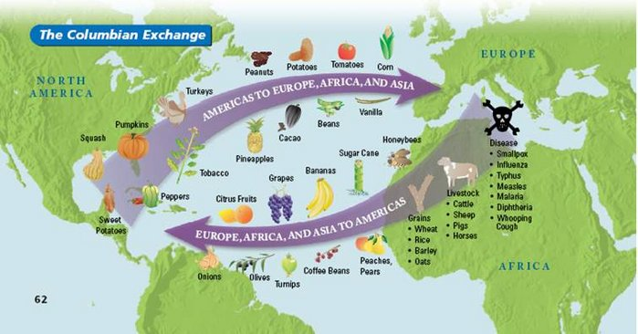
Columbian Exchange
After Pangea separates 200 million years ago…
Plants, Animals, etc. were isolated
Columbus arrives in 1492 – Old World and New World collide
Plants, animals, and diseases are exchanged

Slide 5
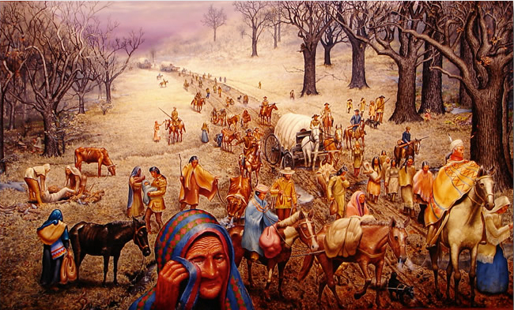
Decline of American Indians
Columbian Exchange – Small Pox (1500-1700)
American Colonists – Genocide (1700-1800)
Trail of Tears – Ethnic Cleansing (1830)
The West – Genocide (Post Civil War)

Slide 6
NC Ethnic Groups - is a social group of people who identify with each other based on common ancestral, social, cultural, or national experience
Moravians
Scots-Irish
Highland Scots
Latino
Hmong
African-American
American Indians

Slide 7
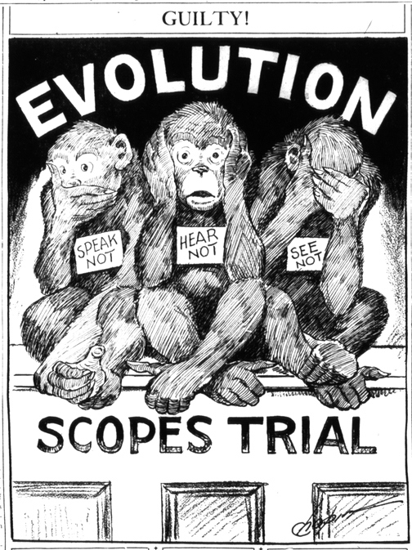
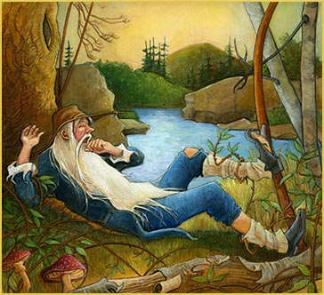
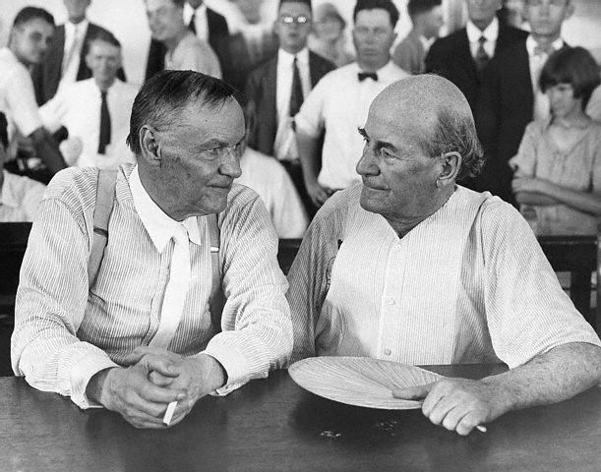
Education
Early 1800s (Rip Van Winkle state)
People want public education
Rich – do not want to pay, or lose any power
Teaching Evolution (1920s)
NC House of Representative write a bill – Ban teaching evolution
Does not pass
Scopes “Monkey Trial”
https://www.youtube.com/watch?v=S_DQUAuNUvw

