Slide 1

Limited Gov’t = Checks and Balances
Approves
Judges
Rule Laws
unconstitutional

Slide 2
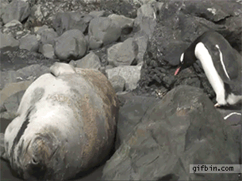
Legislative
Penguin
Approves
judges
Judicial
Seal

Slide 3
435
100
Checks:
Override Veto
Approves Budget
Approves Appointments
Impeaches President & Judges
Checks:
Vetoes laws
Force Congress to work (special session)
Appoints judges
Checks:
Judicial Review
Declare laws unconstitutional
Declare actions unconstitutional

Slide 4
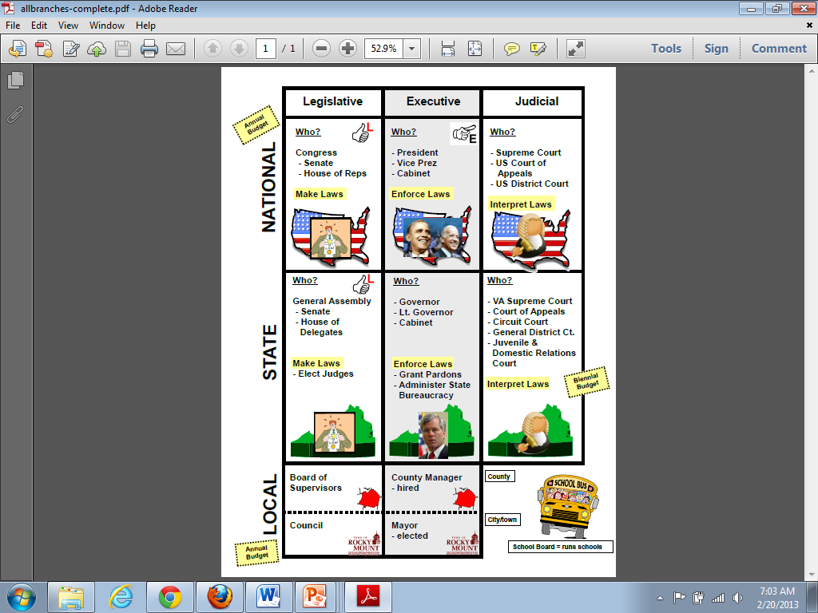
Separation of Powers
Federalism

Slide 5
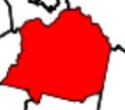
Federalism – Power Flows Down
POWER
POWER
POWER

Slide 6
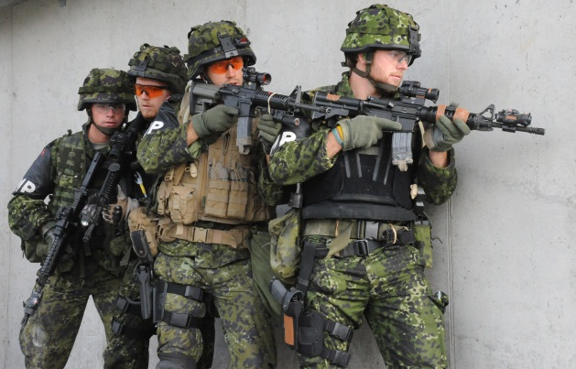
Federalism – division of power between state & national gov’t
POWER
POWER
POWER
national
state

Slide 7
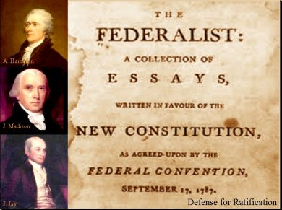
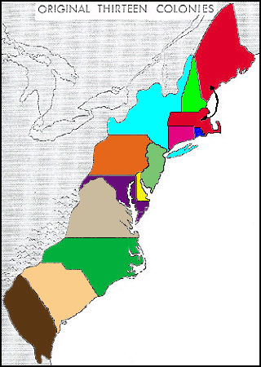
vs.

Slide 8
Federalism – Power Flows Down
POWER
POWER
POWER

Slide 9
Federalism – division of power between state & national gov’t
POWER
POWER
POWER
national
state

Slide 10
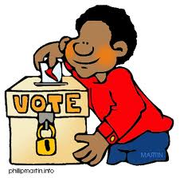
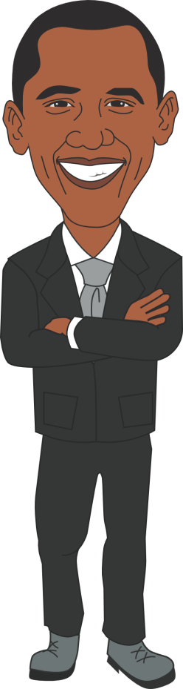
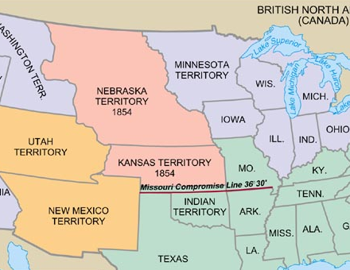
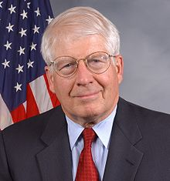
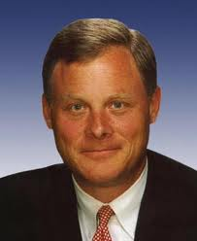
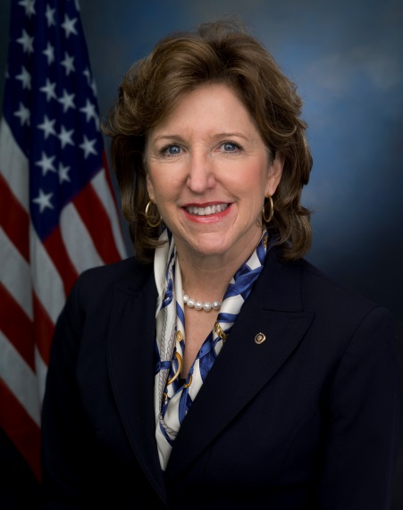
Popular Sovereignty
  People have the power
    Vote for Representatives
    Vote for Laws
Republicanism
  Representative Government
  We elect officials to vote for us

Slide 11
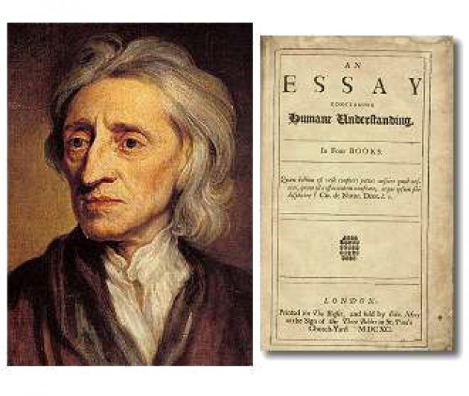
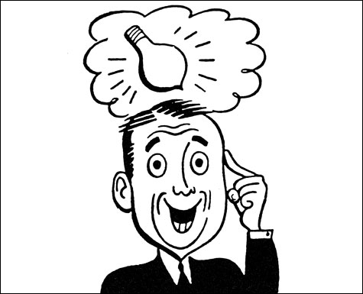
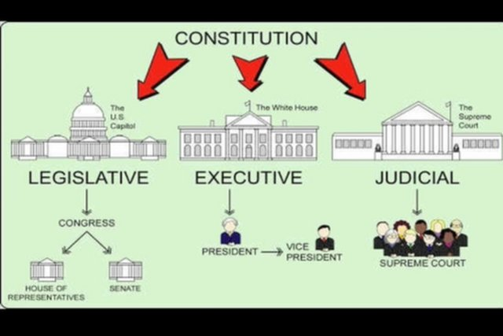
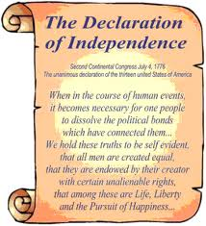
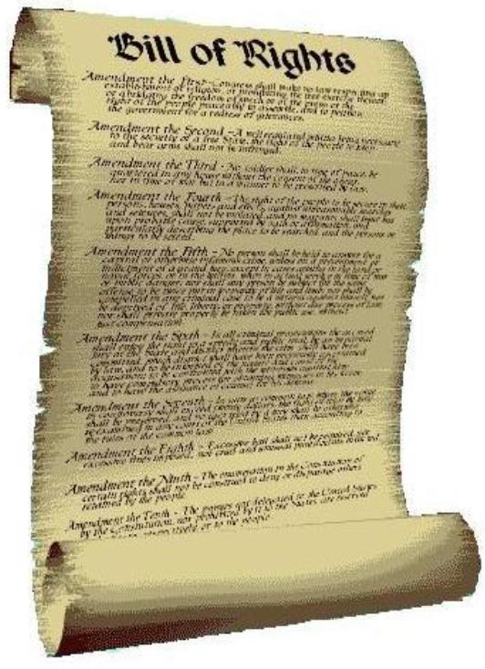
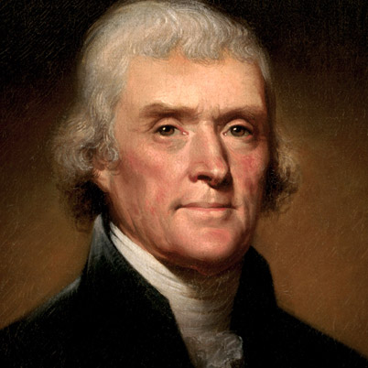

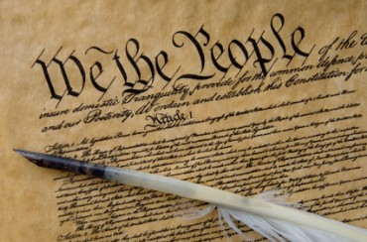
individual rights
  Everyone is born with rights
  Gov’t protects them
  John Locke
    Life, Liberty, and Property
  Thomas Jefferson
    Declaration of Independence
    Life, Liberty, and the Pursuit of Happiness
  US Constitution
    Bill of Rights (1st Ten Amendments)
NEW
Protect rights
duties
Answer the Question – Do Not Write

Slide 12
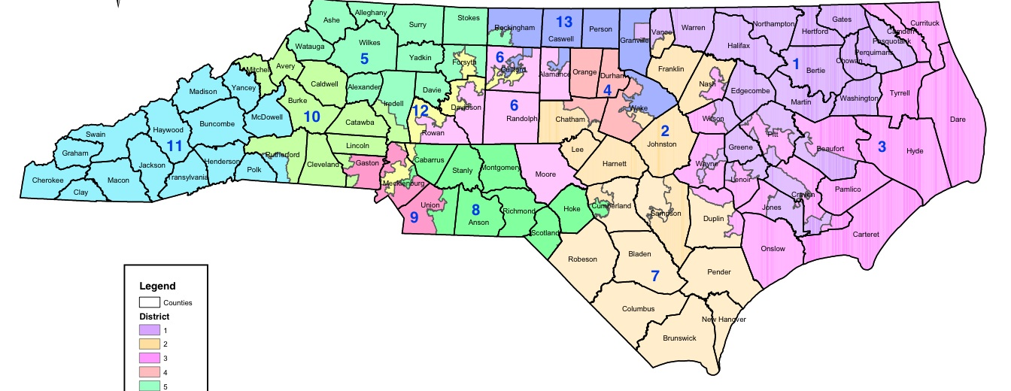

Representative Democracy or Republicanism
The People vote for Representatives
The Representatives make Laws to HELP the people

Slide 13
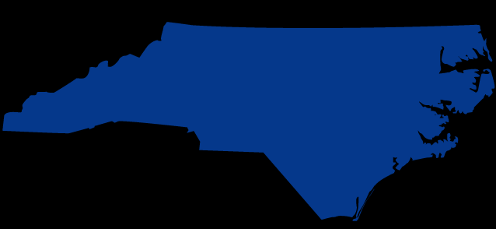

Direct Democracy
The People vote on EVERY decision
All 10 Million NC citizens vote

Slide 14
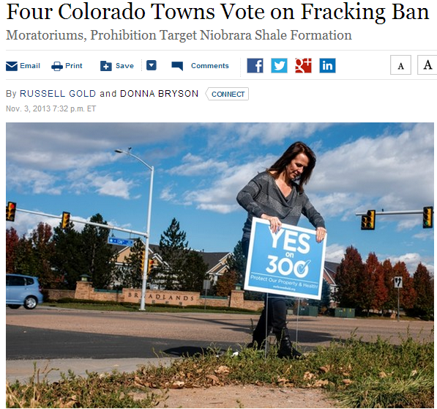
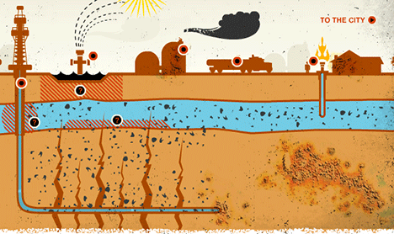
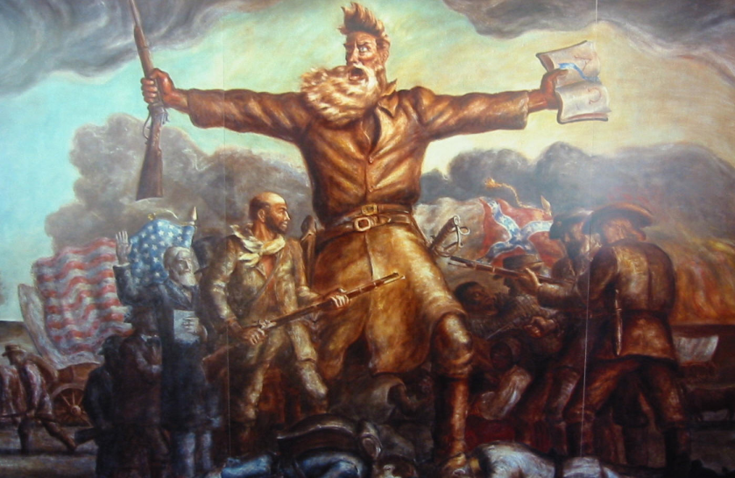
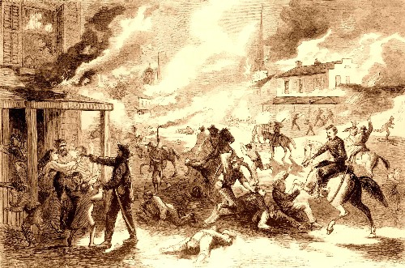
Popular Sovereignty
  People have the power
    Vote for Laws

