Slide 1
Day 7

Slide 2
Documents!
Rules
Laws
Rights
Contract
Treaty

Slide 3
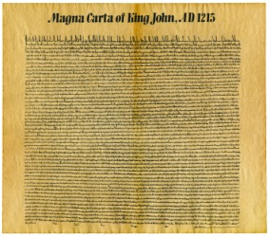
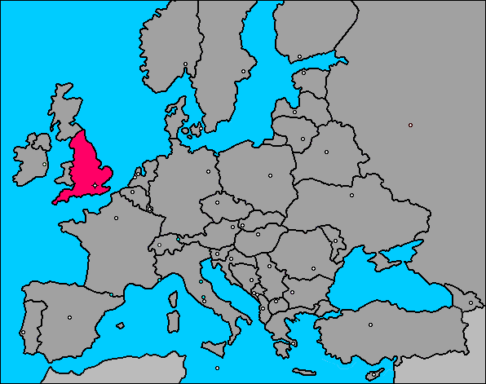
Magna Carta
1215
Limits the King’s Power
Right to Prosper (Succeed)

Slide 4
English Bill of Rights
William & Marry will follow the Magna Carta
Parliament has power:
Write Laws & Tax
People have Rights (speech, jury trial, etc)
Outlawed Cruel & Unusual Punishment

Slide 5
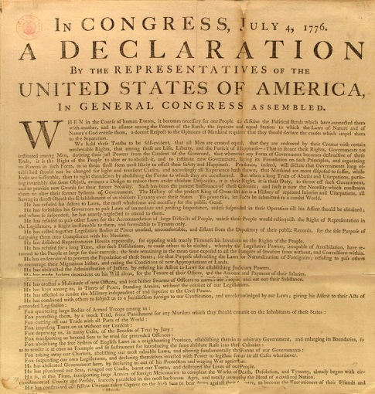
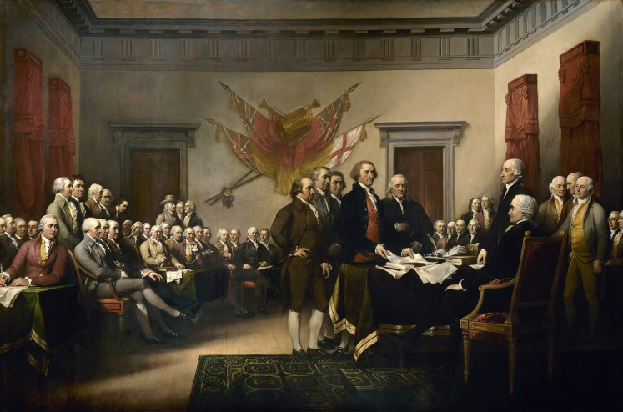
Declaration of Independence
Declares the Colonies independence from England
People are equal
Gov’t must protect our unalienable rights
Life, liberty, & pursuit of happiness
People are allowed to overthrow a tyrannical Gov’t

Slide 6
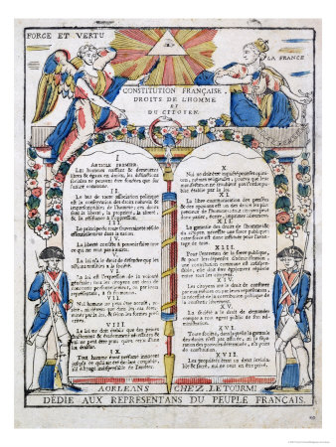
French Declaration of the Rights of Man
Power from the People
People have rights
People are equal

Slide 7
Day 8 – French Revolution
Revolution Review
English people want rights & power in Gov’t
Overthrow Gov’t (several times)
Gov’t agrees to protect their rights
American Colonists want rights & power in Gov’t
Declare independence, go to war, win!
Start NEW gov’t and Nation
Gov’t protects their rights

Slide 9
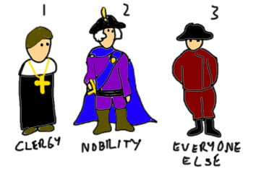
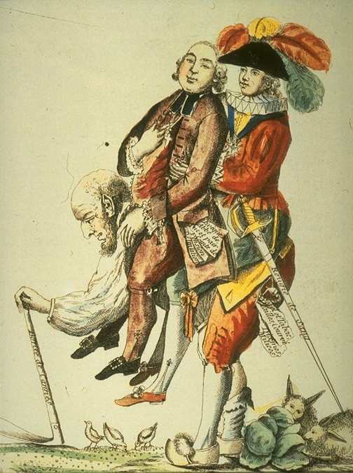

Slide 10
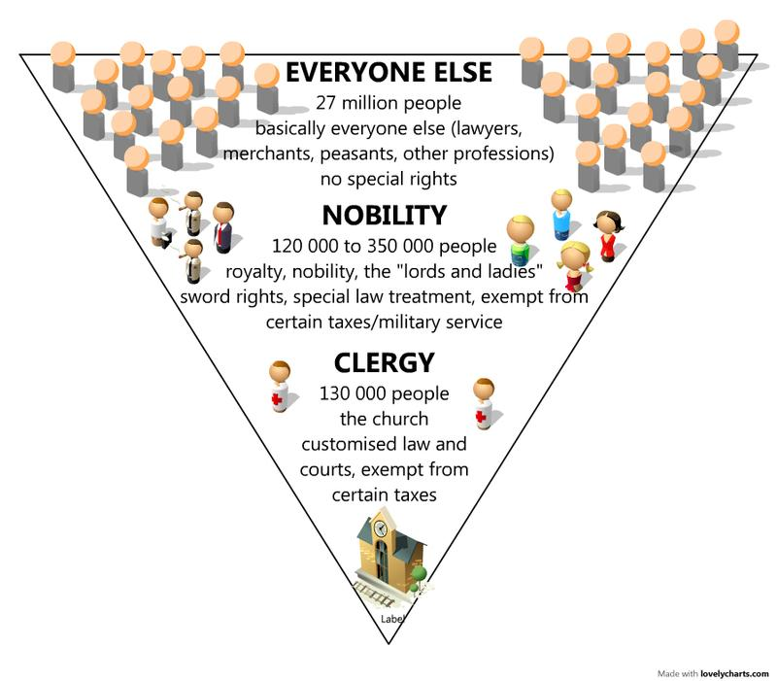
3rd estate
2nd estate
1st estate

Slide 11
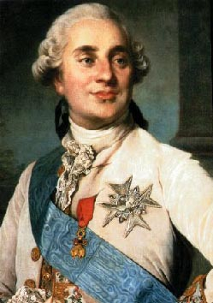
French Gov’t

Slide 12
We want rights, and to limit your power.
No!

Slide 13
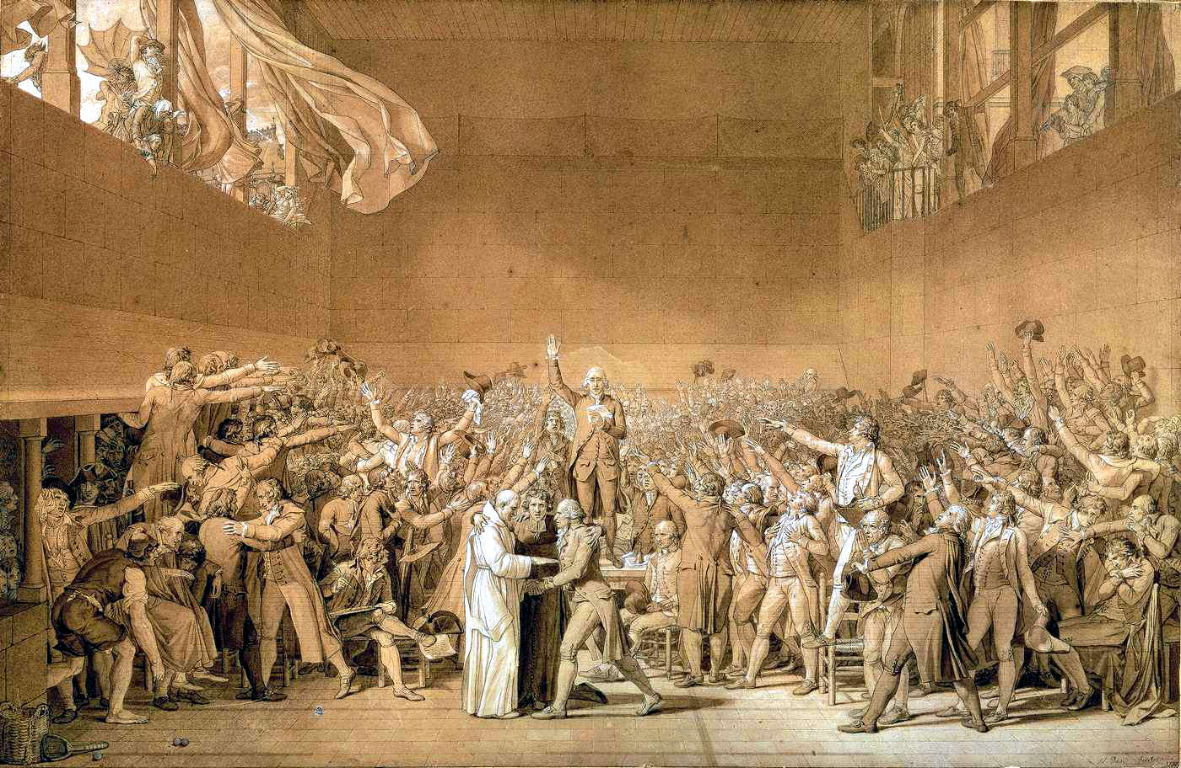
Tennis Court Oath
We must pledge to work together against the King, Clergy, and Nobles.
We will call our group “The General Assembly.”

Slide 14
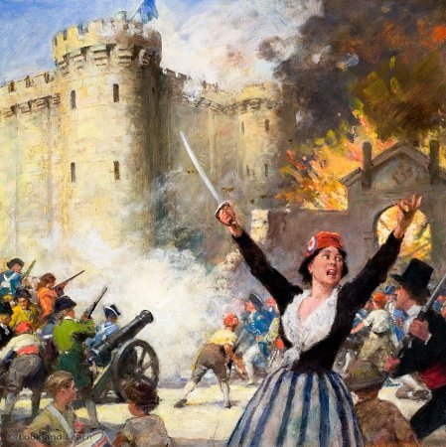

Slide 15
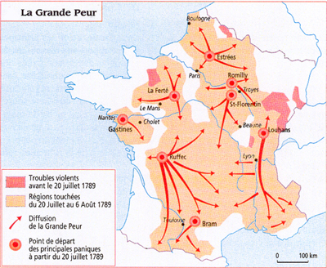
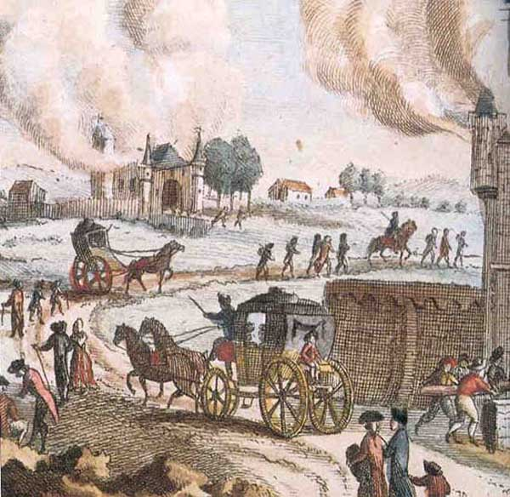
The Great Fear

Slide 16
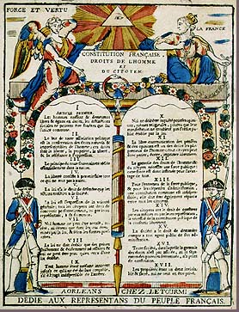
We want rights
Ok.

Slide 17
Reign of Terror
We’re in control now!
Girondins
Jacobins
Want
- Get rid of the King
- Don’t want to rule
Want
- Keep the King
- Want to rule
16,594

