Slide 1
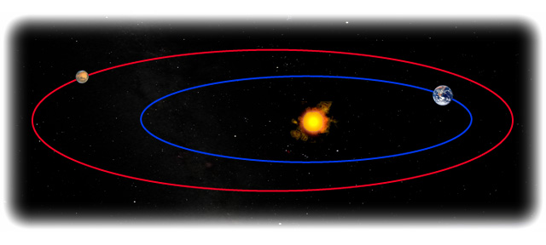
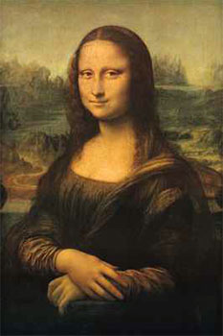
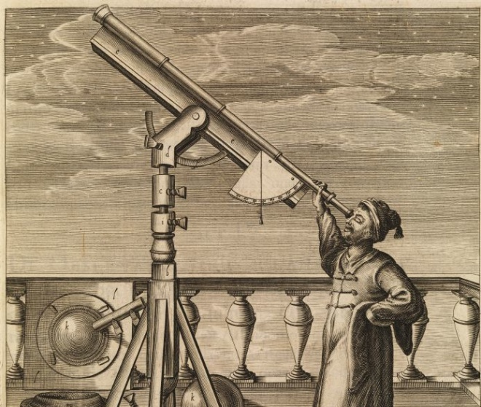
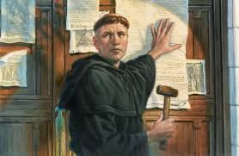
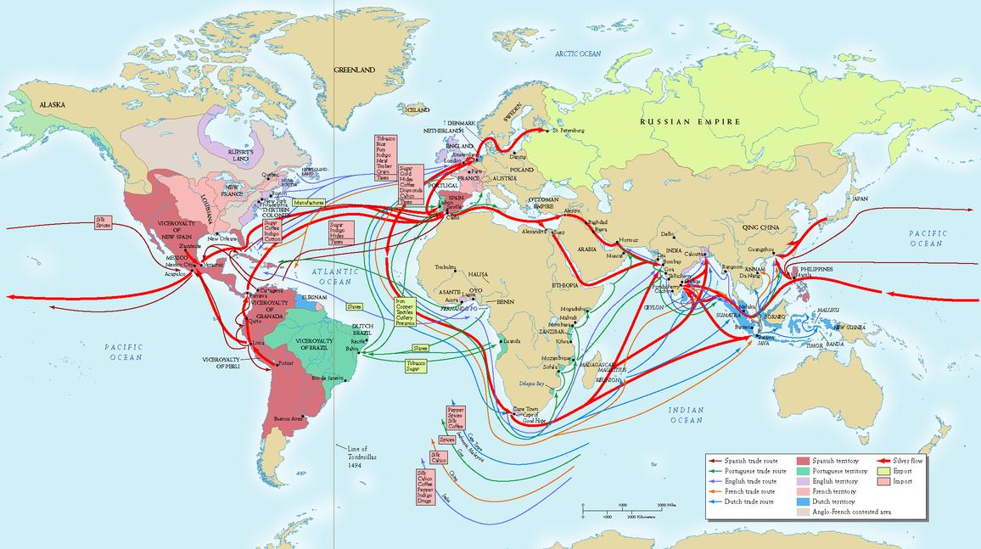

Change in Europe
Renaissance – Art and Lifestyle
Reformation – Religion
Scientific Revolution – Science
Voyages of Discoveries – New Land and Goods
NOW…
  The Enlightenment
    Government and Society

Slide 2
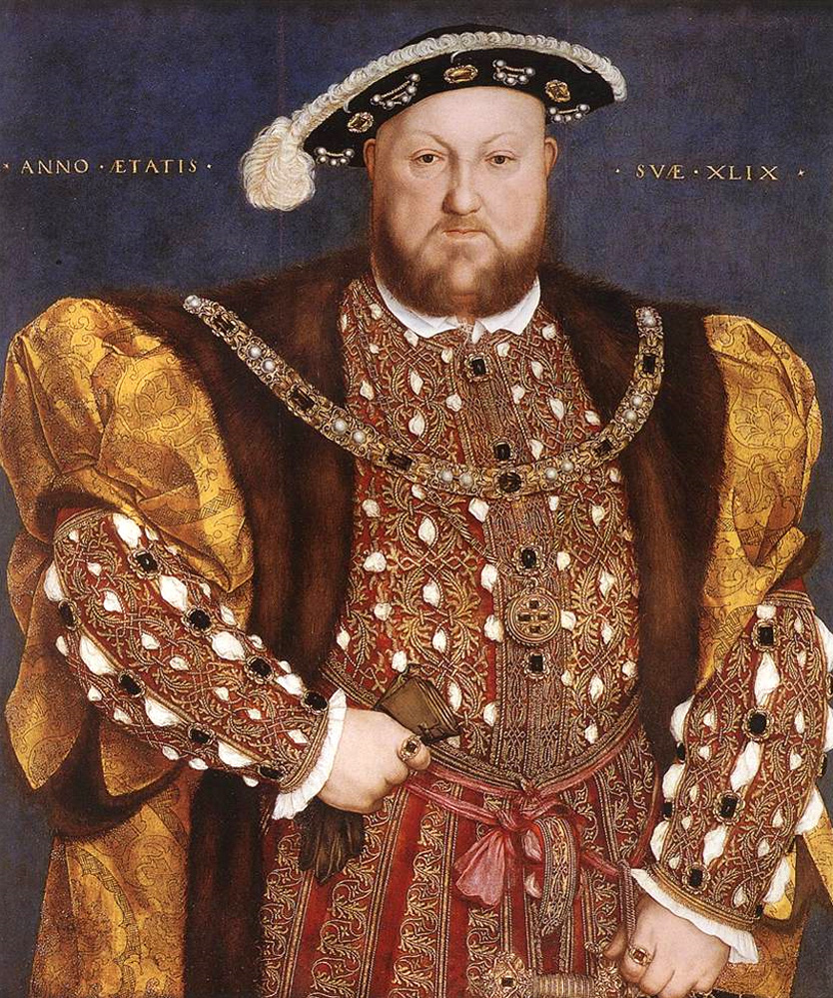
Monarchy
Kings runs the government

Slide 3
Enlightenment
Reason and Logic > Religious teachings
With human reason you could achieved
  Knowledge
  Freedom
  Happiness
    Improve Society

Slide 4
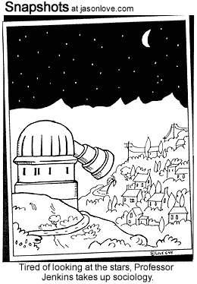
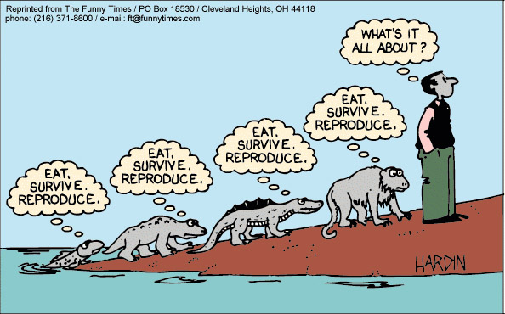
Enlightenment – Age of Reason
What did they think about?
How did the use their reasoning skills?
  Philosophy
    Study Reality, existence, reason, etc.
  Society
    Organized groups of people
  Politics
    Government

Slide 5
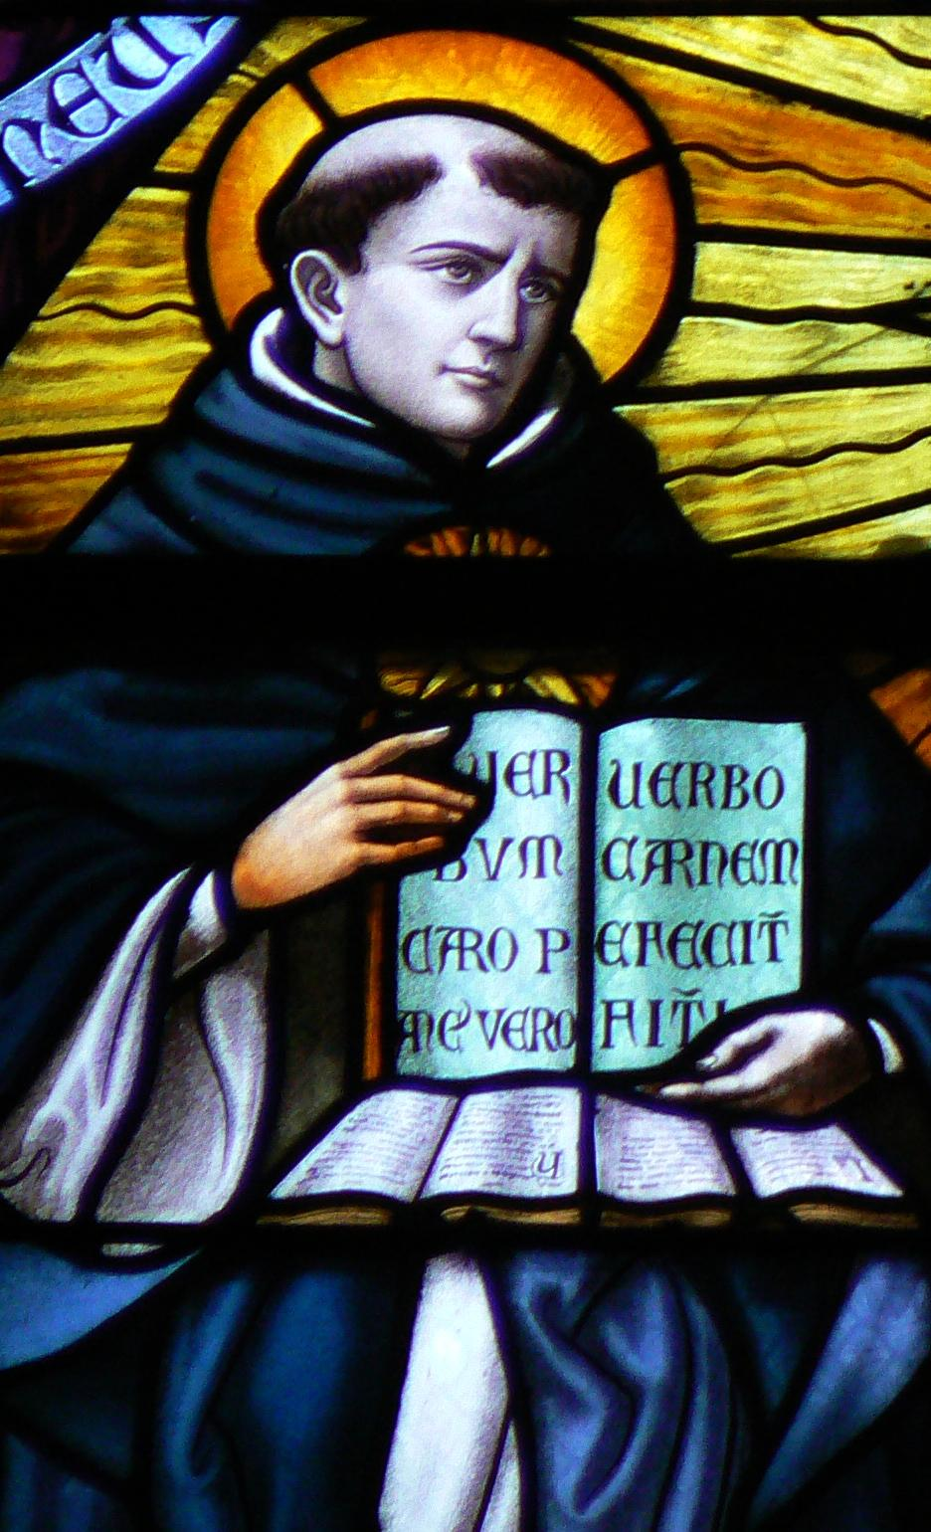
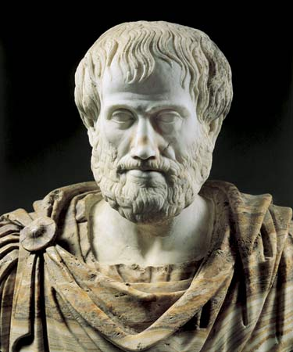
Enlightenment
Roots
  Greek and Roman Philosophers
    Aristotle – Used logic to discover new truths
    Roman philosophers – The world is based on laws
  Christianity
    Thomas Aquinas
      Combination of Faith and Reason to explain the world
  Not many listened to him – It’s a Secular Movement
    Non-religious

