Slide 1
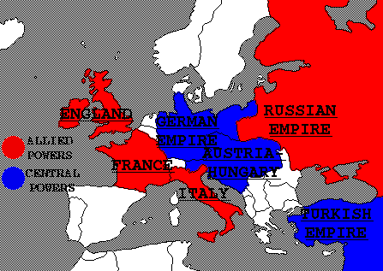
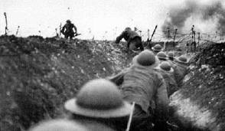
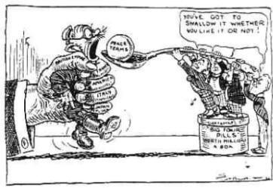
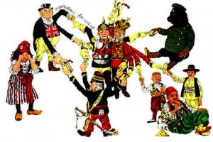
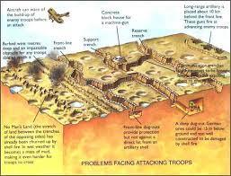
World War I Review
Causes
Alliances, Nationalism, Imperialism, Militarism
War
Trench Warfare
Technology
Bloody Stalemate
Result
Treaty of Versailles
Flawed Peace
Punish Germany
US doesn’t join the League of Nations

Slide 2
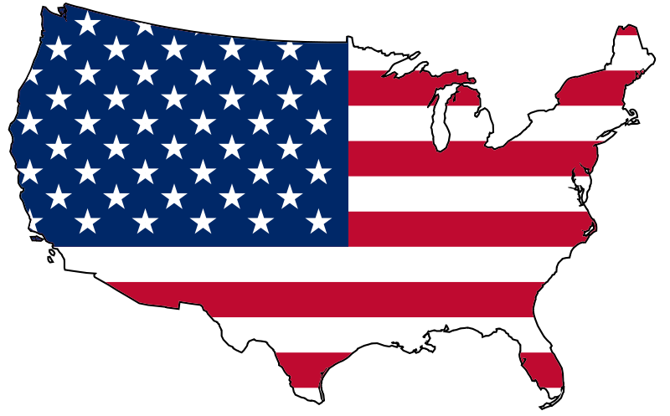
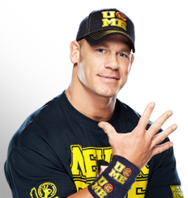
WWI = WWE
United States
Heroes
Save the Day
Help Allied Powers win
John Cena
Hero
Always wins
Helps others out

Slide 3
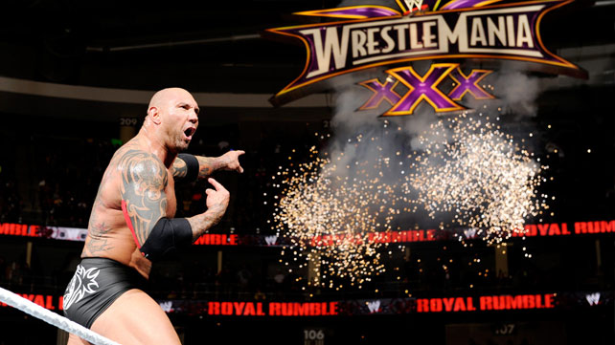
WWI = WWE
Germany
#1 opponent against Allied Powers
Blamed for the war
World hates Germany
Batista
#1 opponent for the WWE title
Blamed for CM punk quitting
Fans hate Bautista

Slide 4
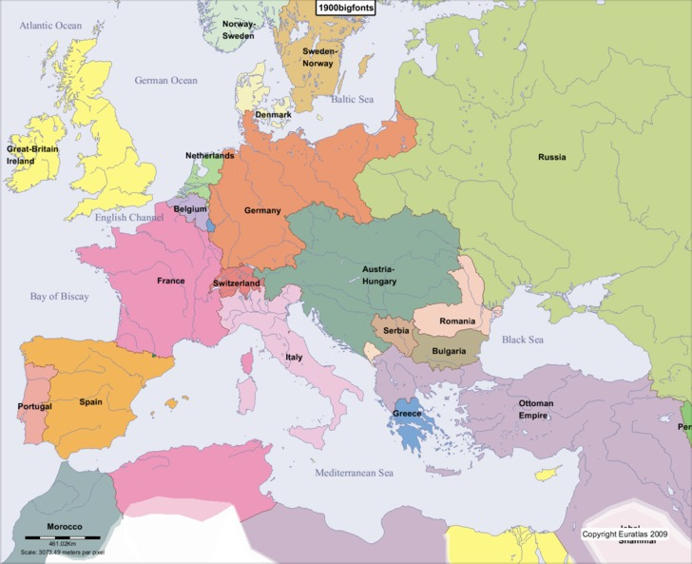
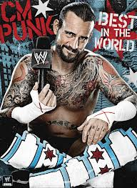
WWI = WWE
Russia
Sacrificed the most
Quit the war
CM Punk
Sacrificed a lot to build the WWE
Quit the WWE

Slide 5
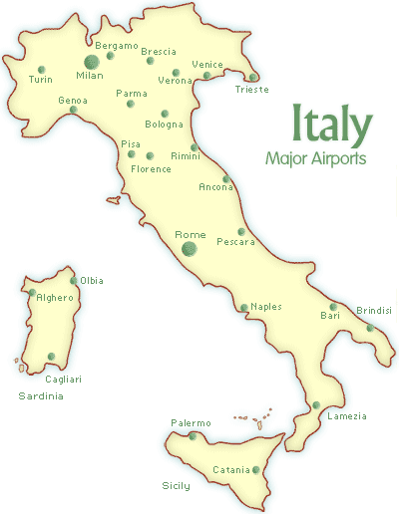
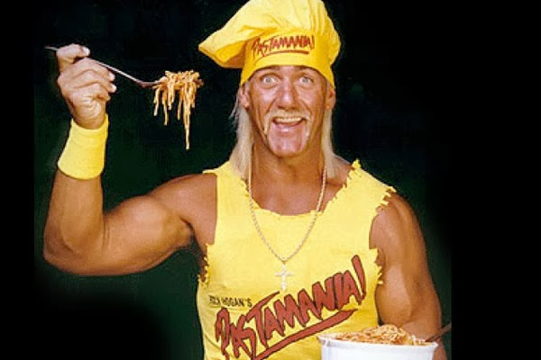
WWI = WWE
Italy
One of the oldest European Powers
Winner, but not that involved
Switched side
Hulk Hogan
Been in WWE for 30 years
Big time winner, but not that involved anymore
Used to be a bad guy with the NWO

Slide 6
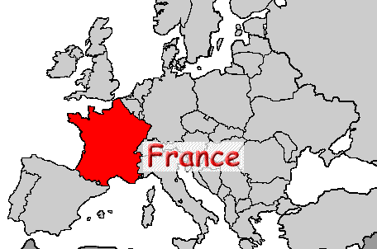
WWI = WWE
France
Get beat up a lot during war
Almost lose the war twice
In the end, they win
Daniel Bryan
Gets attacked a lot
Nearly loses a lot
In then end, he wins

Slide 7
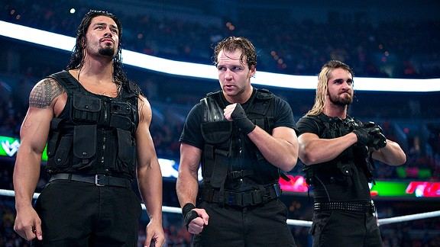
WWI = WWE
Austria-Hungary
Tried to pick on the smaller Serbia
In the end, they lose the war
The Shield
Pick on weaker opponents (3 on 1)
In the end, they lose a lot of matches

Slide 8
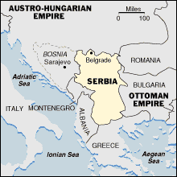
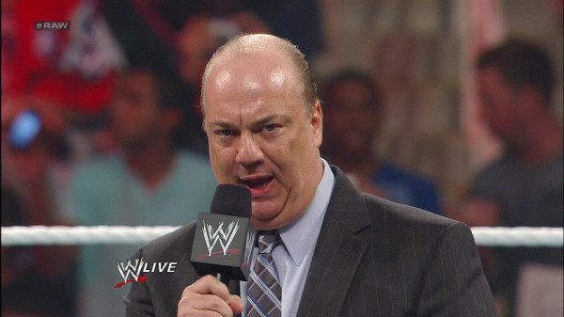
WWI = WWE
Serbia
Small, weak country
Doesn’t want to fight
Stirs things up, and starts WWI
Paul Heyman
Weak, couldn’t beat up anyone
Always runs from fights
Always stirs things up, and starts fights

Slide 9
WWI = WWE
Analogies
Alliances
Alliances drag other people into fights
Militarism – They glorify fighting
Nationalism – Everyone thinks they’re the greatest
In the end, fights solve nothing, they will fight again

