Slide 1
Social Studies – EOG Test Topics
7.H.2.1: Analyze the effects of social, economic, military and political conflict among nations/regions/groups
War
Genocide
Imperialism
Scramble for Africa,
West in China & Japan
Colonization
British in India
Exploration and colonization of America
Key Concepts
Genocide
Scarcity
Imperialism
Ethnic Cleansing
Isolationism
Refugees

Slide 2
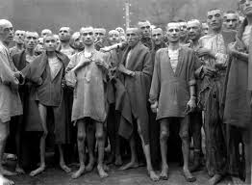
Concepts
Genocide:
the deliberate and systematic destruction, in whole or in part, of an ethnic, racial, religious, or national group

Slide 3
http://endgenocide.org/learn/past-genocides/
http://en.wikipedia.org/wiki/Genocides_in_history

Slide 4
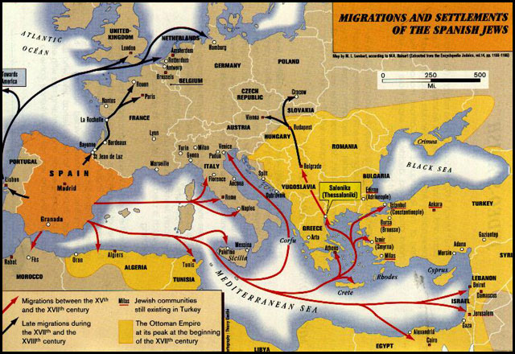
Concepts
Ethnic Cleansing:
Similar to Genocide, but…
Not complete extermination
Just want the group to leave the country
Murder is a common means
http://en.wikipedia.org/wiki/List_of_ethnic_cleansings

Slide 5
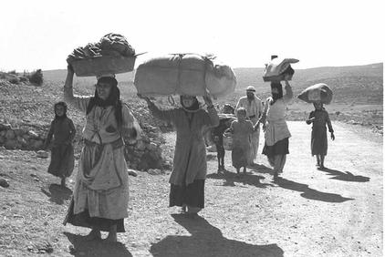
Concepts
Refugee:
One who flees in search of refuge, as in times of war, political oppression, or religious persecution.

Slide 6
Concepts
Scarcity
Inability to satisfy all wants at the same time
Resources and Good are limited
Choices must be made
Example: HDtv
2004 – Not many had an HDtv (scarce)
2011 – Everyone has an HDtv (not scarce)
Example: Natural Resources
Rare = Valuable
Nations will KILL for valuable resources
What are other things that are scarce?

Slide 7
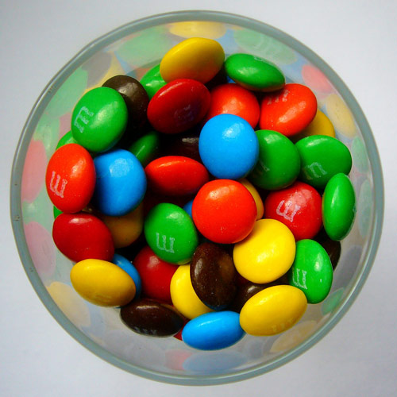
Which M&M is scarce?

Slide 8
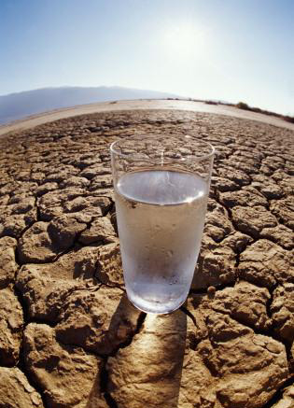
What is scarce?

Slide 9
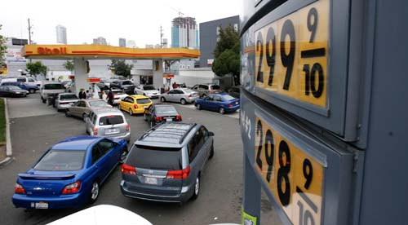
What is scarce?

Slide 10
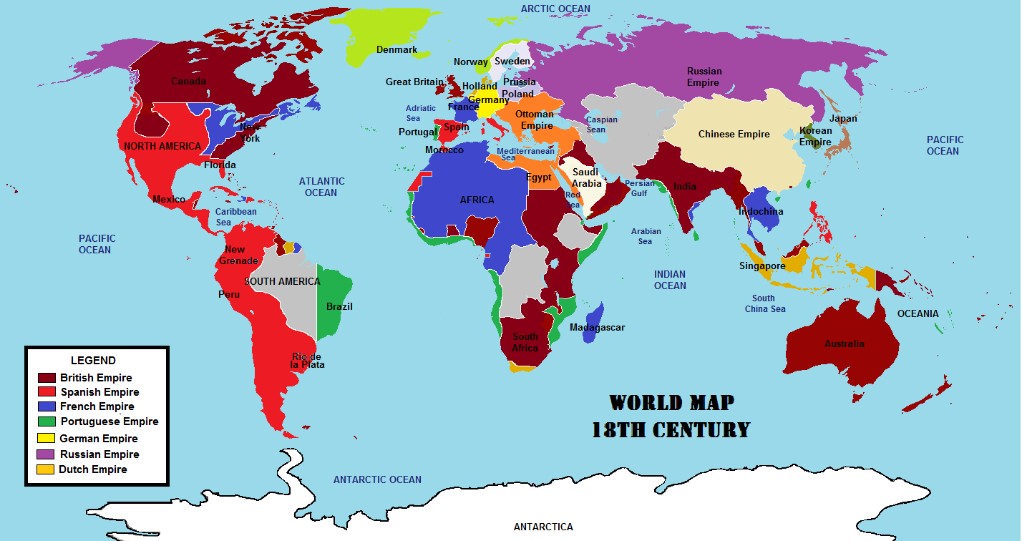
Scarcity and Imperialism are related

