Slide 1
Civics and Government - Concepts
Enlightenment
Reason as the primary source of legitimacy and authority
Scientific Revolution
Democracy
Republicanism
One-Man-One Vote
Equality
Liberalism
Rule of Law
Natural Rights of Man
Communism
Socialism
These are only a few of the government ideas that men and women have created. We are not learning the bad ideas.

Slide 2
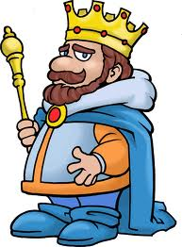
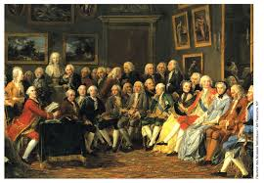
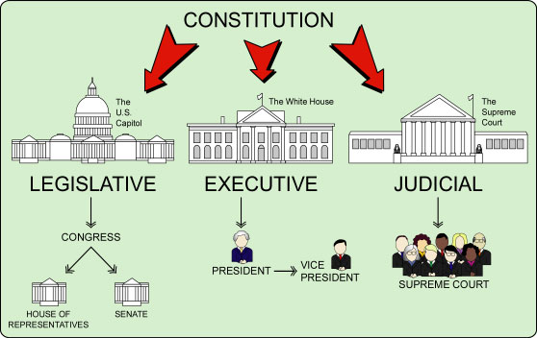
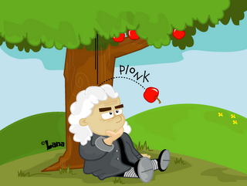
Day 1
Enlightenment
1600-1800
Change Society
Change Governments
Reason as the primary source of legitimacy and authority
Scientific Revolution
Mid 1500s
Developments in Science and Math
Rational Thinking > Faith

Slide 3
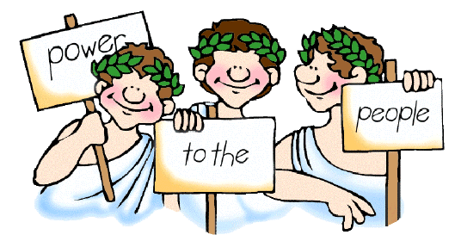
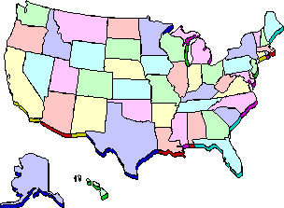
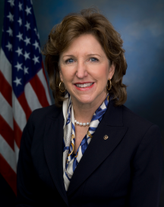
Democracy
People Rule through voting
People are Equal and have Rights
Republicanism
People elect representative to vote for them

Slide 4
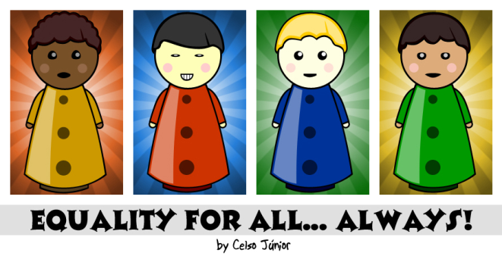
One-Man-One Vote
Equal voice in government
Rich Person = Poor Person
African-American = White Person
Man = Woman
Equality
New idea during enlightenment
Liberalism
Created during enlightenment
Gov’t job is…
protect liberty
provide equality
Opposite of Conservatism (favors tradition)
1
1
1

Slide 5
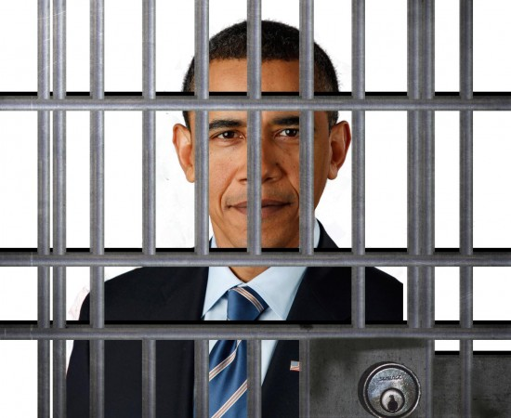
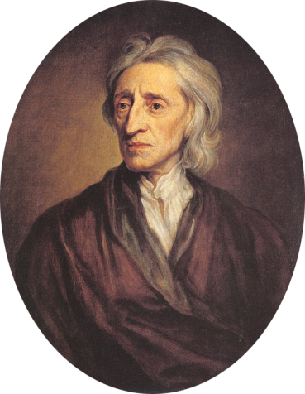
Rule of Law
No one is above the law
Equal under the Law
The #1 Rule is that everyone must follow the laws
Natural Rights of Man
Rights you are born with
Gov’t must protect these rights
John Locke
Life, Liberty, Pursuit of Happiness (property)

Slide 6
Economics
What type of economy do you want?
Communist (command market)
Socialist
Mixed
Capitalist (free market)
You get to vote!
Right now - America has voted for Mixed
30 years ago - America voted for Free
80 years ago - America voted for Socialism
Do not write

Slide 7
Capitalism
1
%
Do not write

Slide 8
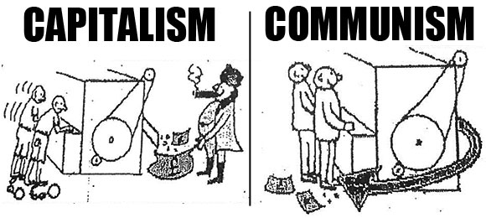
Socialism
Do not write

Slide 9
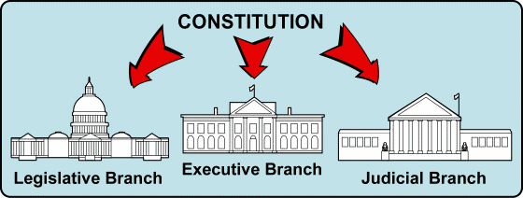
Socialism
Similar to Communism
Still have Choice and Freedoms
Gov’t evenly divides wealth between citizens
Doctors are not rich
Fast Food workers are not poor
Socialism

Slide 10
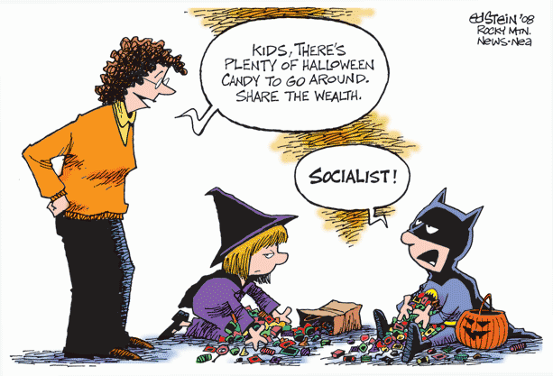

Slide 11
Socialism
Do not write

Slide 12
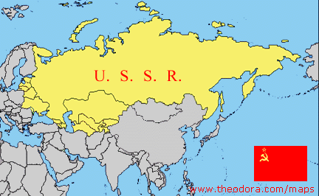
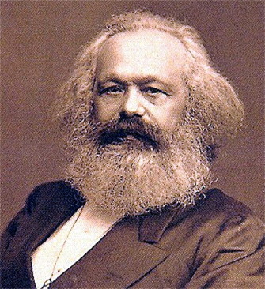
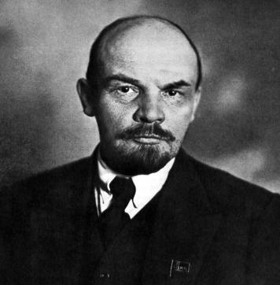
Communism
Economic System (extreme socialism)
Gov’t controls economy (not people)
Makes what is NEEDED (not what is wanted)
No classes (no rich or poor)
No leaders (people rule)
No Religion
Wealth and resources are divide equally
Karl Marx’s idea
USSR attempts communism in 1917
Fails due to lack of incentives
Marx
Lenin

Slide 13
Day 1 – Economic Systems
Command (communism)
Free (capitalism)
- Lots of Gov’t involvement
- Gov’t makes all decisions
- Gov’t owns property
- No Profits (Gov’t helps people)
- No Competition
- Ex. North Korea, Cuba (rare)
- Little Gov’t involvement
- Individuals Choose
- Private property
- Profit Driven (make $)
- Competition
- Ex. Australia
Mixed
- Gov’t involvement (free < mixed < command)
- Individuals & biz make choices
- private sector (make money)
- Gov’t makes choices
- public sector (help people)
- Ex. USA (most common economy)
Traditional
-based on survival
-eskimos
-zombie apocalypse

Slide 14
Cartoon Assignment
Create 4 comic strips
Each comic strip will explain a government concept
Democracy
Republicanism
One-man-one vote
Rule of Law
Work on this Wednesday and Thursday in Class

Slide 15
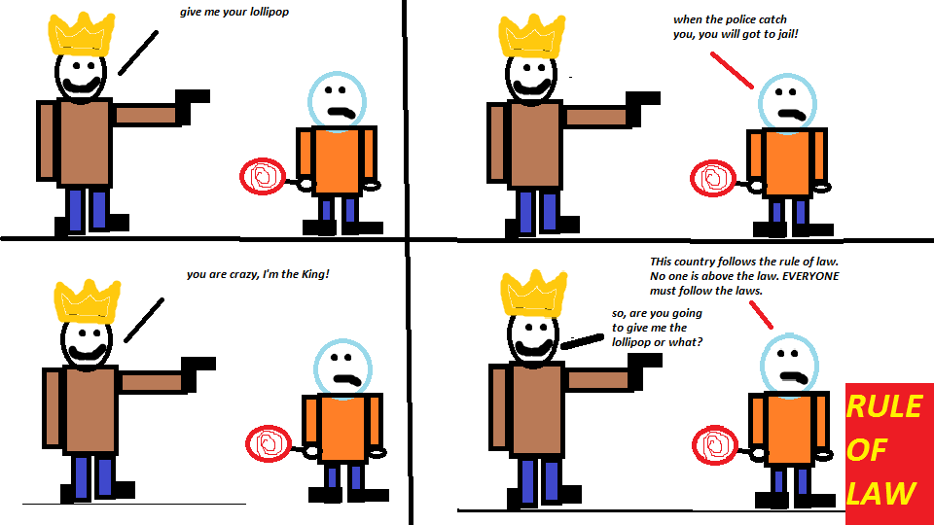

Slide 16
